Slide 1
Year 2 End of Year Expectations for Maths and Literacy

Slide 2
Overview
Assessment
Teacher Judgements
Reading
Reading – Types of Question
Writing
Writing ‘Must Haves’
Examples of Year Two writing
Maths
Place Value
Addition
Subtraction
Multiplication
Division
Fractions
Money
Shape
Time
Measurement
Statistics

Slide 3
Assessment
Key Stage One includes Year 1 and Year 2.
Children are more formally assessed at the end of Year 2, as it is also the end of the Key Stage.
Teachers make the overall judgement, and they assess against The Key Stage One Assessment Framework. https://assets.publishing.service.gov.uk/government/uploads/system/uploads/attachment_data/file/740343/2018-19_teacher_assessment_frameworks_at_the_end_of_key_stage_1_WEBHO.pdf
Children are assessed for Reading, Writing and Maths and will be assessed as either;
In some cases, a child may be assessed as Pre-Key Stage, which means they are working at a level below Year 1.
Working Towards The Expected Standard | Working At The Expected Standard | Working At Greater Depth within The Expected Standard

Slide 4
Teacher Judgements
Teachers make their Assessment Judgements based on various things. These include;
Pieces of work the child has completed throughout the school year.
Informal Assessments, such as CLIC tests, notes taken during Guided Reading Sessions and other end of unit tests, e.g. at the end of a particular maths topic.
SATs Tests. Children sit two tests in maths (an Arithmetic Paper and a Reasoning Paper) and two tests in Reading.
There is no SATs Test for Writing. Instead, children are assessed using six pieces of writing they have completed over the course of Year 2. These pieces of writing are marked in depth against the Writing ‘Must Haves’ (more on this later!).

Slide 5
Reading
Children need to be able to read the first 100 High Frequency Words, as well as the Common Exception Words (sometimes called tricky words) for Years 1 and 2. Children should be reading these words ‘on sight’, without the need for ‘sounding out’.
Children should use their Phonics to segment and blend sounds together in order to read unfamiliar words. However, they should be reading relatively fluently, at roughly 90 words per minute.
Children should be taking account of the punctuation and beginning to read with some expression.
Children should be able to answer questions about the text. In Reading Paper 1, these questions are likely to be mostly simple retrieval of information questions. Sometimes questions might also be related to vocabulary or the order of events. In Reading Paper 2, questions are more likely to be inference based.

Slide 6
Reading – Types of Question
Simon was sweating and could feel his skin beginning to burn. He wished more than anything that he had remembered to bring a drink of water. He usually loved playing soccer, but today he was struggling.
Retrieval of information;
Who is the story about?
What was he doing?
Inference;
What was the weather like? How do you know?
How was the character feeling? Tick two….
Hot Happy Thirsty Excited
Vocabulary
Find and copy a word that means the same as ‘Football’.

Slide 7
Writing
Children are assessed against pieces of INDEPENDENT work. The teacher marks these pieces against the Year Two Writing Must Haves (which link directly to the Assessment Framework). The teacher ticks off the features that the child has included.
Not all features would be included in every piece of work, but the child needs to demonstrate all of them at some point throughout the year.
If a child is working below this standard, they would be assessed against the Year One Writing Must Haves or the Pre-Key Stage Standards.

Slide 8
Please note that some points are required in order to achieve Greater Depth only and are not required for children working at the expected standard.
They are;
Adverbs,
Possessive Apostrophe,
Exclamations.
We begin to teach handwriting joins, but children only need to demonstrate ‘some’ joins and only if they are working at Greater Depth.
The other point to note is that children should be using some suffix words in their writing, but they do not need to show evidence of all of the different suffixes, a range of two or three is fine.

Slide 9
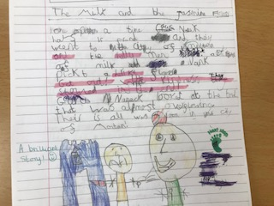
Examples of Year 2 Writing
Working Towards the Expected Standard

Slide 10
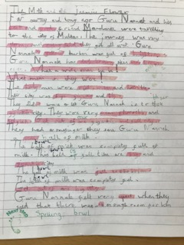
Examples of Year 2 Writing
Working At the Expected Standard

Slide 11
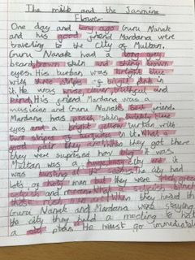
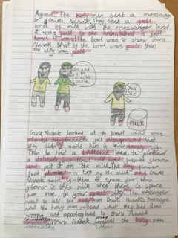
Examples of Year 2 Writing
Working at Greater Depth

Slide 12
Maths
We cover a wide range of topics. These include;
Place Value
Addition and Subtraction
Multiplication and Division
Fractions
Money
Shape
Time
Measurement (length / height, weight / mass, capacity / volume, temperature)
Statistics
Within the above topics, we teach children to;
Develop Mathematical Fluency – being able to recall facts, recognise what we already know and apply it in appropriate circumstances.
Demonstrate Reasoning Skills – explaining your thinking.
Solve Problems – being systematic, selecting appropriate information, applying what we know.

Slide 13
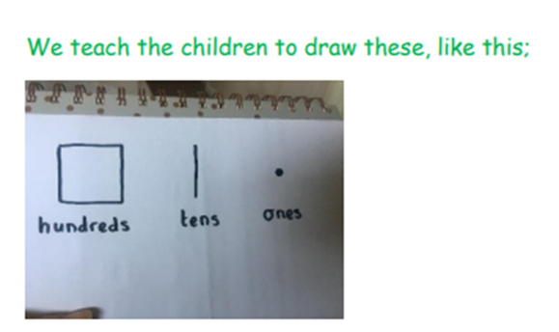
Place Value

Slide 18
Please note, that tackling calculations which leave a remainder is only necessary for children working at Greater Depth.

Slide 19
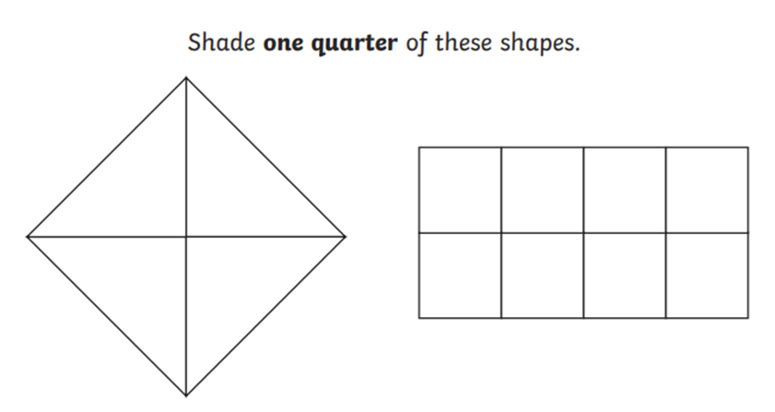
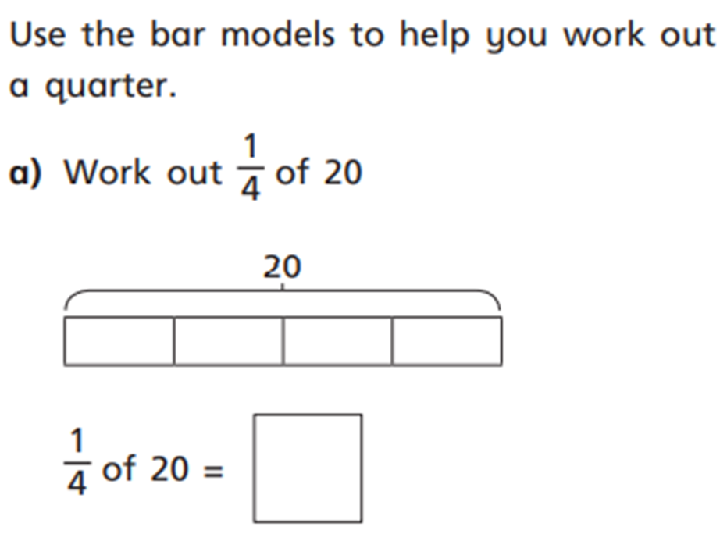
Fractions
Children learn about halves, thirds and quarters
They learn about fractions of shapes, as well as fractions of numbers or quantities
They learn about unit fractions and non-unit fractions, i.e. not always simply finding one quarter or one third, but also finding two quarters, three quarters or two thirds.
They learn to recognise equivalent fractions, e.g. ½ = 2/4

Slide 20
Money
Children learn to recognise coins and notes
Count money (both pounds and pence)
Making the same amount of money in different ways (different combinations of coins and notes)
Find change

Slide 21
Shape
Children learn to recognise and name both 2D and 3D shapes
They learn to count the number of sides (and recognise when sides are curved or straight) and to count the number of vertices (corners) on 2D shapes.
For 3D shapes, children learn to count faces / surfaces, edges and vertices. They also talk about the shape of the faces / surfaces and talk about whether they are flat or curved
Children learn about lines of symmetry, making patterns and different ways of sorting shapes

Slide 22
Time
Children learn about the seasons, days, months, years, minutes in an hour, seconds in a minute
Children learn to tell the time using an analogue clock
Children learn to read the time to the nearest quarter of an hour, including the language ‘past’ and ‘to’. Telling the time to the nearest 5 minutes is required for Greater Depth.
Children also learn to find durations of time and compare durations of time.

Slide 23
Measurement
Children learn to measure in centimetres and metres and to order and compare lengths / heights from shortest to longest
Children learn to measure capacity and volume in millilitres and litres and to order and compare different amounts
Children learn to measure weight / mass in grams and kilograms and to order and compare amounts
Children learn to read temperature in degrees Celsius and to compare different temperatures

Slide 24
Statistics
Children learn to read and draw tally charts, pictograms, block graphs

