Slide 2
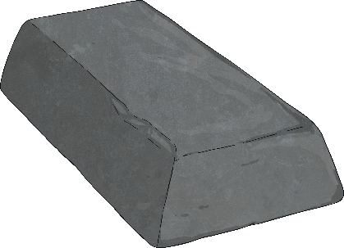
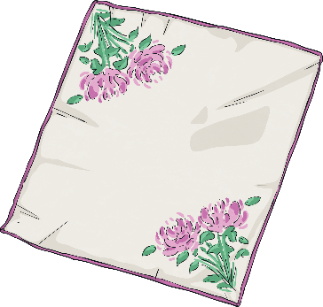
Materials
We use wood, metal, plastic, glass and fabric to make most everyday objects.
Different materials have different properties.
Materials can be natural or man-made.
Here are a few facts about some materials…

Slide 3
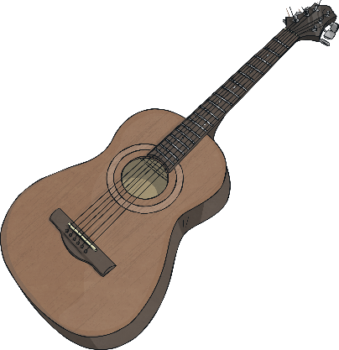
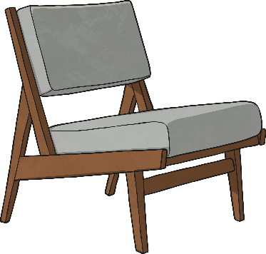
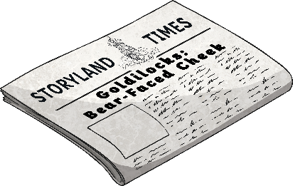
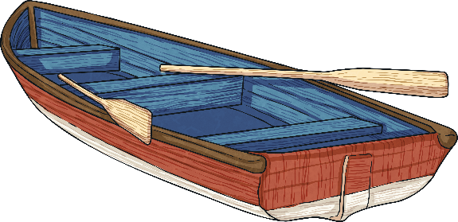
Wood
Wood is a natural material. It comes from trees.
A few things made from wood are:
furniture
boats
instruments
paper
Wood is used as it can be carved in to any shape, is strong and has a very nice appearance.

Slide 4
wood

Slide 5
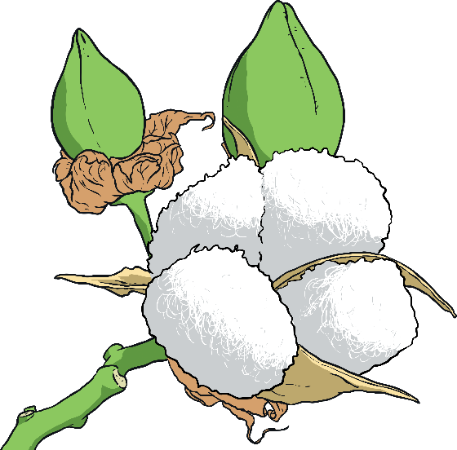
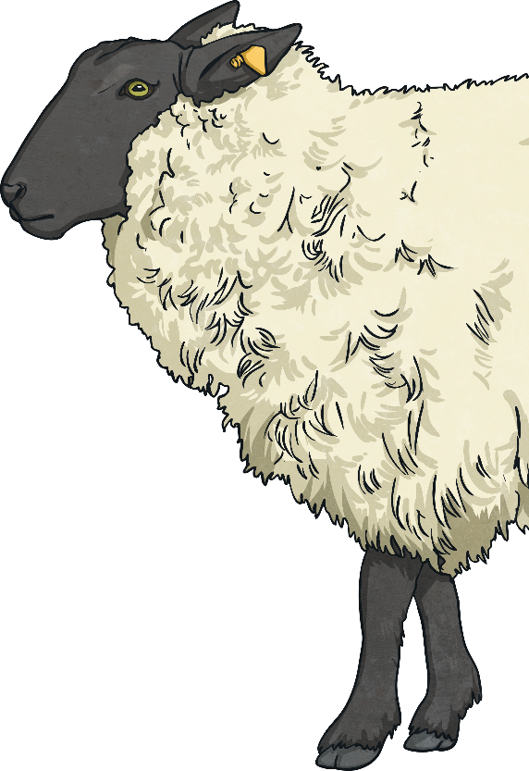
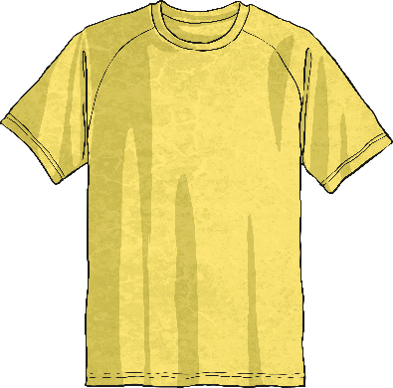
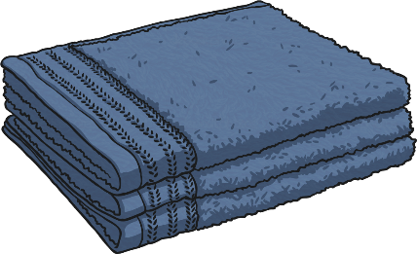
Fabric
Fabric comes from plants and animals.
A few things made from fabric are:
curtains
clothes
towels
Fabric is used as it is very light, warm, soft and quite easy to produce and sew.

Slide 6
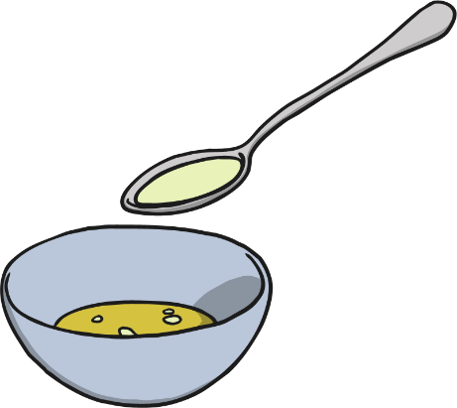
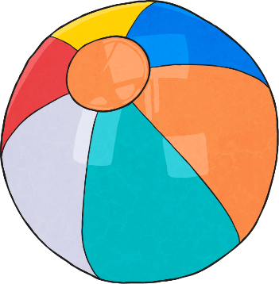
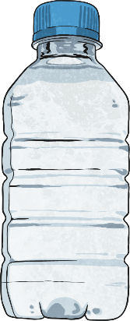
Plastic
Plastics are man-made, mostly from oil.
A few things made from plastic are:
balls
bottles
carrier bags
Plastic is used as it can be made to be flexible, hard, rough or smooth. It is also very cheap to produce and easily washable.

Slide 7
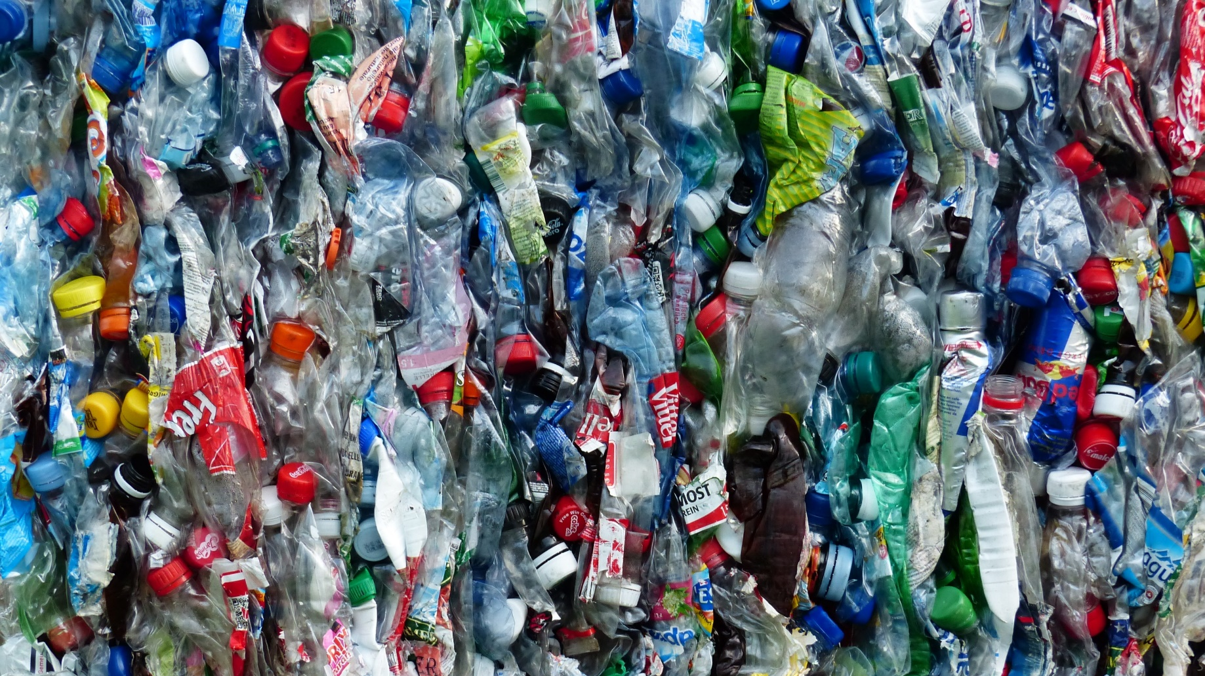
plastic

Slide 8
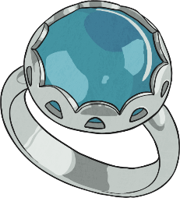
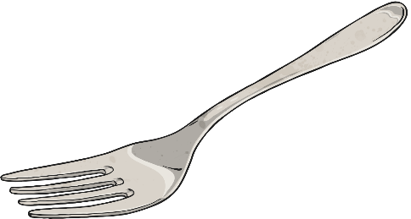
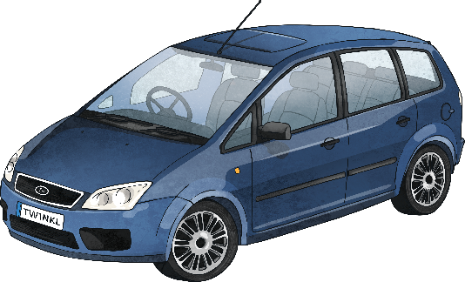
Metal
Metals are made from rocks. The rocks are dug up and taken to a factory where they are heated and processed into metal.
A few things made from metal are:
jewellery
cutlery
cars
Metal is used as it is strong, hard, smooth and easily washable.

Slide 9
metal

Slide 10
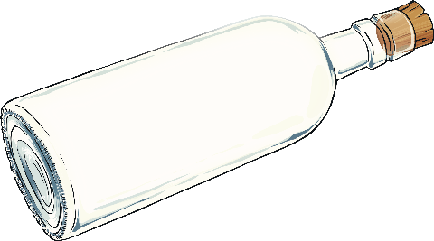
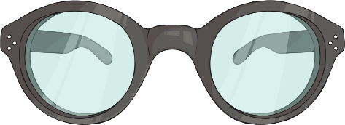
Glass
Glass is made from very fine sand. It is heated until it melts.
A few things made from glass are:
bottles
light bulbs
glasses
Glass is used as it is strong, hard, smooth, easily washable and transparent.

Slide 11
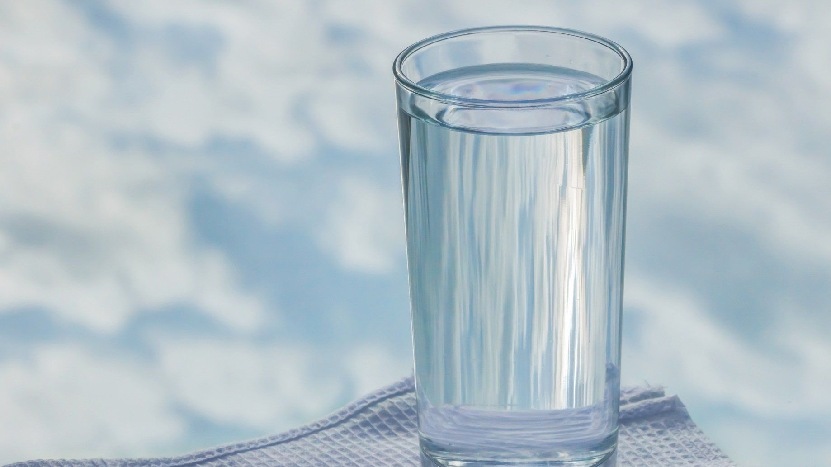
glass

Slide 12
