Slide 1
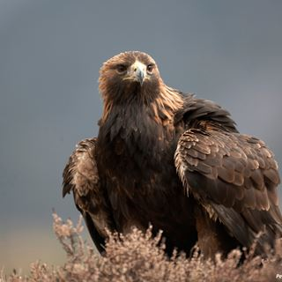
L.O. I can interpret and construct pie charts.
L.O.I can interpret the mean as an average.

Slide 2
Here is the data for the 2021 and 2020 Big Garden Birdwatch by the RSPB. People were asked to record each species of bird that landed in their garden for one hour for one day between 29th and 31st January. You had to record the highest number of birds you could see at any one time, not a running total to avoid any double counting.
Across the UK, over one million people (1,019,802) took part in Big Garden Birdwatch, spotting a phenomenal 17,117,256 birds

Slide 4
What do you think the heading “mean 2021” means?
What do you think “rank” means?
What do you think “% gardens” means?
Is it possible to see 0.6 carrion crow in your garden at any one time?
What does it mean by 4.2 sparrows?
What do you notice are the main differences between 2020 results and 2021?

Slide 5
How can we represent data?
Bar chart
line graph
tally chart
pictogram pie chart

Slide 7
You need to know:
your data (the frequency of the items you are counting and the total of all the data)
The number of degrees in a circle 360
The relationship between the total number of items of data and the whole circle as 100% of your data
For example: if 24 children are surveyed about the films, then each child will be represented by a 15 degree slice of the pie because
360 divided by 24=15

Slide 8
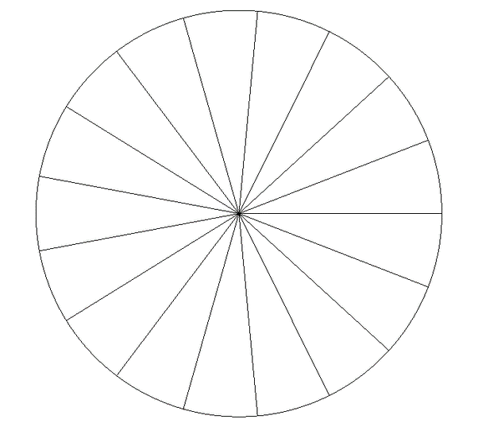
We need 24 slices so each slice will be 15 degrees

Slide 9
When you draw a circle, always mark the middle.
Read that again as it is important!
When you draw a circle, always mark the middle.

Slide 10
https://www.youtube.com/watch?v=sdMT6iasnYQ
Watch this film to see how to draw a pie chart.

Slide 11
 | Mon | Tue | Wed | Thurs | Fri | total
Robin | 2 | 2 | 2 | 1 | 1 | 8
Thrush | 1 | 1 | 1 | 0 | 1 | 4
Sparrow | 5 | 6 | 8 | 4 | 0 | 23
Blue tit | 2 | 2 | 2 | 1 | 1 | 8
pigeon | 4 | 2 | 5 | 4 | 3 | 18
Blackbird | 3 | 1 | 2 | 2 | 3 | 11
total | 17 | 14 | 20 | 12 | 9 | 72
There are 72 birds in the set of data. The frequency is 72.
Each bird will represented by a slice of pie: 360 divided by 72 degrees 360 ÷72=15

Slide 12
Draw a circle. Remember to mark the centre.
Use a protractor to divide the circle into 15 degree slices.
Each slice represents one bird.
Complete the pie chart for the different birds. Group the same birds together.
Can you make a pie chart to show the birds on different days of the week?

Slide 13
When you need to calculate the divisions of the circle to make the slices you need, you can use a coin card.
A whole circle is 360. This 100% of the circle.
So a coin card could look like this.
Now fill in the rest of the card.
100 | 360
10
5
2
1

Slide 14
This helps when you measure amounts in fractions or percentages.
So if you had a pie chart that showed
data as percentages e.g A class of children bought new sweatshirts.
20% chose green, 50 % chose blue, 10 % chose black, 5% chose red and 15% chose purple.
Represent this on a pie chart.
You can calculate the degrees for each section using the coin card. 10% will be 36 degrees. See if you can work out the rest.
100% (1) | 360
50% (1/2) | 180
10% (1/10) | 36
5% (1/20) | 18
2%(1/50) | 7.2
1% (1/100) | 3.6

Slide 15
Here is a set of questions to help you to practise.

Slide 17
Find the total number of students.
100% of the circle is 360 degrees to represent 18 students.
Add the degrees needed for each slice into the third column of the table

Slide 18
https://corbettmathsprimary.com/wp-content/uploads/2018/07/pie-charts-pdf.pdf

