Slide 2
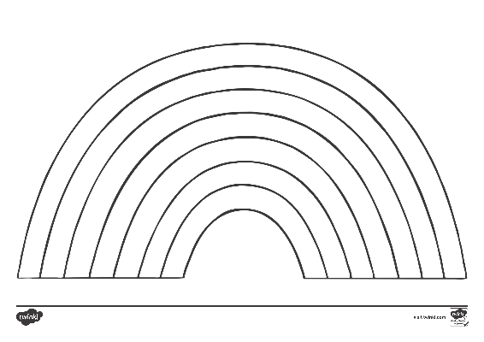
Rainbow Mindfulness Art
To create a piece of rainbow mindfulness art you will need:
a copy of the rainbow template;
a felt-tip pen for each colour of the rainbow;
a sheet of paper to practise drawing mindfulness patterns.

Slide 3
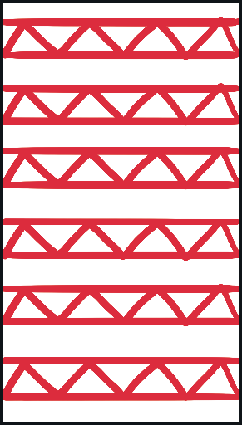
Mindfulness Patterns
First, let’s practise some mindfulness patterns.

Slide 4
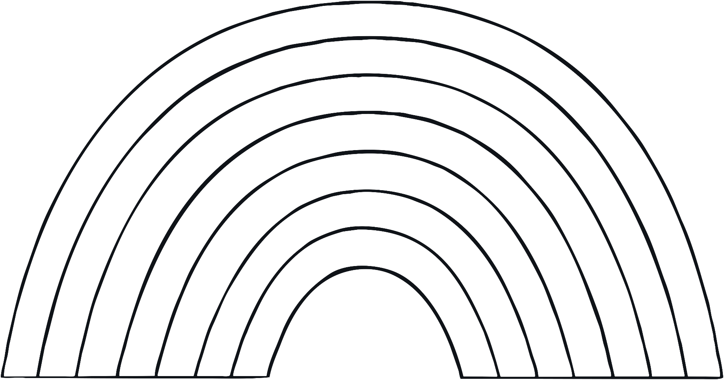
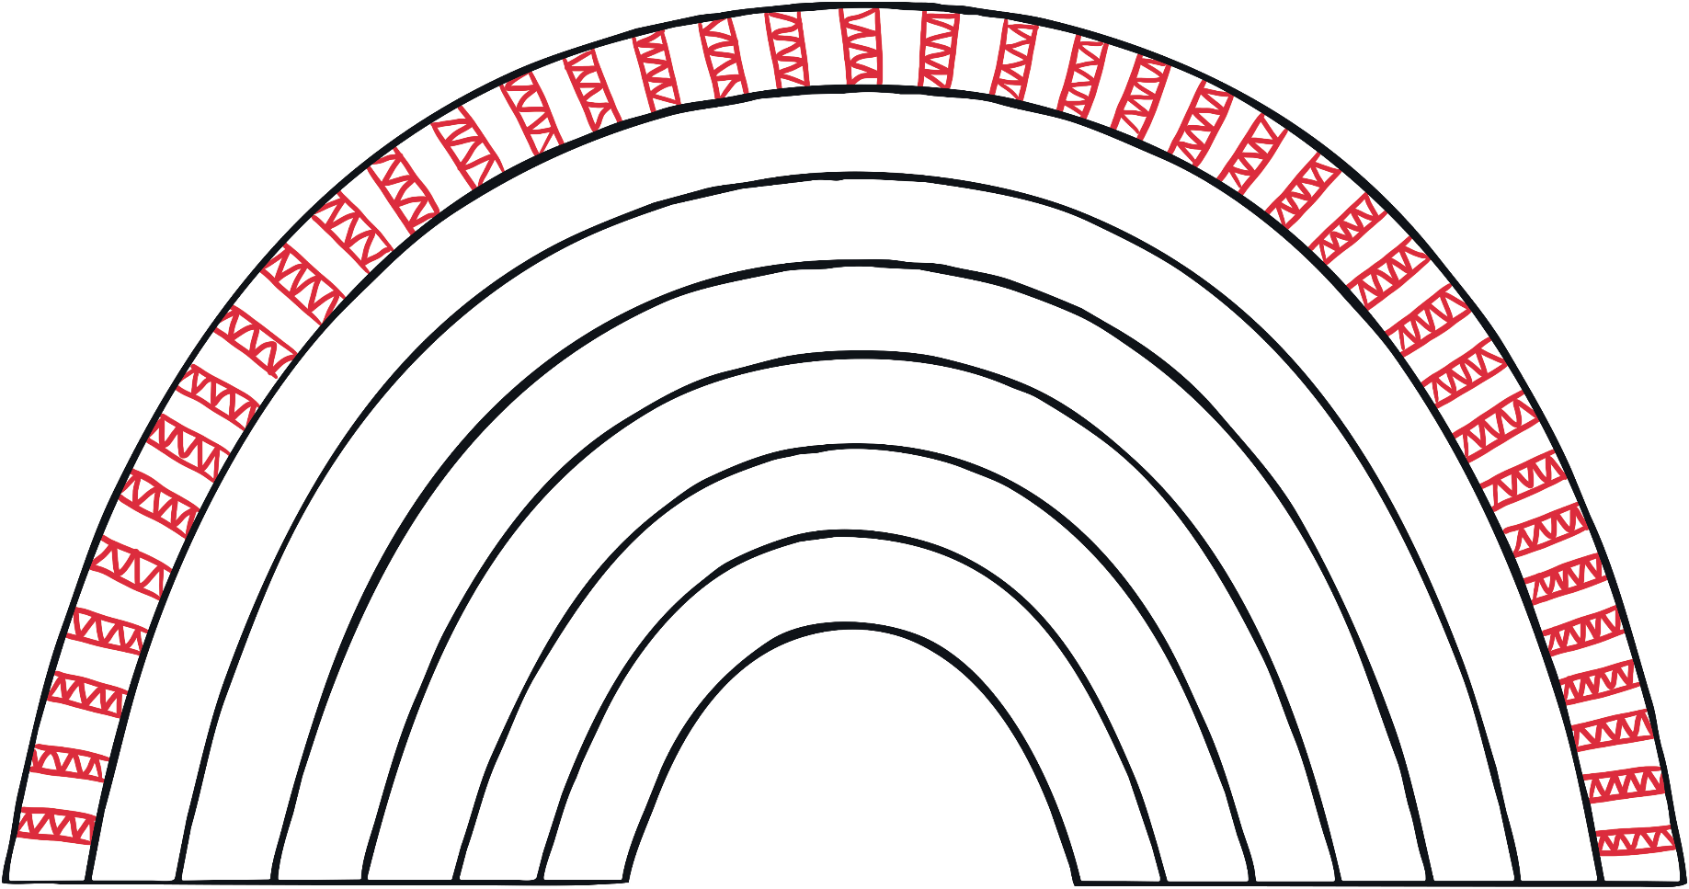
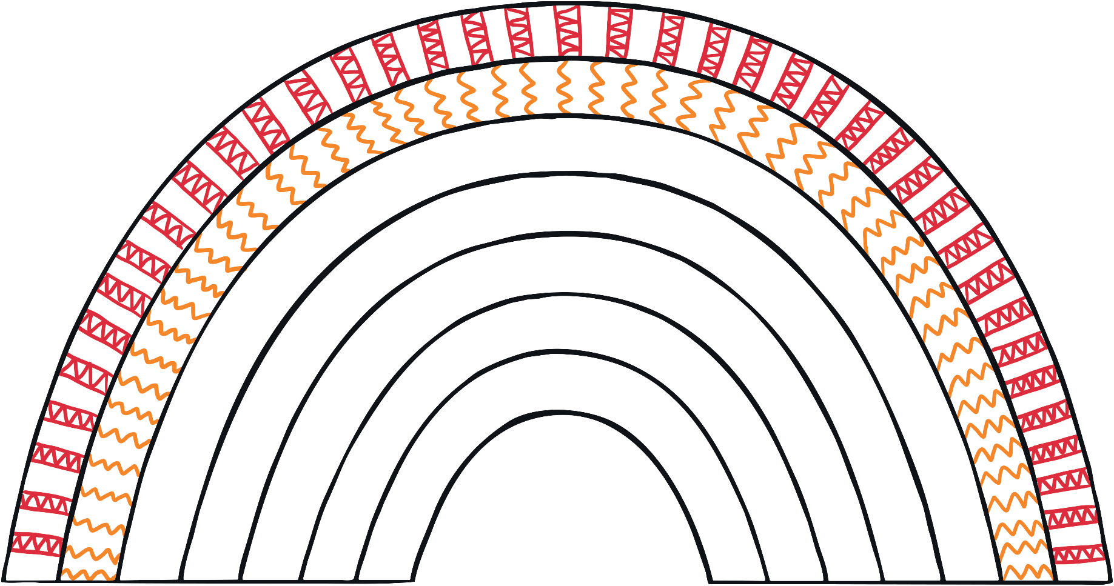
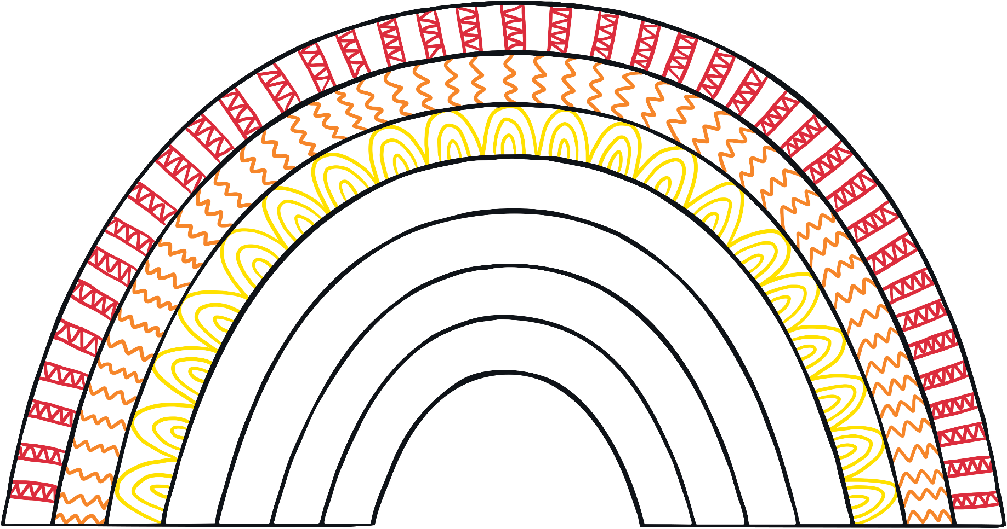
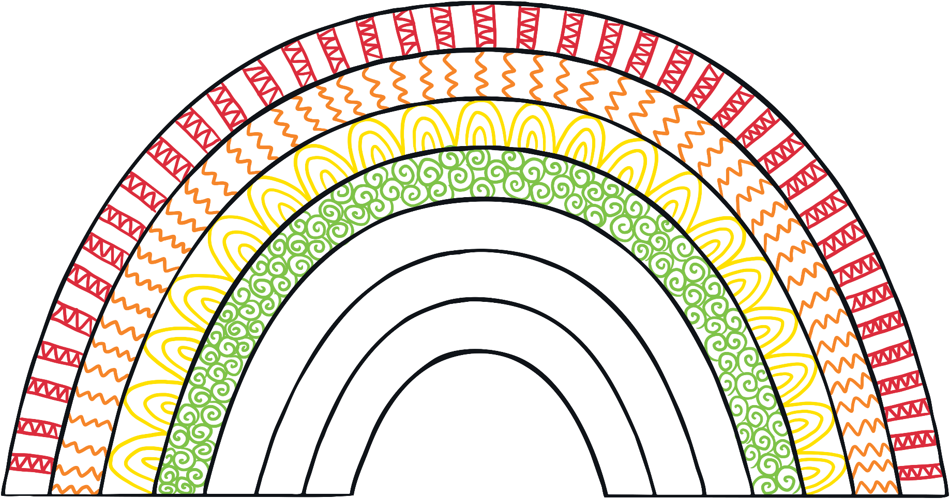
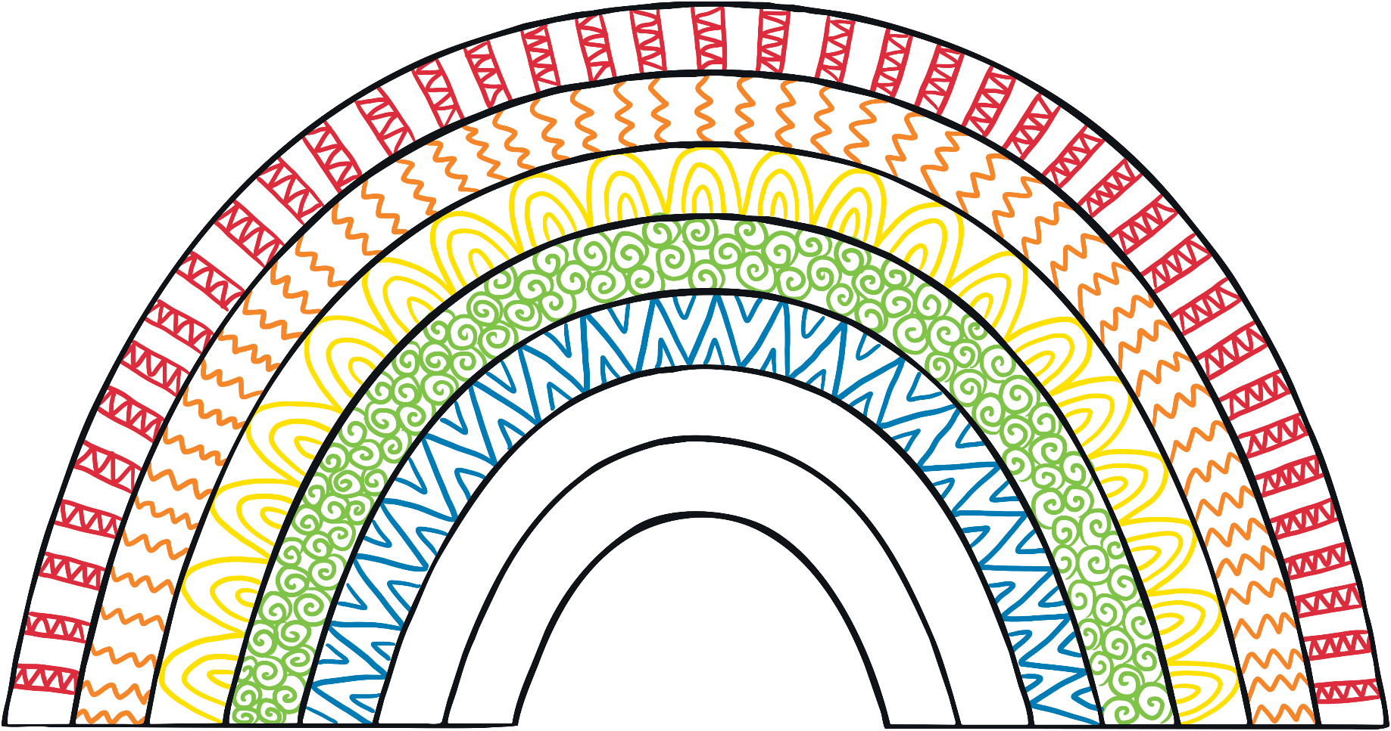
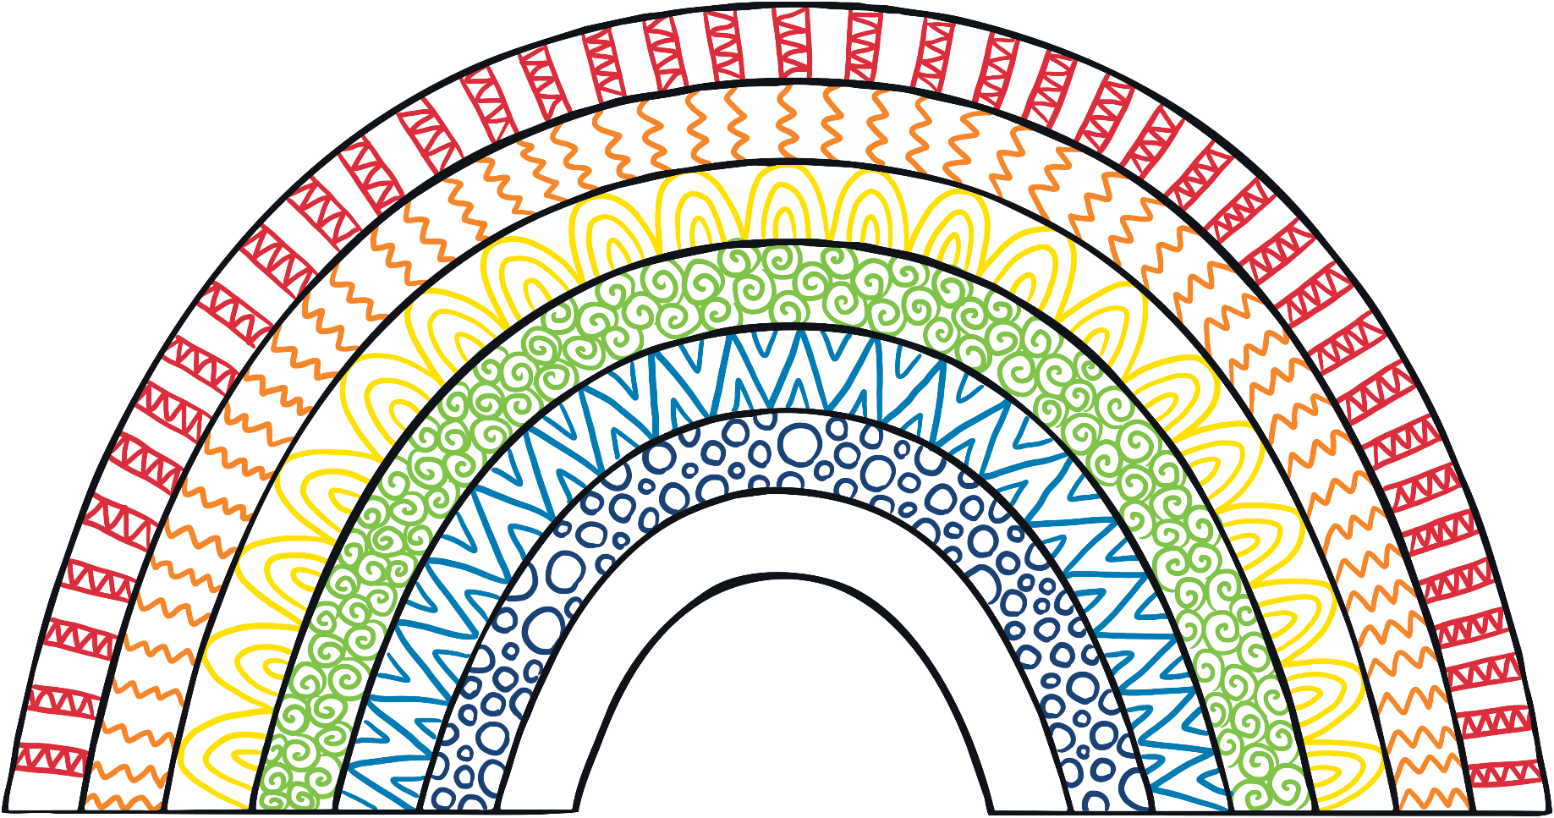
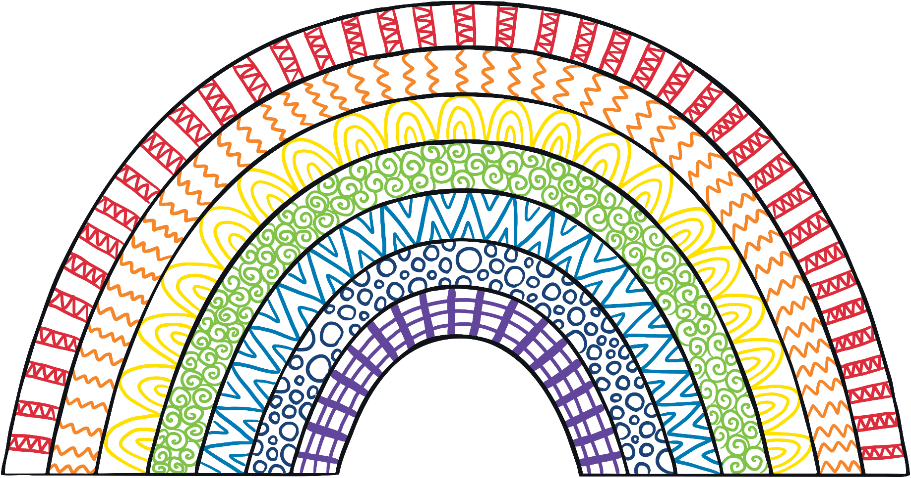
Rainbow Mindfulness Art
Now, create a mindfulness rainbow using your patterns.
Remember to use a different pattern for each colour.

