Slide 1
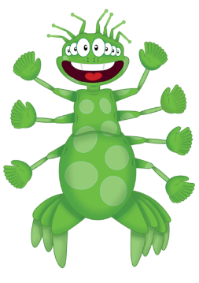
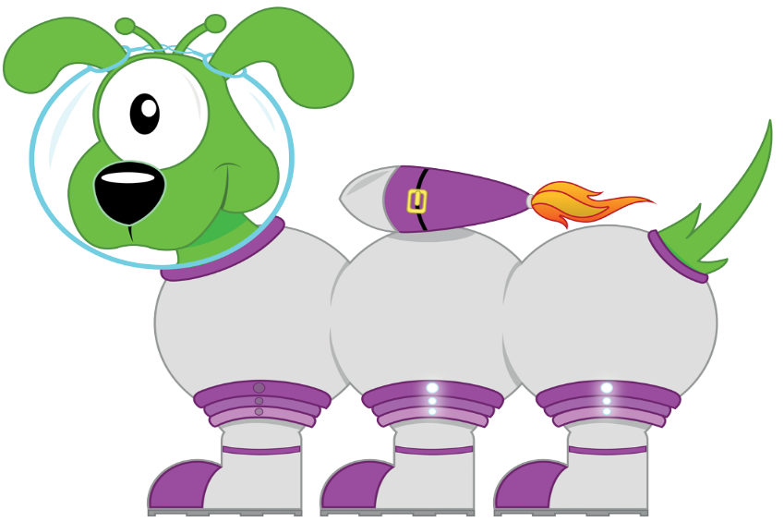
C
L
I
C
Year 2 Spring 1 Week 1-3

Slide 2
C
Day 1
Reading numbers- I can read 3d numbers.
Remember to:
Say the hundreds digit.
Say and.
Say the 2d number.
335
H T O

Slide 3
L
Day 1
Learn Its – Step 8
If I know that 5+5=10 then I also know that…
Step 7
5 + 4 = 9
5 + 6 = 11
6 + 7 = 13
8 + 7 = 15
8 + 9 = 17
5 + 4 = __
5 + 5 = 10
5 + 6 = __
-1
+1
0
1
2
3
4
5
6
7
8
9
10
11
12
13
14
15
16
17
18
19
20

Slide 4
I
Day 1
Adding with PIM – I can add 100s
If I know that 4 cats & 3 cats is 7 cats
Remember to:
Use your addition Learn Its
Swap ‘the thing’ to a hundred
+
Then I know that 3 tens & 4 tens is 7 tens
+
10
10
10
10
10
10
10
Then I know that 3 hundred & 4 hundred is 7 hundred
+
100
100
100
100
100
100
100

Slide 5
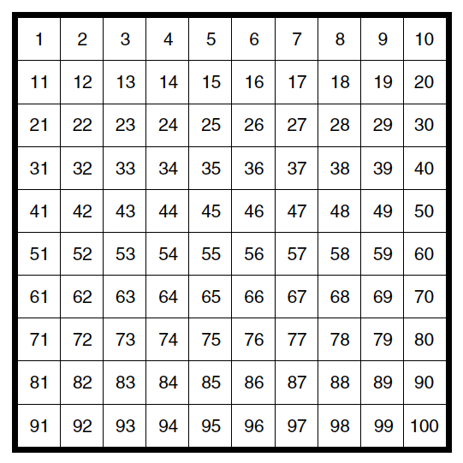
C
Day 1
Addition – I add a 1d number to a 2d tens number
Remember to:
Say the tens number
Say the tens number with the ones digit added on
Try adding 7 to a range of two digit tens numbers. What do you notice?

Slide 6
C
Day 2
Counting Multiples- I can count in 50s.
50
0
100
200
300
400
500

Slide 7
L
Day 2
Learn Its – Step 8
If I know that 7+7=14 then I also know that…
Step 7
5 + 4 = 9
5 + 6 = 11
6 + 7 = 13
8 + 7 = 15
8 + 9 = 17
6 + 7 = __
7 + 7 = 14
8 + 7 = __
-1
+1
0
1
2
3
4
5
6
7
8
9
10
11
12
13
14
15
16
17
18
19
20

Slide 8
I
Day 2
Jigsaw Numbers– number partners to next multiple of 10
Remember to:
Check the ones digit
Use your jigsaw numbers to 10 to make the units digit total 10
Remember
1
9
2
8
3
7
4
6
5
5

Slide 9
C
Day 2
Addition – I add a 1d number to a 2d tens number
Remember to:
Find the starting number
Count back from where you started.
See where you have landed

Slide 10
C
Day 3
Reading numbers- I can read 3d numbers.
Remember to:
Say the hundreds digit.
Say and.
Say the 2d number.
465
H T U

Slide 11
L
Day 3
Learn Its – Step 8
If I know that 5+5=10 then I also know that…
Step 7
5 + 4 = 9
5 + 6 = 11
6 + 7 = 13
8 + 7 = 15
8 + 9 = 17
5 + 4 = __
5 + 5 = 10
5 + 6 = __
-1
+1
0
1
2
3
4
5
6
7
8
9
10
11
12
13
14
15
16
17
18
19
20

Slide 12
I
Day 3
Adding with PIM – I can add 100s
If I know that 5 cats & 5 cats is 10 cats
Remember to:
Use your addition Learn Its
Swap ‘the thing’ to a hundred
+
Then I know that 5 tens & 5 tens are 10 tens
10
+
10
10
10
10
10
10
10
10
10
Then I know that 5 hundred & 5 hundred is 10 hundred
+
100
100
100
100
100
100
100
100
100
100

Slide 13
C
Day 3
Remember to:
Say the tens number
Say the tens number with the ones digit added on
Try adding 7 to a range of two digit tens numbers. What do you notice?

Slide 14
C
Day 4
Counting Multiples- I can count in 50s.
50
0
100
200
300
400
500

Slide 15
L
Day 4
Learn Its – Step 8
If I know that 7+7=14 then I also know that…
Step 7
5 + 4 = 9
5 + 6 = 11
6 + 7 = 13
8 + 7 = 15
8 + 9 = 17
6 + 7 = __
7 + 7 = 14
8 + 7 = __
-1
+1
0
1
2
3
4
5
6
7
8
9
10
11
12
13
14
15
16
17
18
19
20

Slide 16
I
Day 4
Jigsaw Numbers– number partners to next multiple of 10
Remember to:
Check the ones digit
Use your jigsaw numbers to 10 to make the units digit total 10
Remember
1
9
2
8
3
7
4
6
5
5

Slide 17
C
Day 4 Subtraction – I can subtract a 1d number from a 2d tens number
Remember to:
Find the starting number
Count back from where you started.
See where you have landed
Try subtracting 5 to a range of two digit tens numbers. What do you notice?

