Slide 2
L.O. I can describe the animals and plants living in the rainforest.
Success Criteria
I can name some animals that live in each layer of the rainforest.
I can explain why different animals live in different layers.
I can tell you more about one animal living in a rainforest.

Slide 3
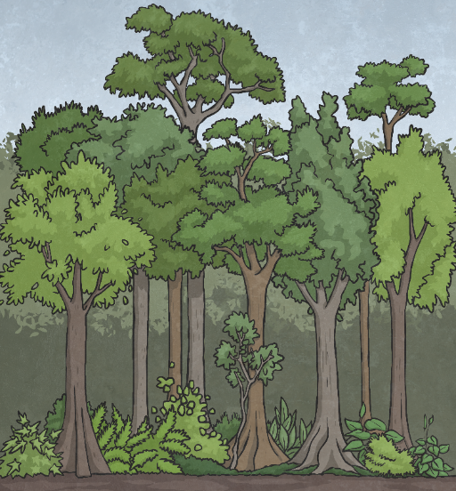
What Lives There?
Monkeys, bats and butterflies live here.
Snakes, toucans and tree frogs live here.
Many insects live here.
Gorillas, leopards and tigers live here.
Why do you think animals live in different layers of the rainforest?
They choose different habitats depending on their diet, how much water they need and how much shelter they need.

Slide 4
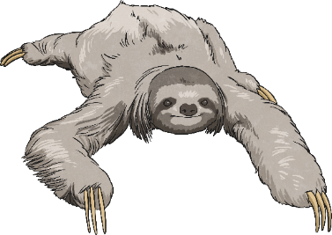
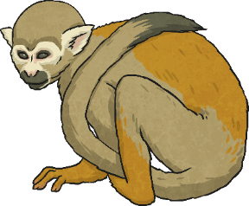
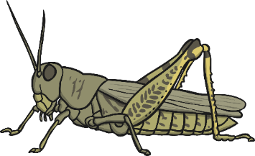
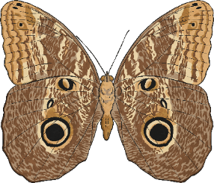
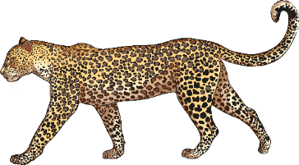
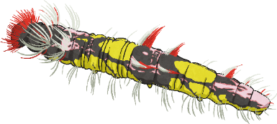
Where Do I Live?
Can you suggest where each of these animals might live?
Can you give a reason for your suggestion?
sloth
monkey
grasshopper
owl butterfly
blue morpho caterpillar
leopard

Slide 5
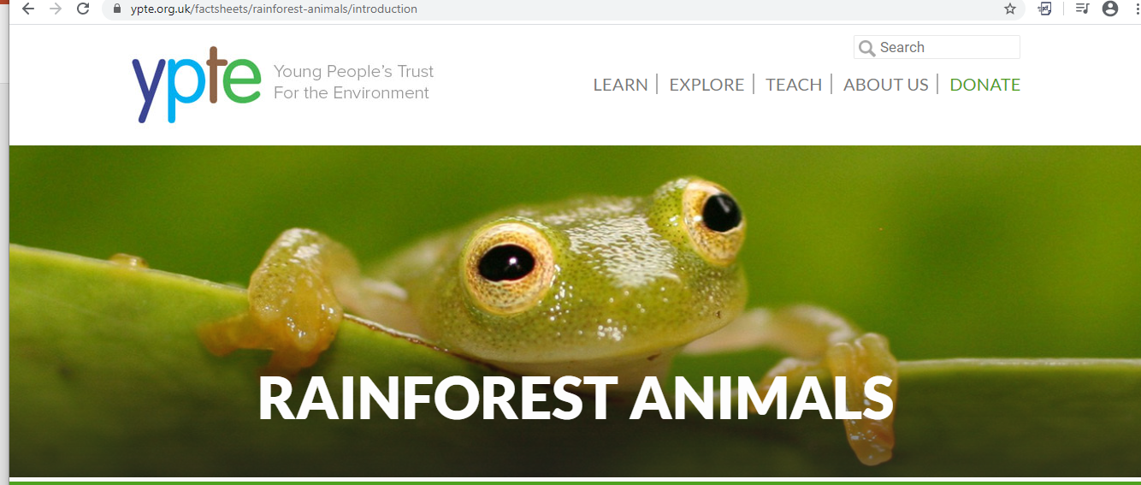
Rainforest Animals
Visit this website.
Read about some of the different rainforest animals (this will help with your English work this week too!)
Think about the layers of the rainforest the different animals use as their habitats. How are they suited to living in their layer of the forest?

Slide 6
Creature discovery!
You are an explorer in the rainforest and you have just made the most exciting discovery of a new creature!
You reach into your backpack for your camera….but you have left it back at camp! Luckily you have your notebook with you.
You need to draw a really detailed picture of your newly discovered creature. Don’t forget to say which layer of the rainforest you found it in and name your exciting discovery!

