Slide 2
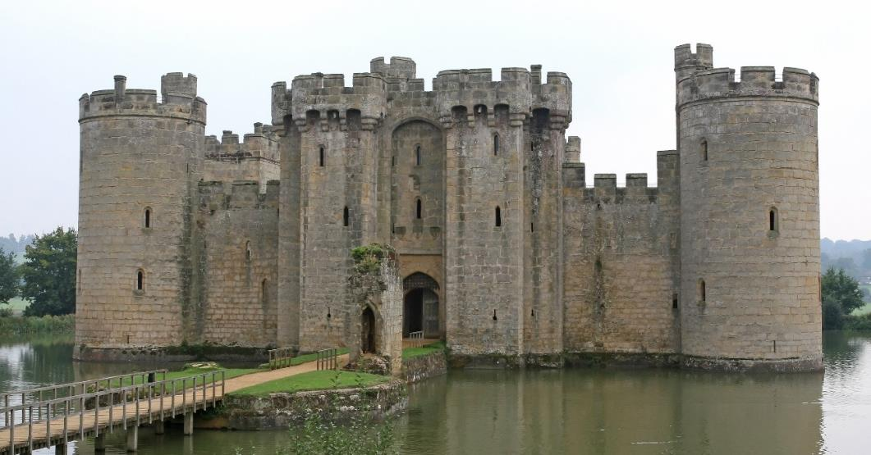
What Is a Castle?
Castles are a type of home. The people who lived in castles were usually kings, queens or lords and their families.
There would also be soldiers, cooks, cleaners and other people who lived inside and helped to look after and protect the king, queen or lord.

Slide 3
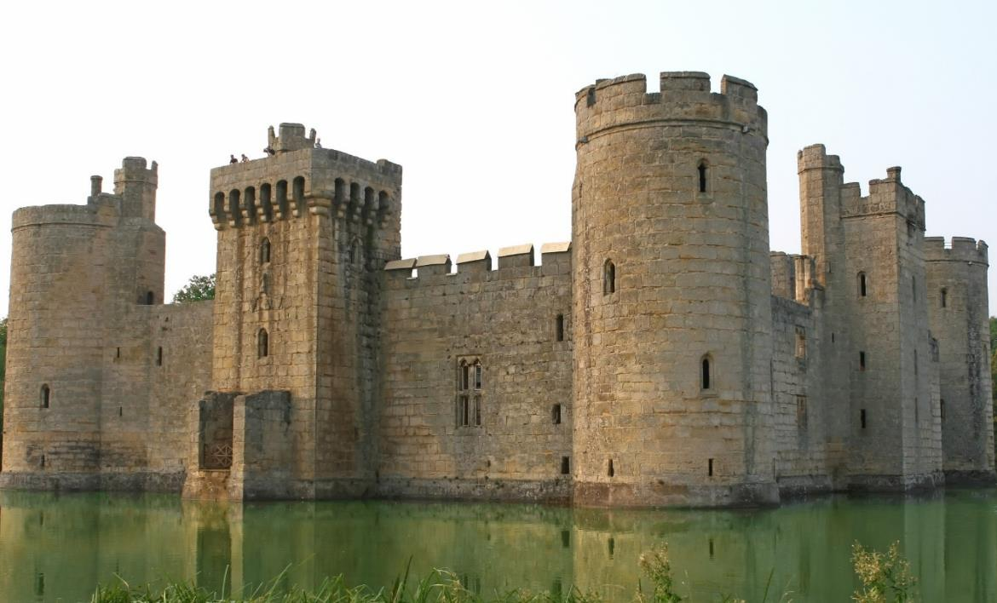
Castles
Castles were designed to keep the people inside safe and to stop enemies from getting in.
Castles have many features to stop people from attacking.

Slide 4
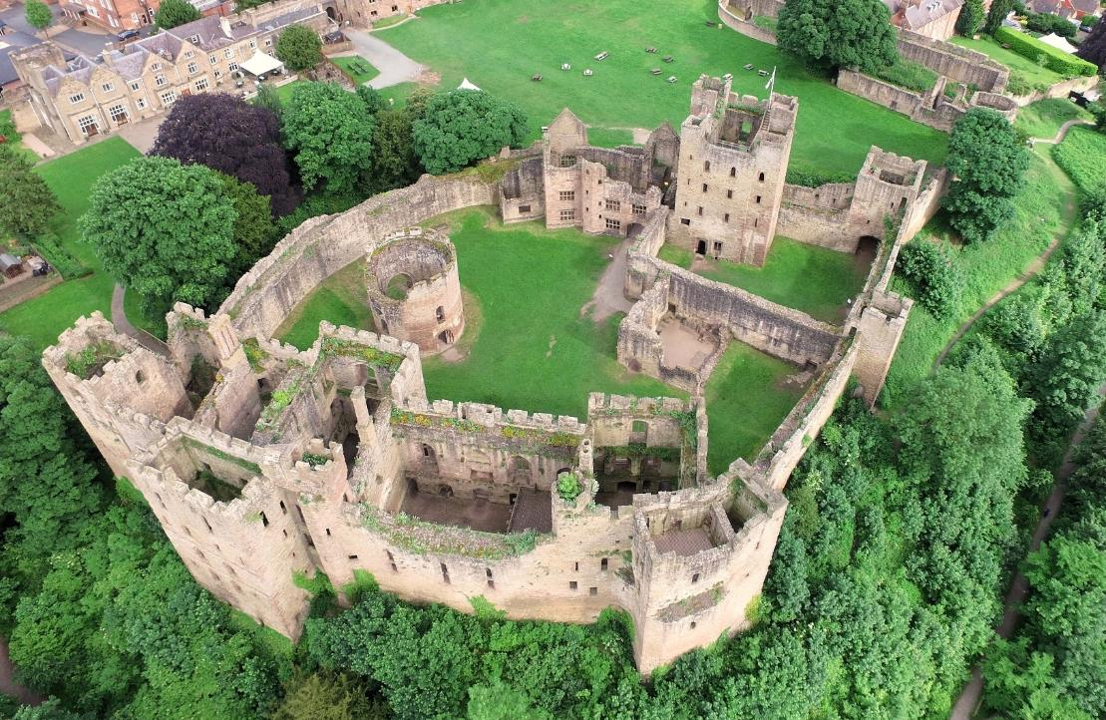
Bailey
Inside the castles walls was the bailey – the area where people lived and worked.
bailey
castle wall

Slide 5
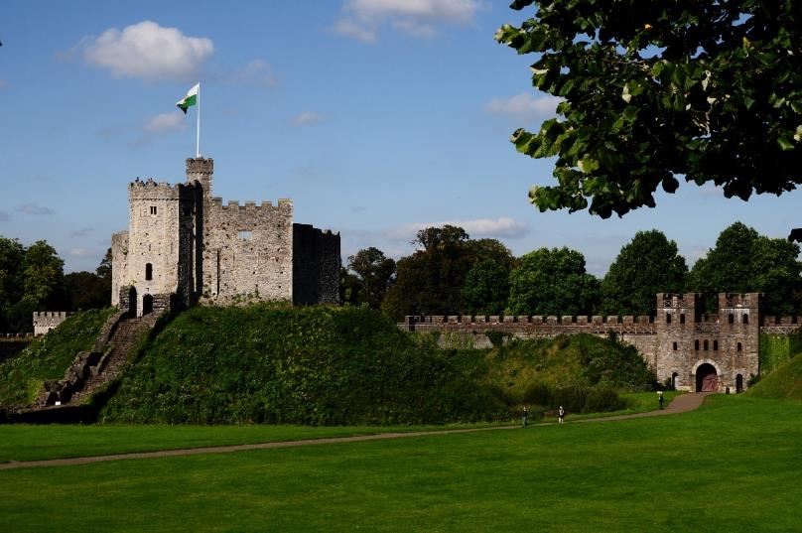
Keep
Inside the castle walls was also the keep.
The keep was the safest part of the castle. The kings, queens or lords could hide here when the castle was in danger.
In some castles, the keep was built on a special mound called a motte.
keep
castle wall
motte

Slide 6
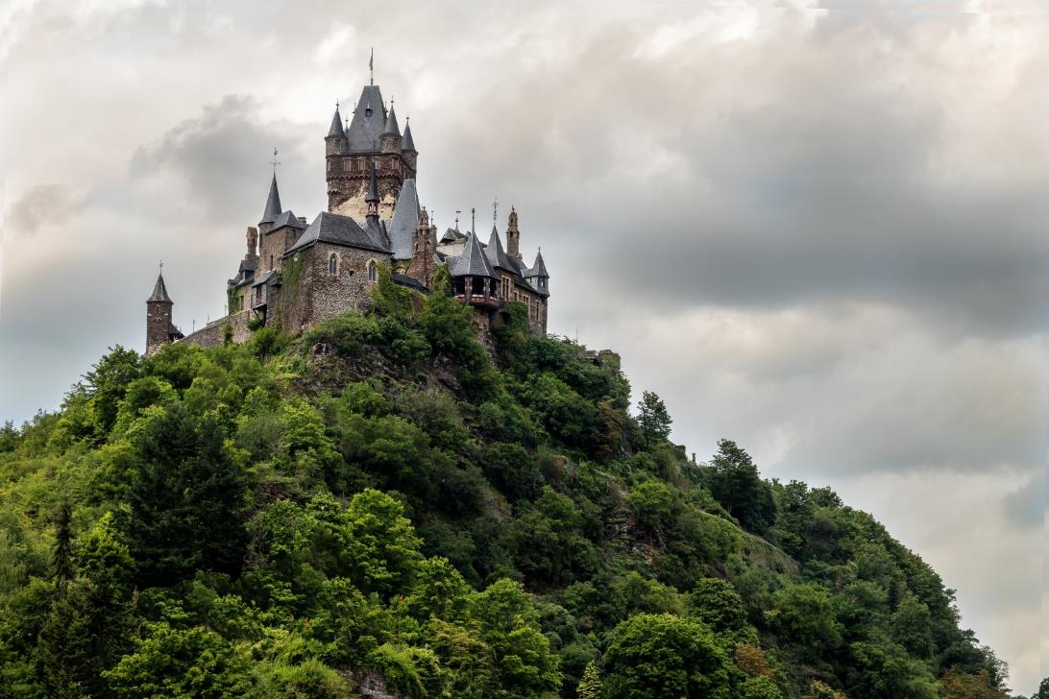
Location
Lots of castles were built on top of hills.
It was hard for enemies to run up steep hills to get to the castle.
It gave the people in the castle an excellent view and meant that they could spot enemies a long way off.

Slide 7
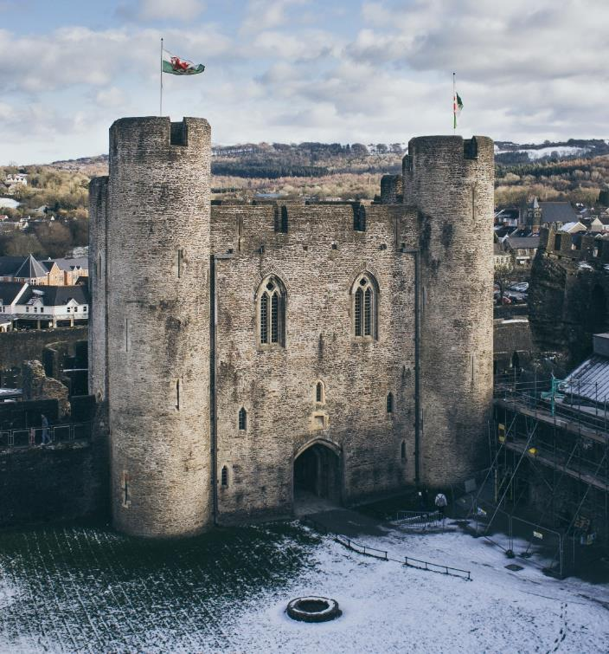
High Walls
It was important that the castle walls were very high.
This made it harder for attackers to climb over the walls.

Slide 8
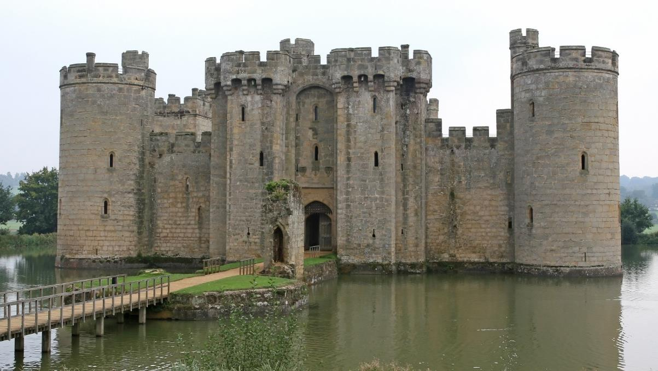
Moat
Some castles had moats. Water completely surrounded the castle.
This made it hard for people to attack it.

Slide 9
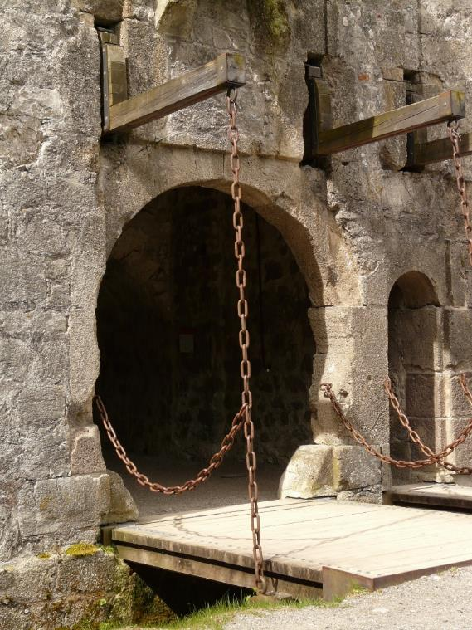
Drawbridge
Lots of castles had a bridge over the moat, that led to the entrance.
The drawbridge could be pulled up to stop enemies from getting across the water and reaching the castle.

Slide 10
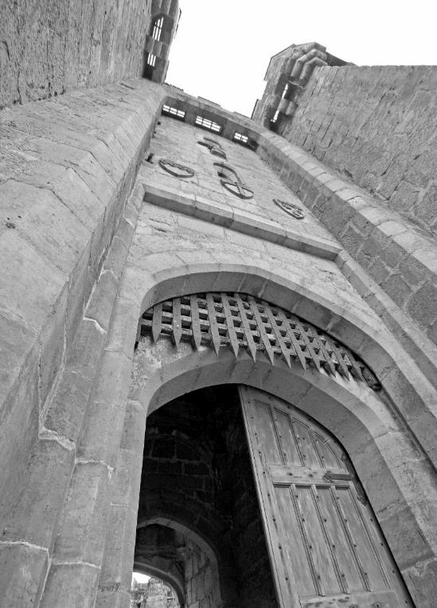
Portcullis
At the entrance to the castle, there was a portcullis covering the door.
This was made of metal or wood.
It was there to protect the door from being set on fire or being bashed in by enemies.
It could be lifted to let people in or out of the castle.
“Bodiam Castle portcullis and machicolations” by [exfordy] is licensed under CC BY 2.0

Slide 11
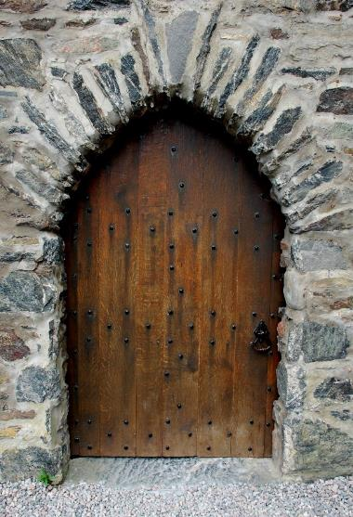
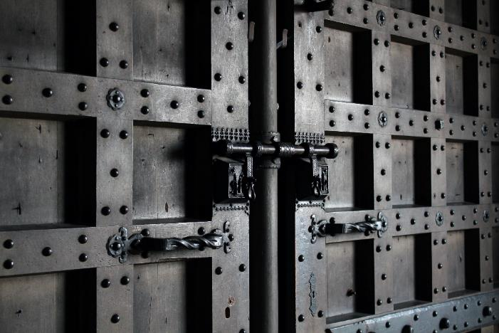
Door
The entrance to the castle was protected by a thick, iron-studded wooden door.
It was big and strong so that enemies could not break the door down and enter the castle.

Slide 12
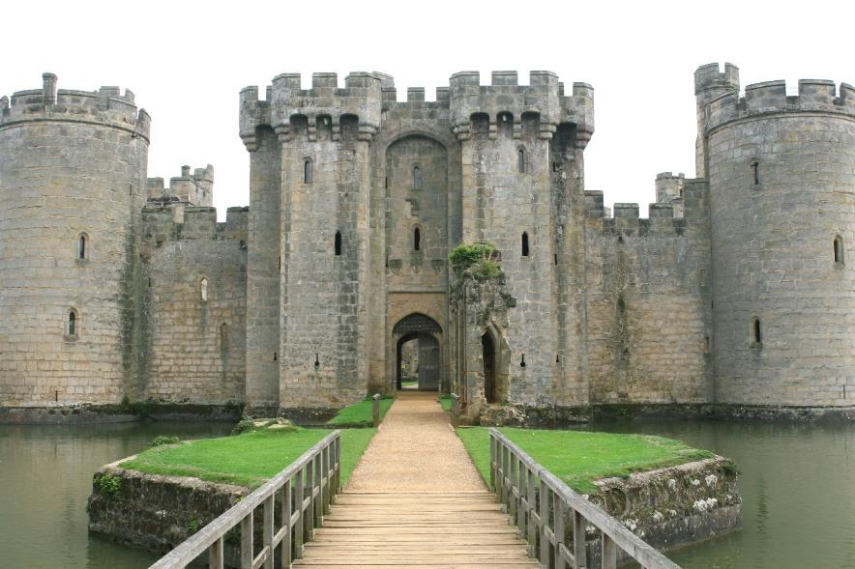
Battlements
At the top of the castle walls were the battlements.
The battlements look a bit like teeth.

Slide 13
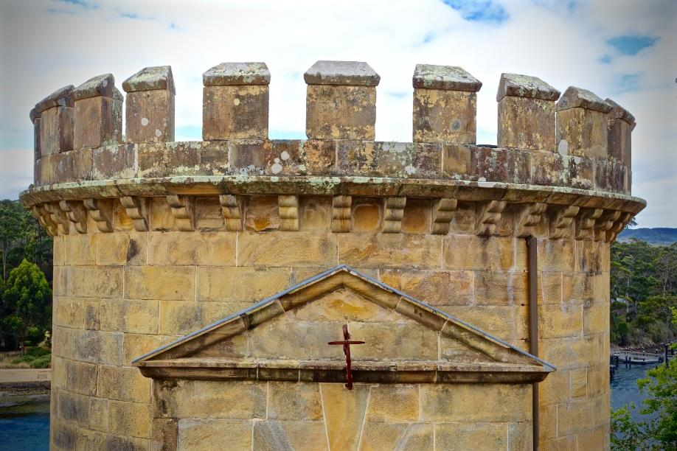
Battlements
The soldiers stood behind the wall and tried to protect the people inside the castle.
They looked through the gaps (called crenels) and shot arrows at any attackers.
They shielded their bodies behind the raised sections (called merlons) to avoid being shot at themselves.
crenel
merlon

Slide 14
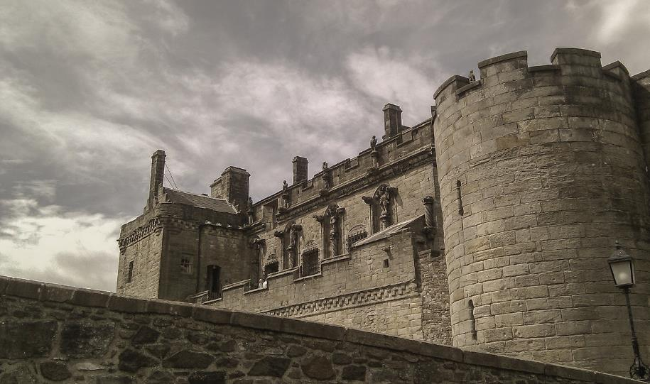
Arrow Slits
Some castles also had arrow slits.
Soldiers could see and shoot arrows through these thin gaps in the wall, without getting shot.

Slide 15
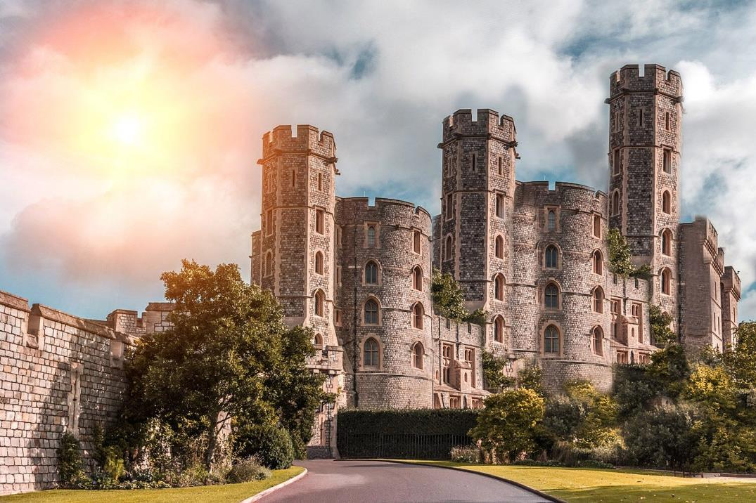
Castles Around the World
Lots of different castles were built in different countries around the world.
There are lots of different styles of castle.

Slide 16
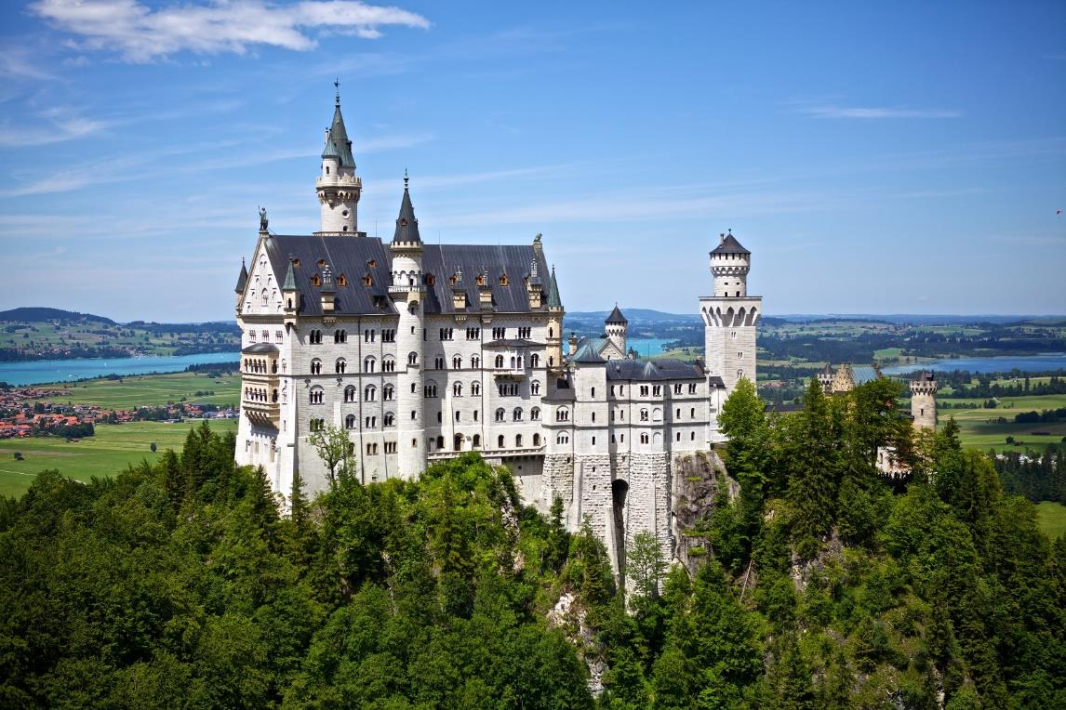
Neuschwanstein, Germany

Slide 17
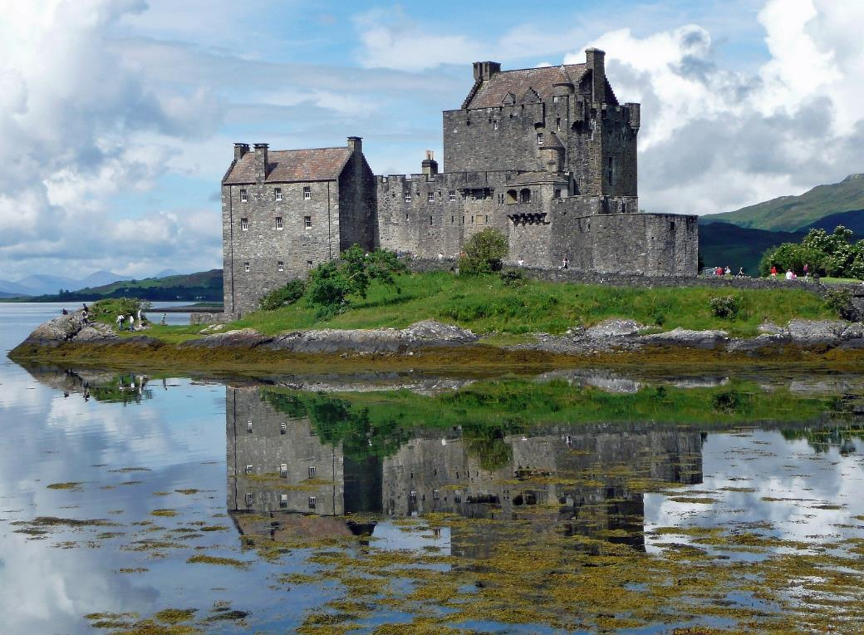
Eilean Donan Castle, Scotland

Slide 18
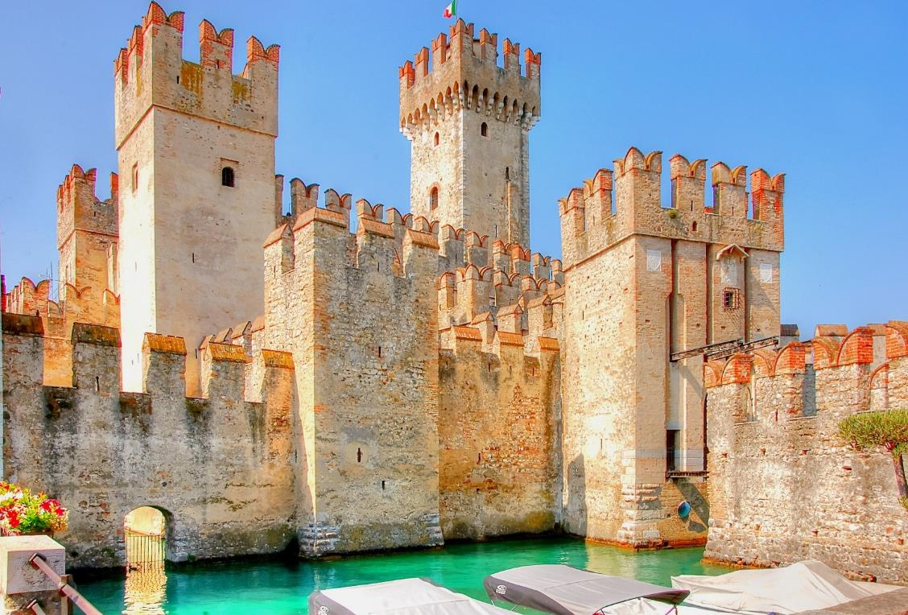
Scaligero Castle, Italy

Slide 19
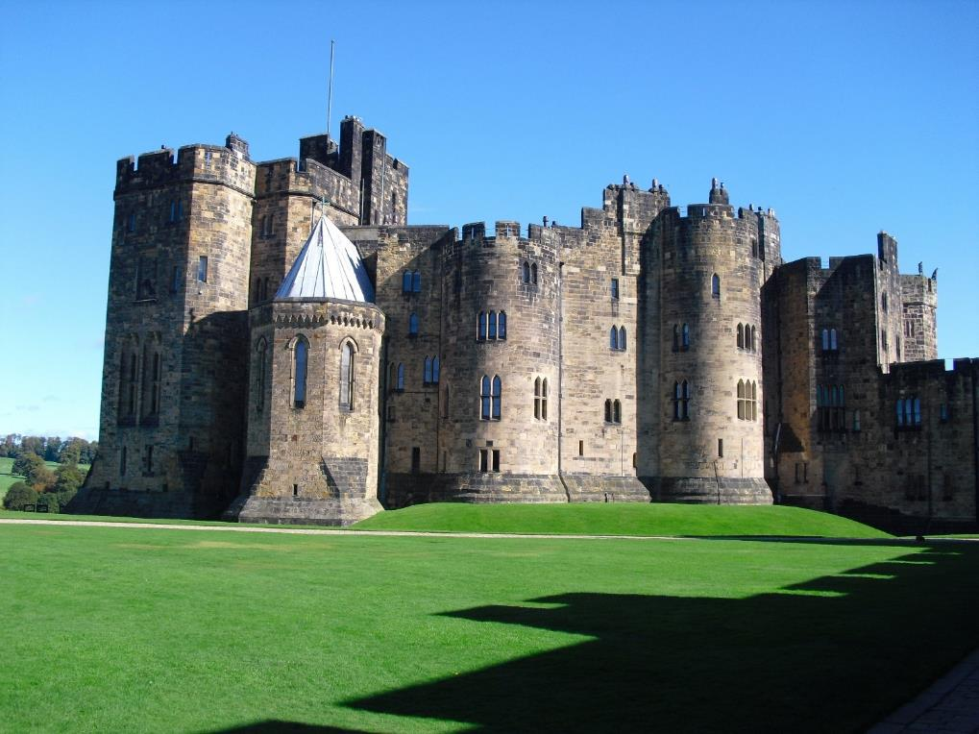
Alnwick Castle, England

Slide 20
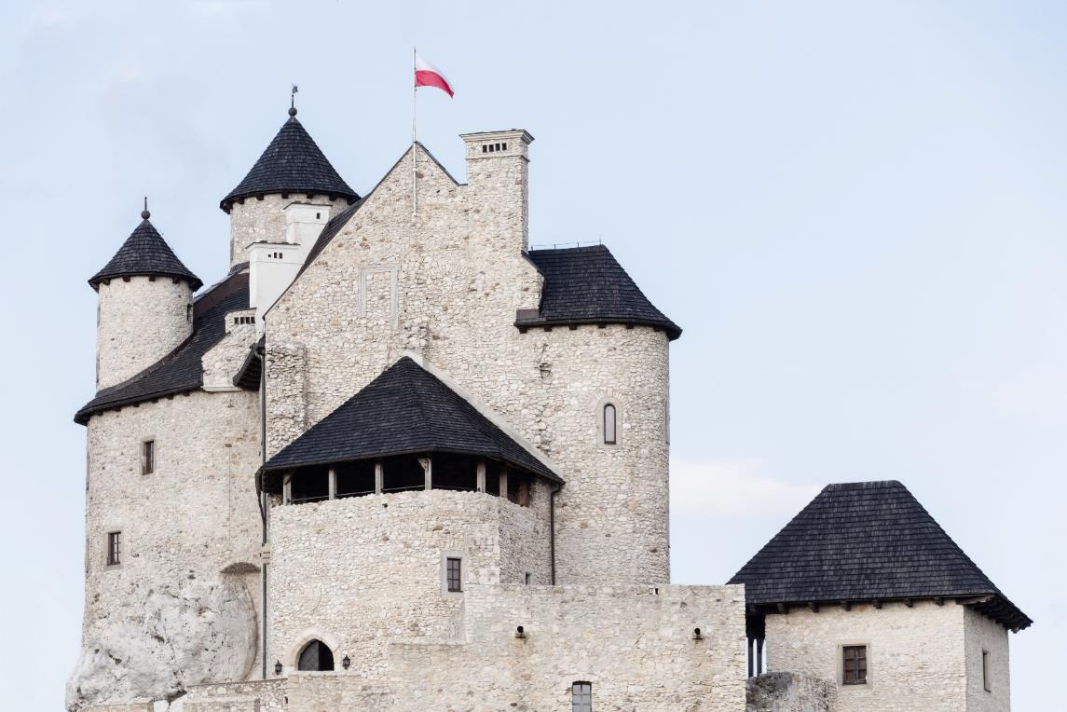
Bobolice Castle, Poland

Slide 21
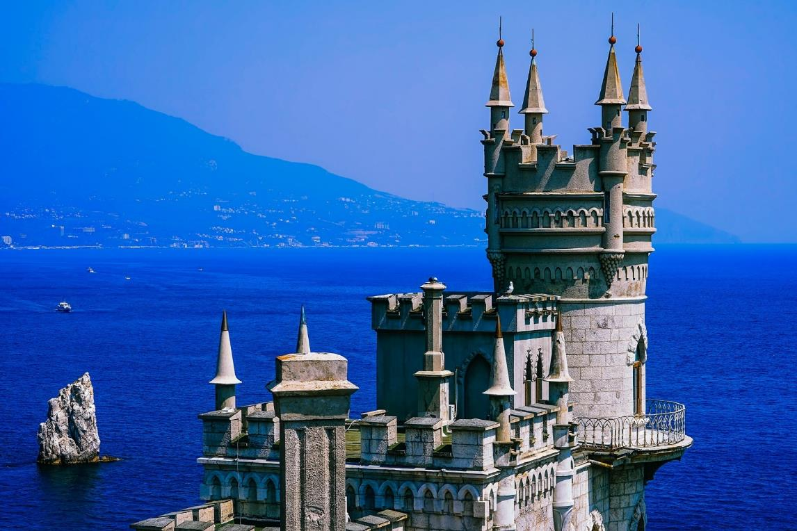
Swallow’s Nest, Crimea

