Slide 1
Anglo Saxon Runes
Runes were letters used by the
Saxons to write short messages of ownership, like “This belongs to Offa”.

Slide 2
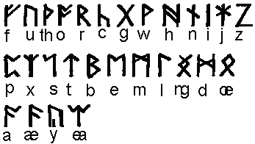
When the Anglo-Saxons became Christians, they began to use the Roman alphabet for writing (as we still do today). Before that time, they wrote in runes like these:

Slide 3
How many letters do you think there are?
There are 33 letters in the Runic
Alphabet. Is that more or less than the
Roman one that we use?

Slide 4
The Anglo Saxon alphabet takes it’s name from the first 6 letters. ‘Futhork’.
F U TH O R K
Feo Ur Thorn Os Rad Ken

Slide 5
Here are the remainder.
G W H N I
J IE P X S T

Slide 6
And some more… B
E M L NG Beroc Eoh Mann Lagu Ing
OE D A AE Y IO
Otael Daeg Ac Asec Yr Ior

Slide 7
And finally…..
EA QU C ST G
Ear Cweorp Calk Stan Gar

Slide 8
You can see that some of the runes are quite like our capital letters.

Slide 9
Some are easier to guess if you turn them upside down.

Slide 10
Some are not what you would think!

Slide 11
The word RUNE means secret or mystery.
Runes were used in religious ceremonies.
They were a charm or a spell as well as a
way of writing messages.
The Anglo Saxons believed that if you
used the runes in the right order they
had magical powers.

Slide 12
That is why……..
To spell ( to put down the right letters in
the right order)
And…..
A spell (a magic spell)…..
are the same word in English

Slide 13
Each rune had a name and were like pictures. The runes were all made of straight lines which made them easier to carve. Runes were often carved on precious objects or stone monuments.
This means ‘joy’
This means ‘ash tree’

Slide 14
Did you know that even our words READ and WRITE are connected with runes.
The Anglo Saxon word ‘writan’ means to
carve runes.
The Anglo Saxon word ‘ridan’ means to
interpret or know what the runes mean.

Slide 15
Now it is your turn!
You are going to try to write your name
using the Runic alphabet.
Here is mine.
J A N E

