Slide 2
Aim
To investigate how images change in concave and convex mirrors.
Success Criteria
I can identify concave and convex mirrors.
I can ask questions about the size of images in concave and convex mirrors.
I can carry out an investigation and record data to answer my question.
I can explain how concave and convex mirrors change images.

Slide 3
House of Mirrors
Convex mirrors bulge outwards, like this:
Concave mirrors bulge inwards (like you go into a cave!) like this:

Slide 4
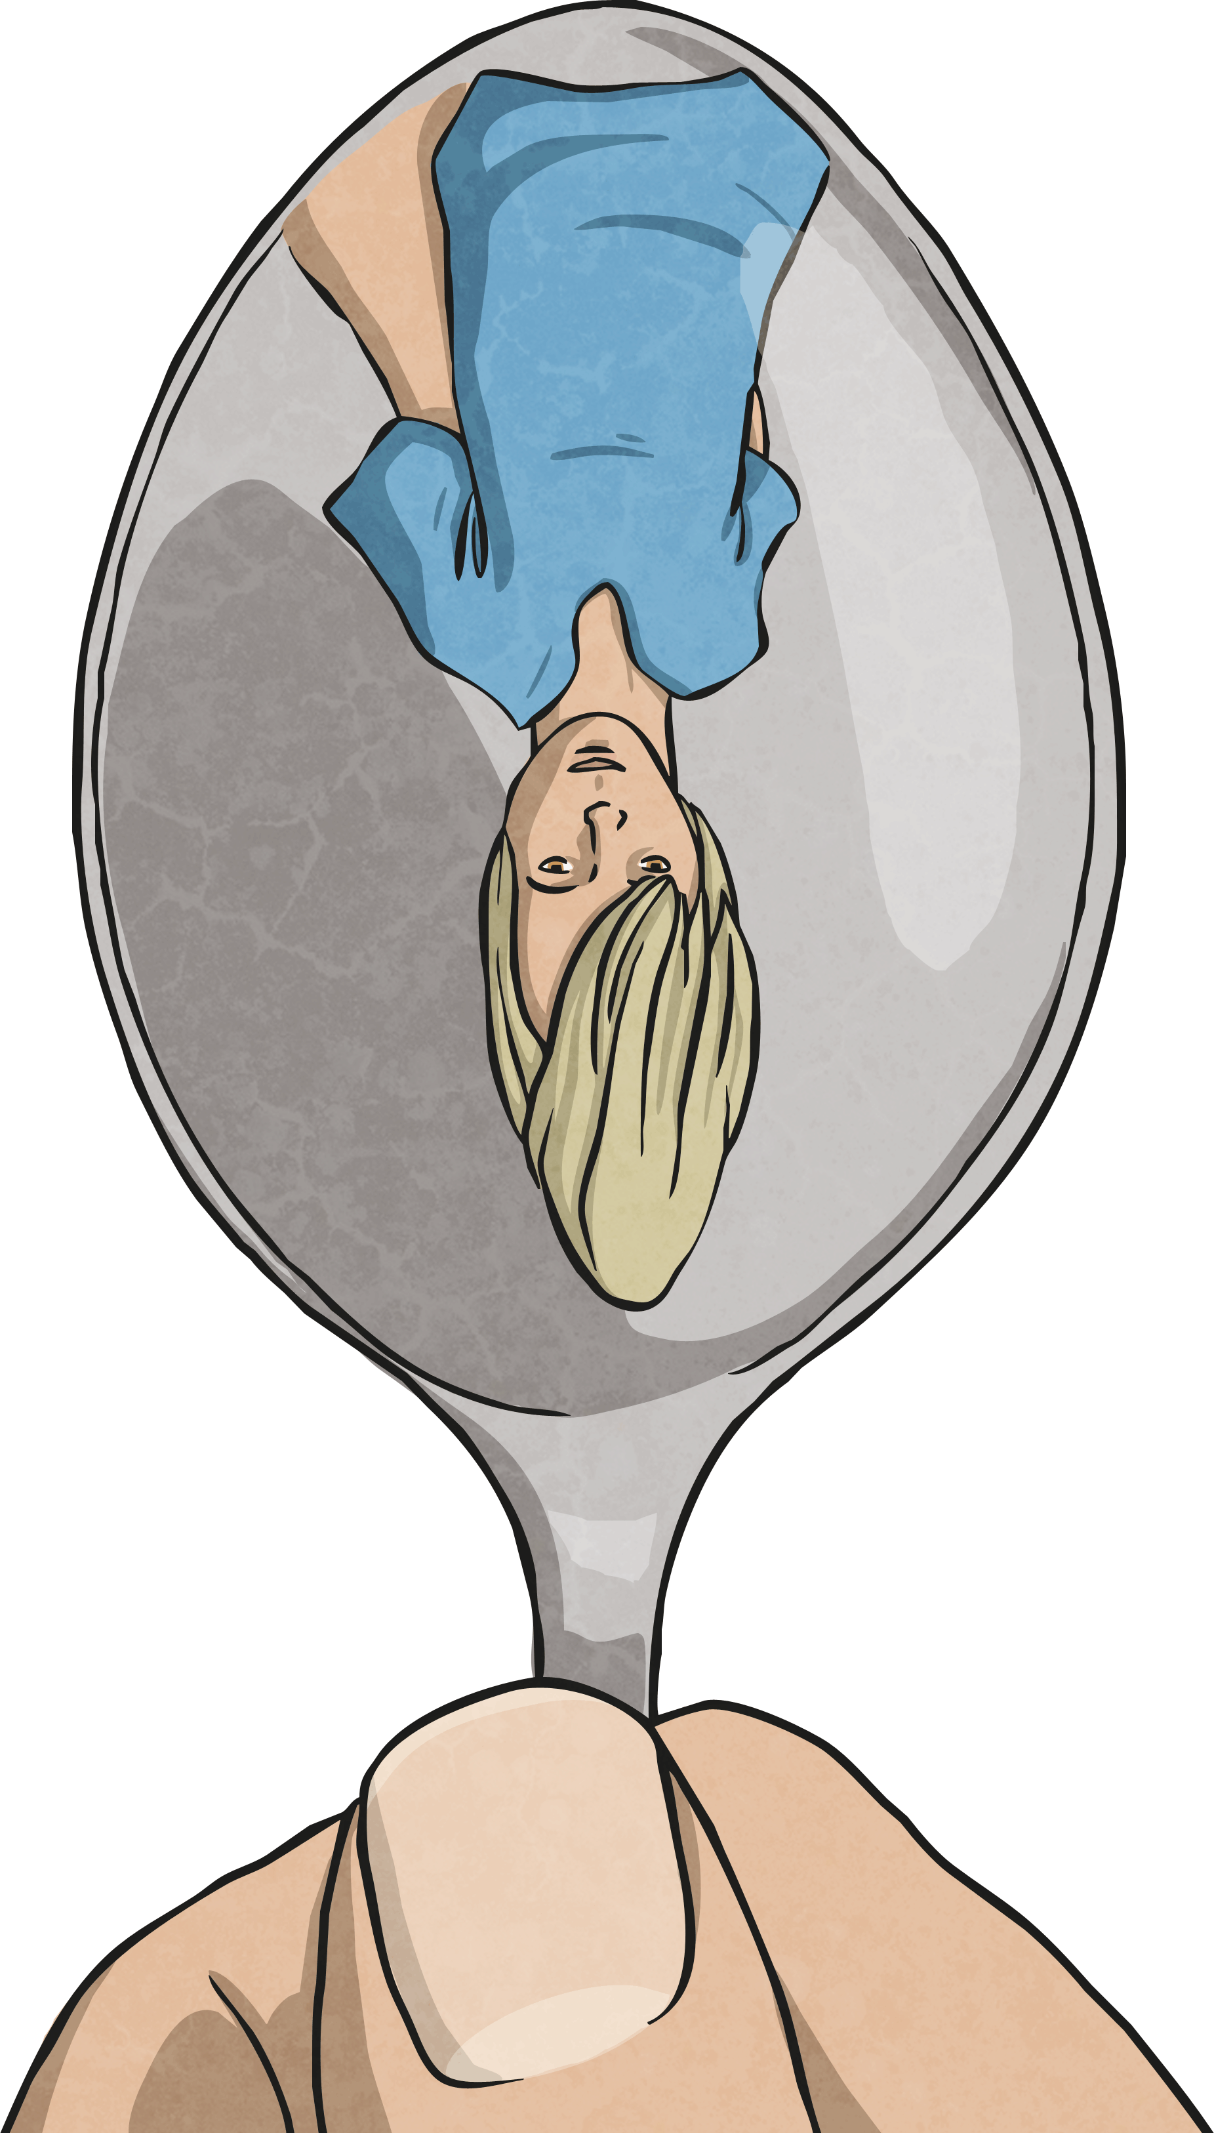
House of Mirrors
Concave and convex mirrors reflect light differently to plane (flat) mirrors, so your image looks different in these types of mirrors.
Today, you are going to investigate exactly how concave and convex mirrors change our images.

Slide 5
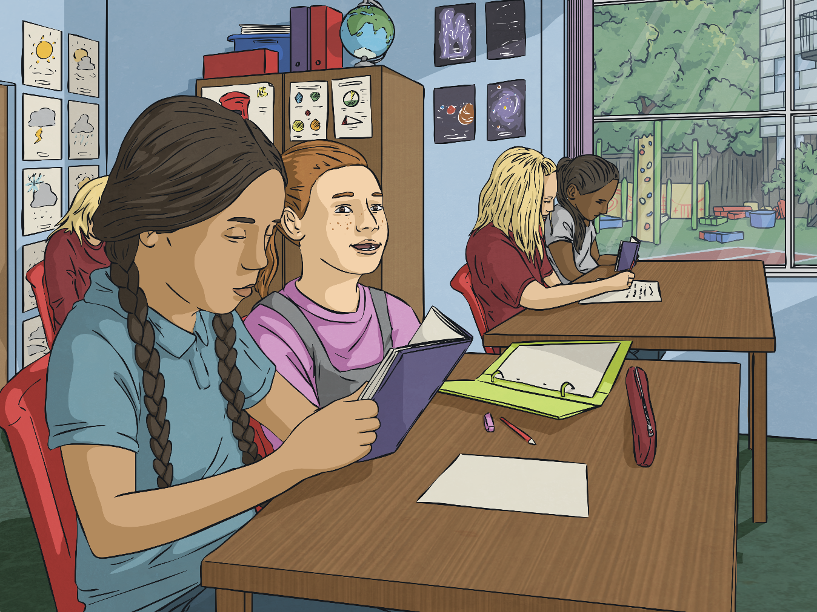
Asking Questions
You will need to decide on a question that your investigation will answer.
Think about the size of your image and how it may appear in convex and concave mirrors.
Talk to your family member about your ideas for a question about the size of an image in these different mirrors.

Slide 6
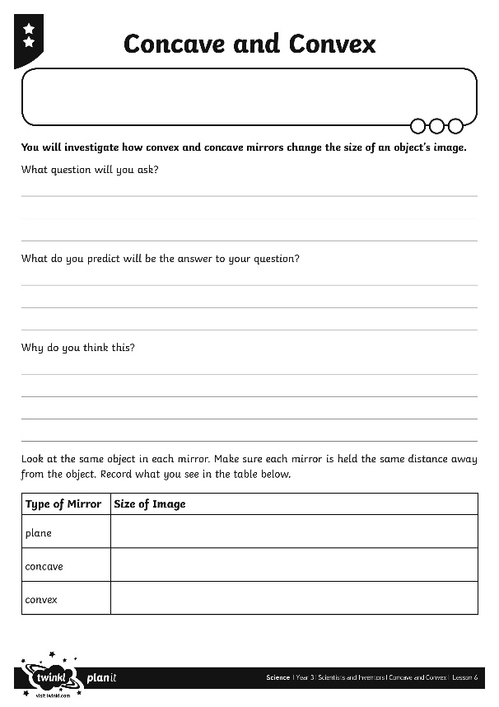
Making Predictions
These are some examples of the question you may have come up with:
?
Is an image bigger in a concave mirror?
Is an image smaller in a convex mirror?
Does a convex mirror make a bigger image than a plane mirror?
Does a concave mirror make a smaller image than a plane mirror?
Write your question on the Concave and Convex Activity Sheet. Make a prediction about what you think the answer will be.
Now, let's answer your question!

Slide 7
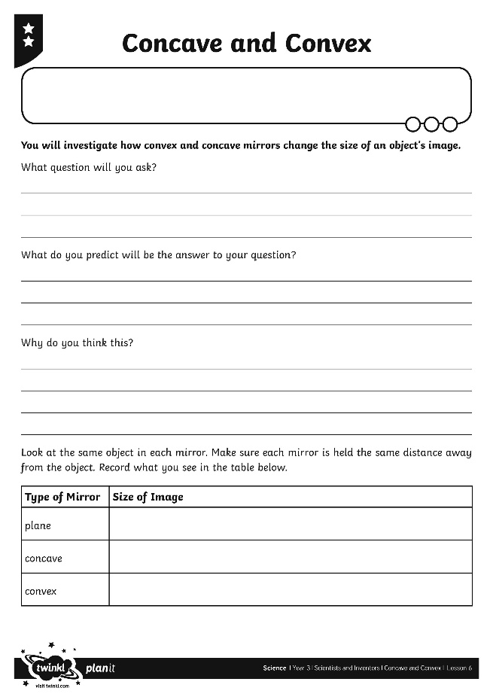
Finding Out
In order to answer your question, you will carry out an investigation.
Hold the different mirrors the same distance away from your face, or from an object. Make sure you use the same object with each mirror.
Compare the size of the image in each mirror.
Record your results on the table on your Concave and Convex Activity Sheet.

Slide 8
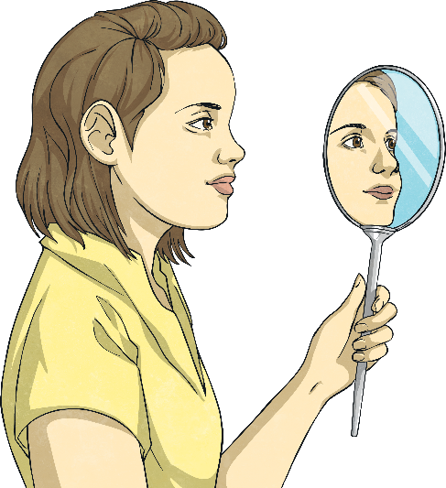
Finding Out
You will look at your results and use them to answer your question.
Look at this example.
The question was, ‘Is the object's image bigger in a convex mirror?’
Type of Mirror | Size of Image
plane | same as the object
concave | bigger than the object
convex | smaller than the object
?
Do the results in the table give an answer to the question?

Slide 9
Finding Out
The results show that the image appears bigger in the concave mirror, so the answer to the question is: ‘No. The object's image appears bigger in the concave mirror rather than the convex mirror.’
Use your results to write your conclusion on your Concave and Convex Activity Sheet, answering your question in full sentences.

Slide 10
Why Does This Happen?
Images appear different in concave and convex mirrors because the way the mirrors bend causes the mirrors to reflect rays of light in different angles.
Watch the ways the rays of light are reflected differently.

Slide 11
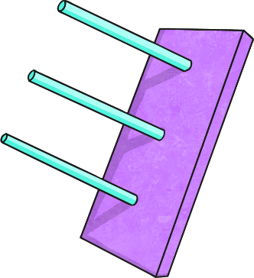
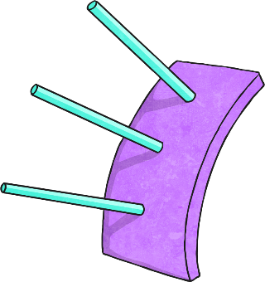
Why Does This Happen?
A plane mirror reflects the rays of light back in a straight line, so images appear the same as they are in real life.
A concave mirror reflects the light rays in towards a point. From far away the object will appear upside down, but as you move nearer and reach the focal point, the image flips the right way up and magnifies, so that the image appears larger than actual size.
A convex mirror reflects rays of light at a wider angle towards its edges, creating a slightly distorted image that appears smaller than actual size. The smaller size of the image means that we can see more in these mirrors.

Slide 12
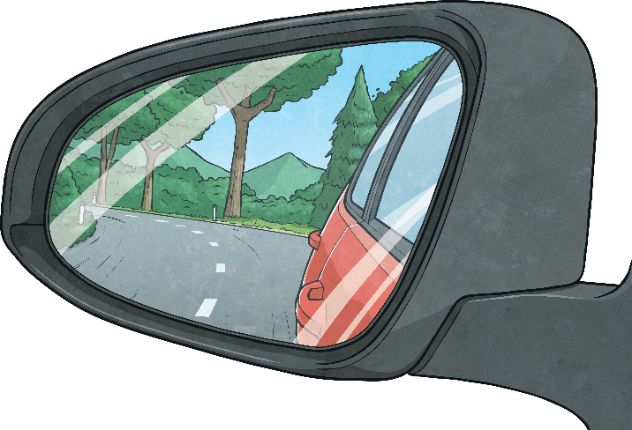
Concave or Convex?
A car wing mirror is a convex mirror.
?
Why is a convex mirror the best choice?
A convex mirror makes objects appear smaller so you can see more widely than you would normally be able to. This means drivers can see more of the road, so they are safer.
It is thought that car wing mirrors were invented by a man named Arthur James Wilson.
Arthur Wilson was a famous cyclist. He was born in 1858, and raced in many competitions in the 1870s. One year, he cycled 3200 miles in races!
Although he was born able to hear, Arthur went deaf at the age of 12 after contracting scarlet fever. In 1896, he was the first deaf British person to buy and drive a motor vehicle.

Slide 13
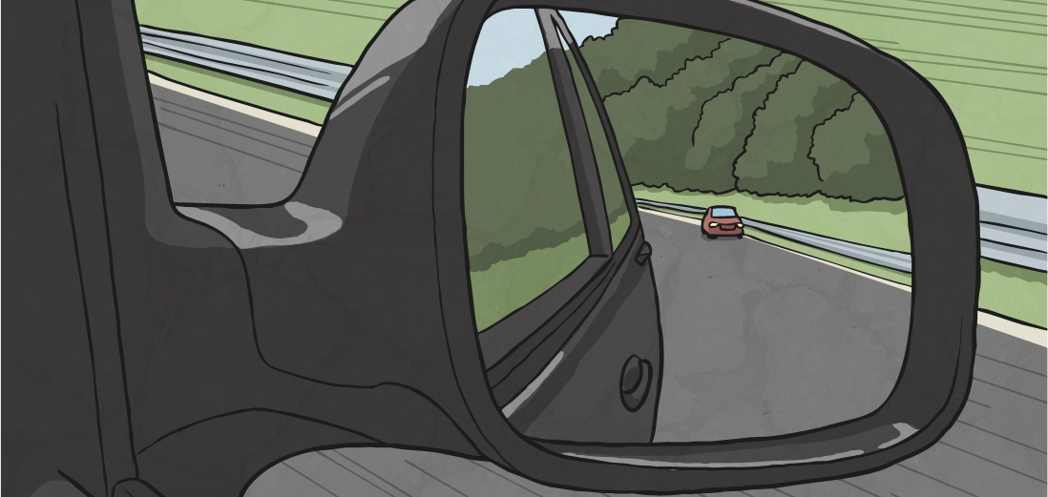
Concave or Convex?
People believe that Arthur Wilson went on to invent car wing mirrors, and he became wealthy. He made friends with the Prince of Wales and taught King George V to cycle!

Slide 14
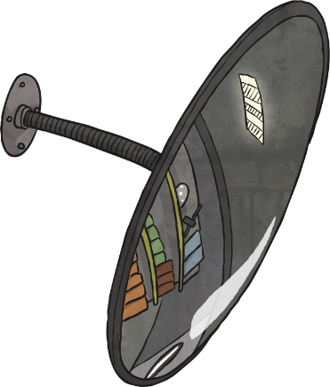
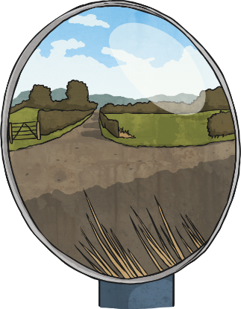
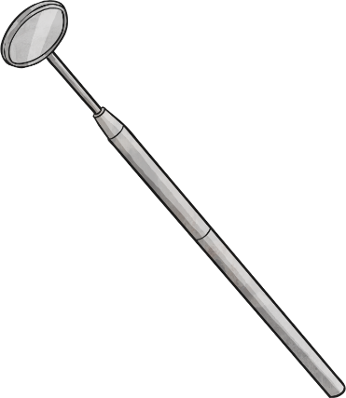
Concave or Convex?
Convex and concave mirrors reflect light in different ways to create different images. Scientists and inventors have used them in many different devices and for different purposes.
Look at these examples and decide whether they are convex or concave mirrors.
?
Why have these mirrors been chosen for their purposes?

Slide 15
Concave or Convex?
concave mirrors
convex mirrors

Slide 16
Aim
To investigate how images change in concave and convex mirrors.
Success Criteria
I can identify concave and convex mirrors.
I can ask questions about the size of images in concave and convex mirrors.
I can carry out an investigation and record data to answer my question.
I can explain how concave and convex mirrors change images.

