Slide 1



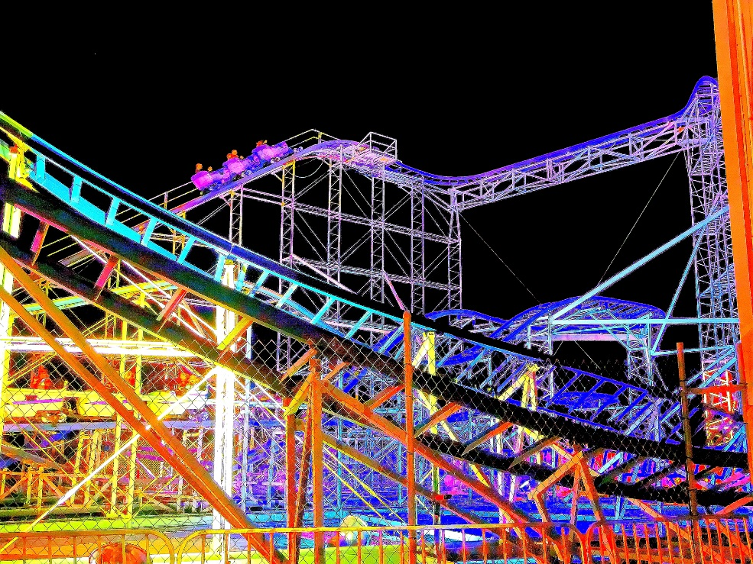
Learning Outcome:
Recognise and use similes and metaphors.

Slide 2






Similes and metaphors share some common traits ...
Notes:
https://www.flickr.com/photos/kim_carpenter_nj/7565537700

Slide 3

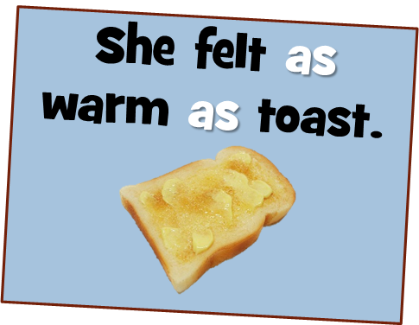


What are Similes?
A simile is a direct comparison and uses the word ‘like’ or ‘as’ in the comparison.

Slide 4


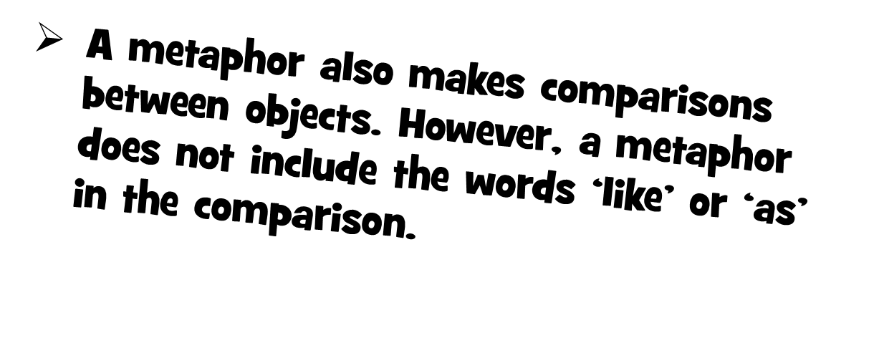

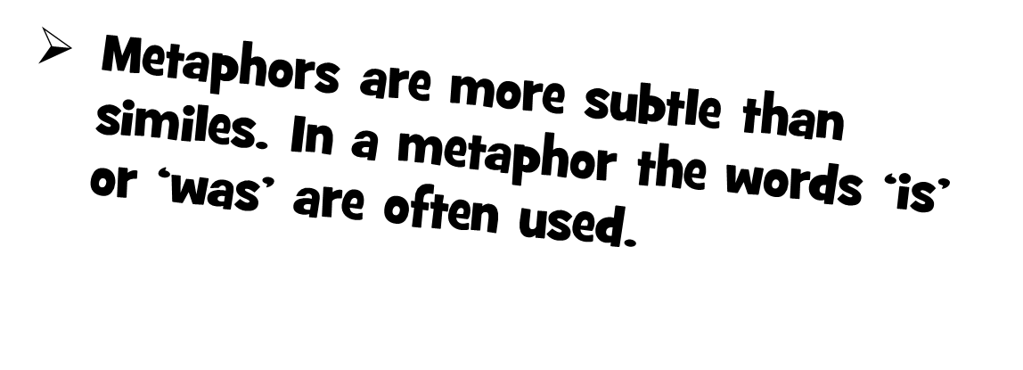
Notes:
https://www.flickr.com/photos/kim_carpenter_nj/7565537700

Slide 5

This metaphor compares life with a rollercoaster. It says life is a roller coaster. It has its ups and downs and can be scary and yet exciting. Much is conveyed in a few words.
Notes:
https://www.flickr.com/photos/kim_carpenter_nj/7565537700

Slide 6
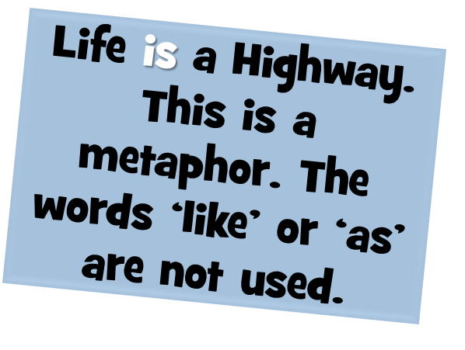


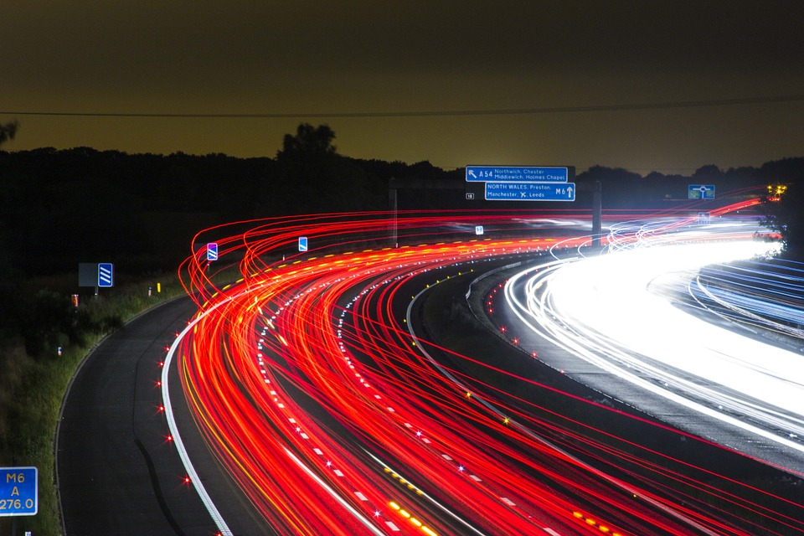
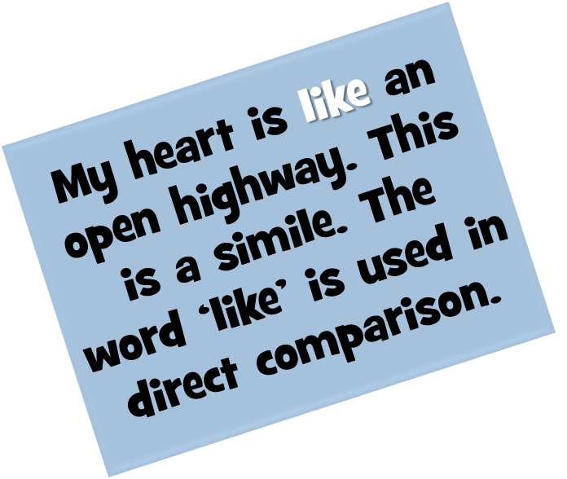


Slide 7


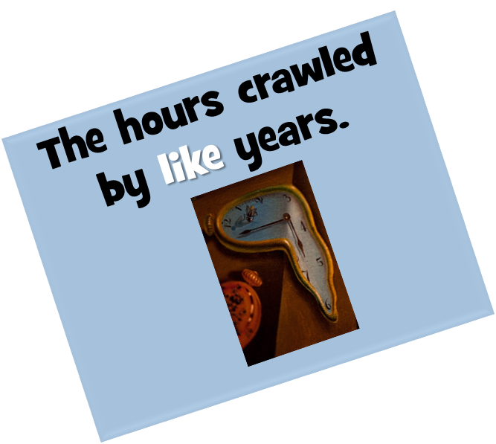
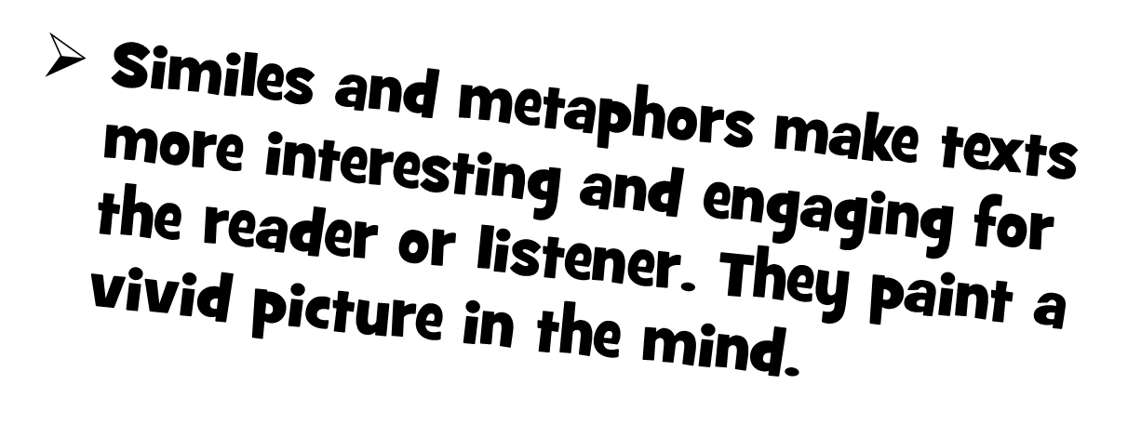

Slide 8

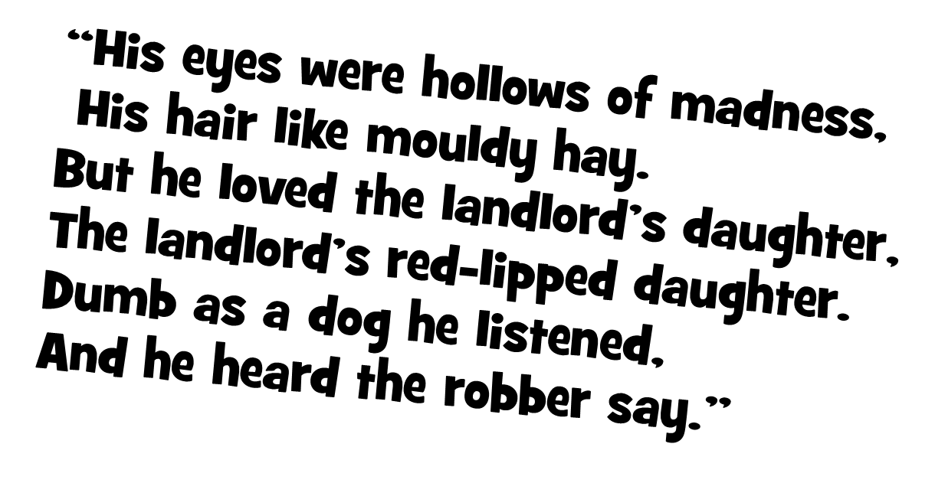
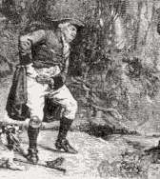

Slide 9

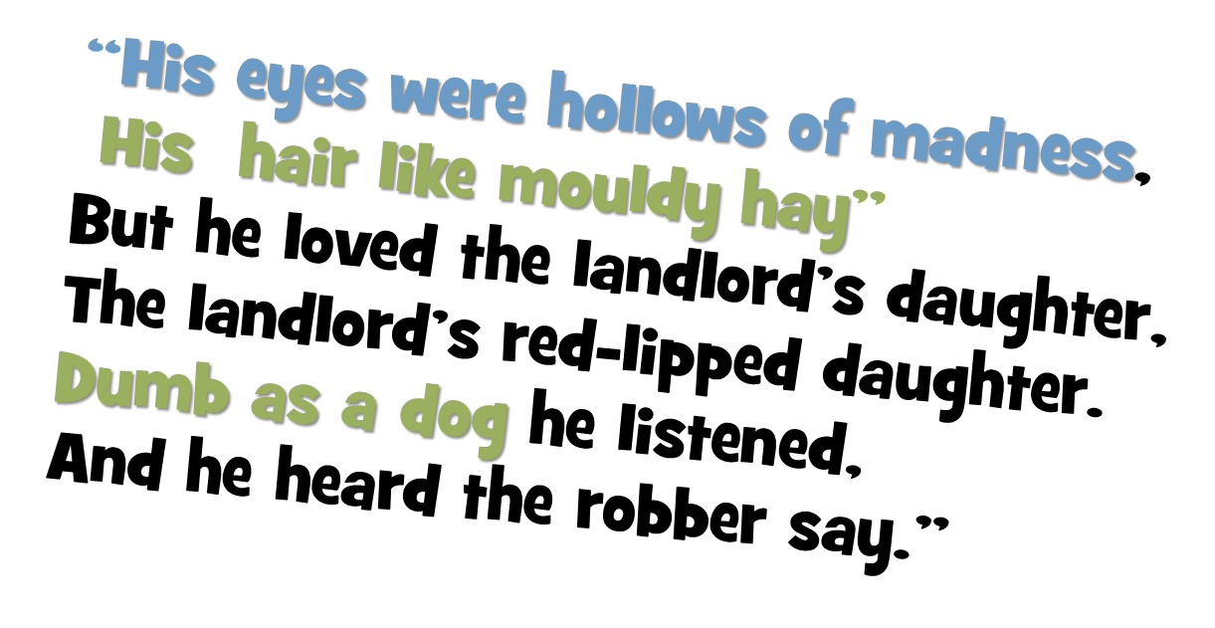
“The Highwayman” by Alfred Noyes

Slide 10




