Slide 2
Aim
To identify inventions and discoveries from all over the world linked to scientific ideas.
Success Criteria
I can recognise that inventions and discoveries come from all over the world.
I can give an example of how some things are invented to make people’s lives easier.

Slide 3
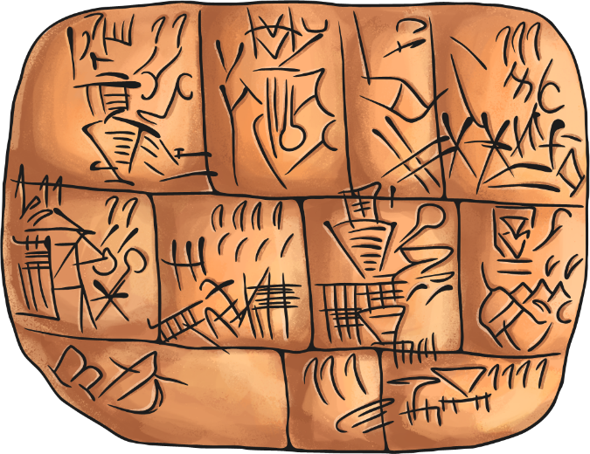
Who and Where?
Who invents or discovers things? Where are inventors from?
Inventions are created all over the world by many different people. They are usually thought up because people need an easier way to do a job or have a problem that needs solving.
?
Think about our classroom equipment: how did people write before pencils or ink were invented?

Slide 4
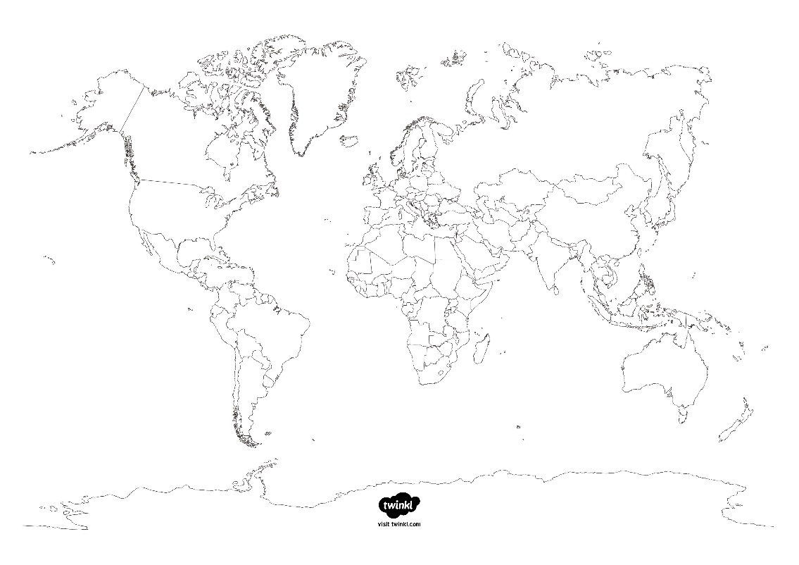
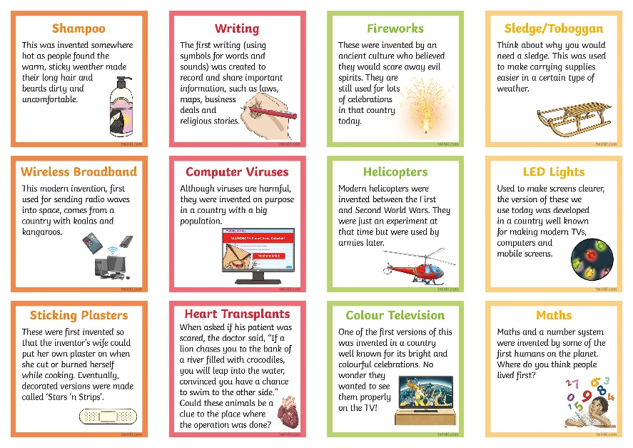
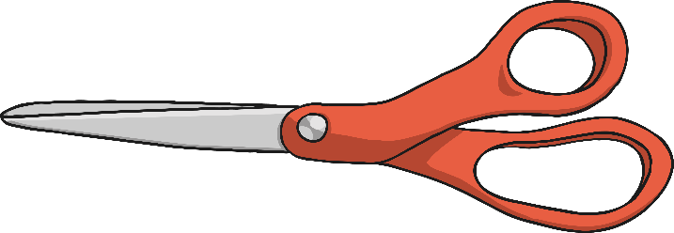
Where in the World?
Inventions are created and discoveries are made all over the world!
Cut out and place the inventions onto the map in the area of the world you think they might come from.

Slide 5
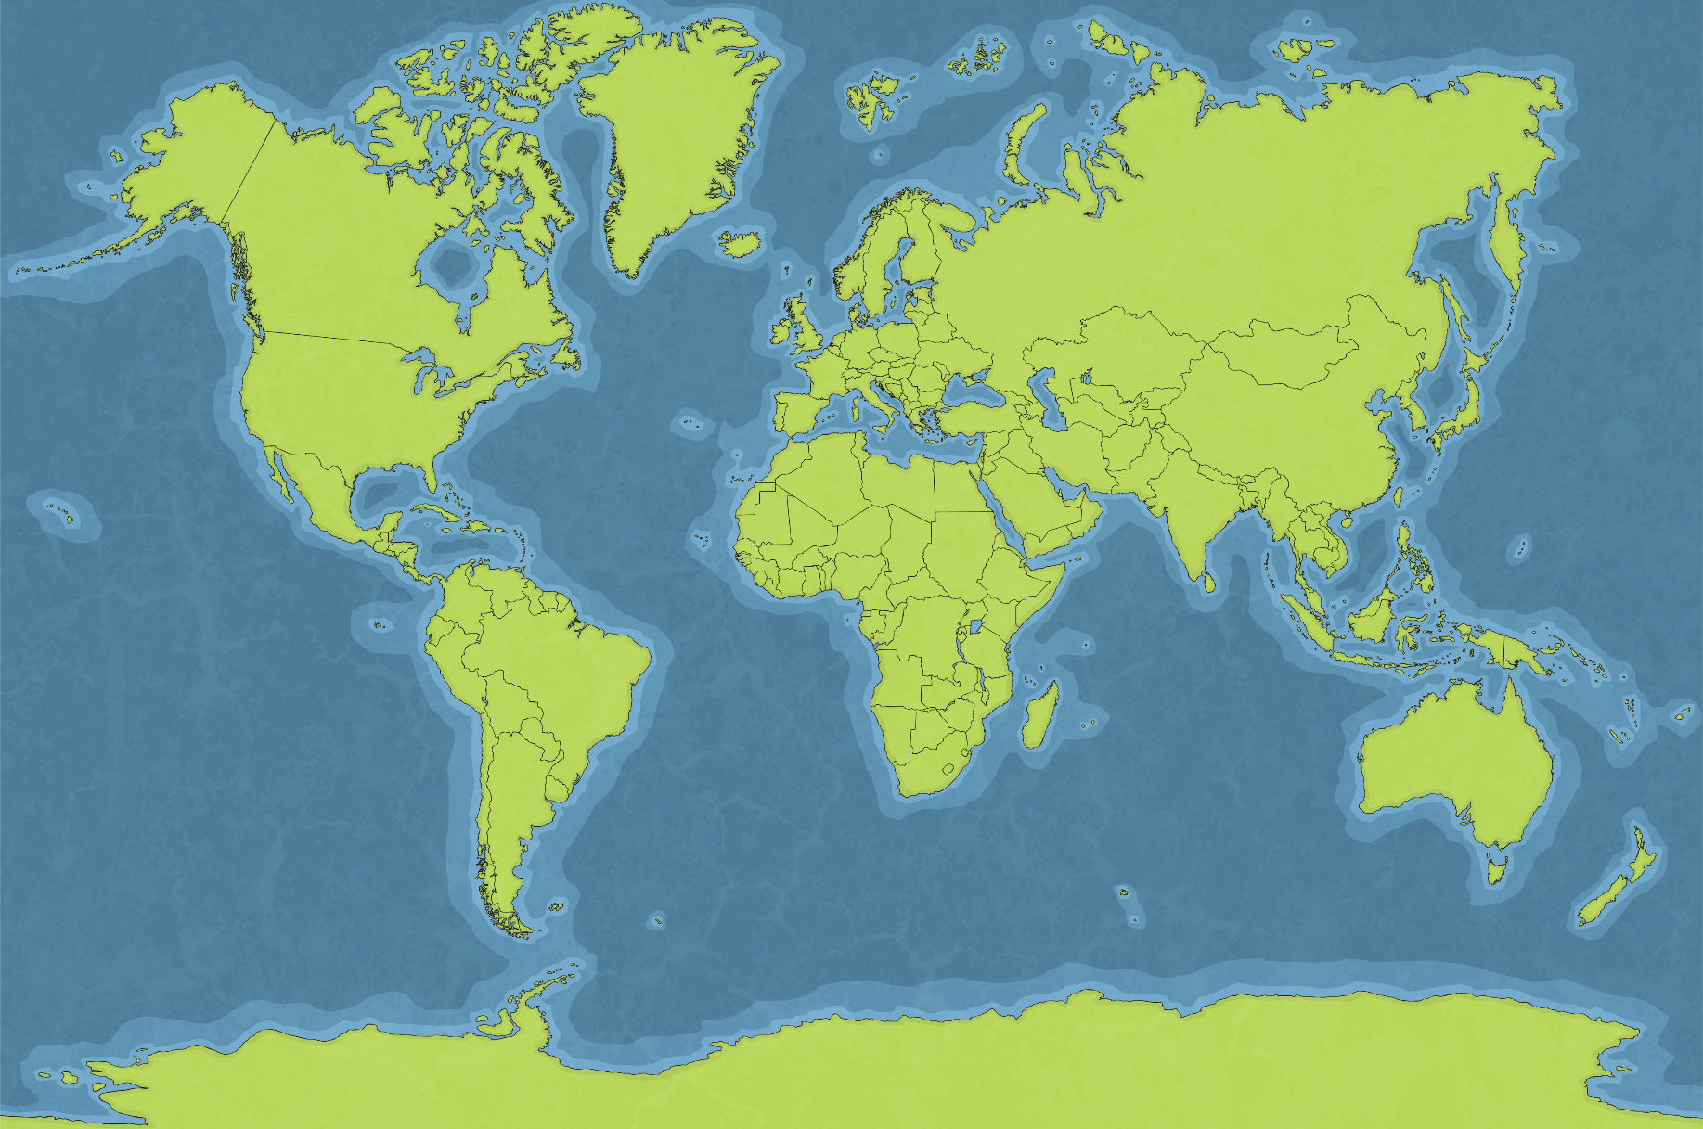
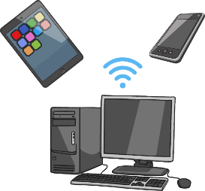
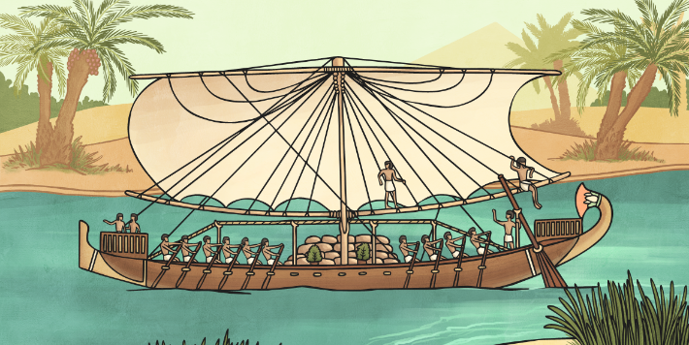
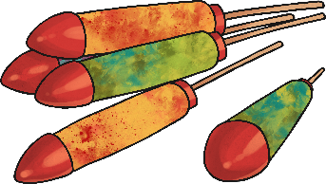
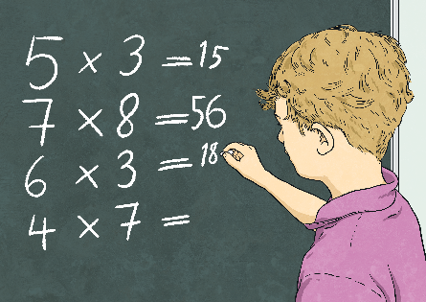
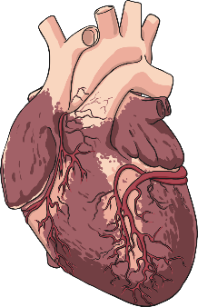
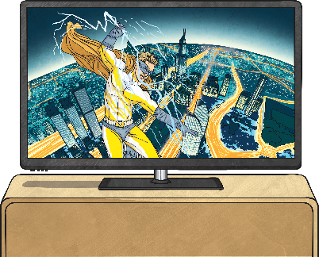
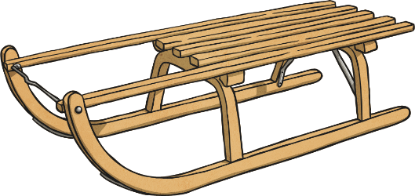
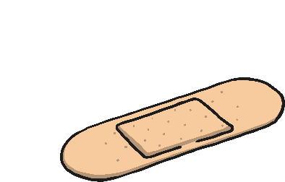
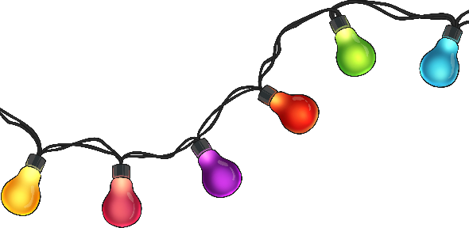
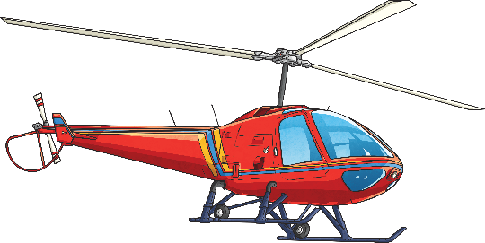
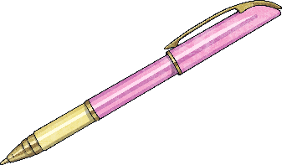
Actually, I’m From…
Maths
Computer viruses
Sailing
Sticking Plasters
Heart Transplants
Sledges and Toboggans
LED Lights
The oldest evidence of humans doing maths is a bone with notches that was found in Swaziland. It is more than 35 000 years old!
The first virus to affect a modern computer was invented by brothers Basit and Amjad Farooq Alvi in Pakistan to stop people making illegal copies of their software.
Helicopters
Wireless Broadband
The first sailing ships are thought to have been invented in Ancient Egypt for sailing up the river Nile.
Fireworks
Colour TV
Writing
Shampoo
In 1920, in New Jersey, USA, Earle Dickson invented the sticking plaster for his wife, who often cut or burned herself while cooking. The design meant that she could put the plaster on herself, instead of needing help with a bandage.
Ballpoint Pens
Professor Christiaan Barnard performed the first ever human heart transplant in South Africa in 1967.
These were invented in Canada by First Nations people (the Innu and Cree) to pull people and supplies in the snow.
LEDs that could be used for full colour screens were invented by Isamu Akasaki, Hiroshi Amano and Shuji Nakamura in Japan in the 1990s. Now, we use them in almost all screens.
Some of the key technology for wireless broadband was developed in the 1990s by a group of scientists, including Dr Jogn O’Sullivan, in Australia.
Between 1910 and 1939, Russian inventor Igor Sikorsky invented several different flying machines, including the design for the modern helicopter.
Both gunpowder and then fireworks came from China.
Guillermo González Camarena invented one of the first colour television systems in Mexico.
Shampoo is from India, all the way back in the 1700s!
The first ever writing was invented 5000 years ago in what is now Iraq.
These were patented by László József Biró, who was born in Hungary and then moved to Argentina. The pens were named ‘biros’ later, after him.

Slide 6
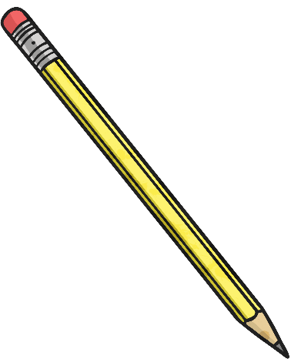
All About Inventions
Choose three of the inventions from the list on the next slide to find out more about. Record what you find out on your All About Inventions Activity Sheet.

Slide 7
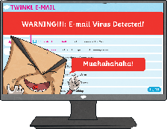
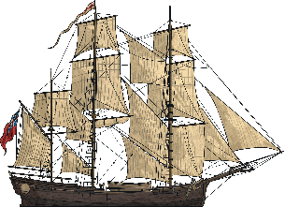
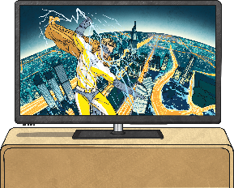
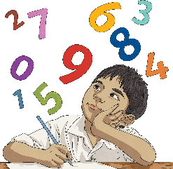
shampoo
writing
fireworks
sledges and toboggans
wireless broadband
computer viruses
ballpoint pens
helicopters
LED lights
sticking plasters
sailing
heart transplants
colour TV
maths

Slide 8
Share
With your family member, share what you found out about your chosen inventions.
Use the last section of your All About Inventions Activity Sheet to record any interesting facts that anyone else has discovered. This could be about any of the inventions, not just the three that you’ve researched.

Slide 9
Aim
To identify inventions and discoveries from all over the world linked to scientific ideas.
Success Criteria
I can recognise that inventions and discoveries come from all over the world.
I can give an example of how some things are invented to make people’s lives easier.

