Slide 2
L.O.
I can describe and understand the features of the layers of a rainforest.
Success Criteria
I can name the four layers of a rainforest.
I can tell you about the climate in each layer.
I can tell you about the plants found in each layer.
I can tell you some animals that live in each layer.

Slide 3
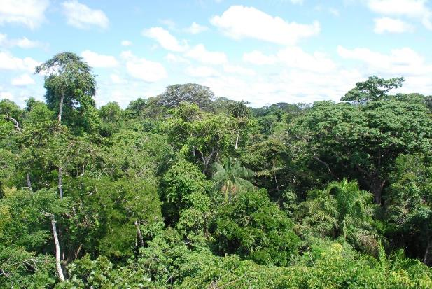
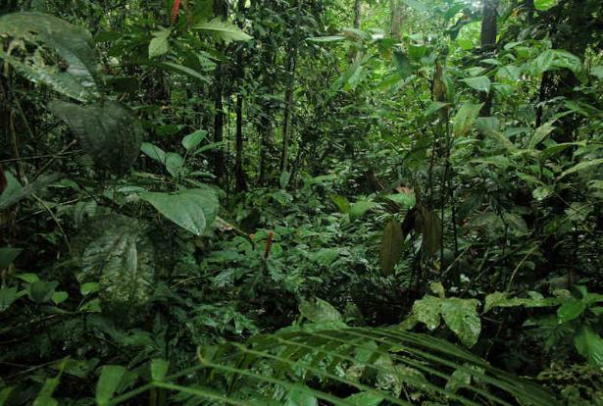
Inside a Rainforest
What do you notice about the plants in a rainforest?
Are all the plants the same height?
Are they all the same shade of green?
Do they have the same kinds of leaves?
Why do you think they are all different?

Slide 4
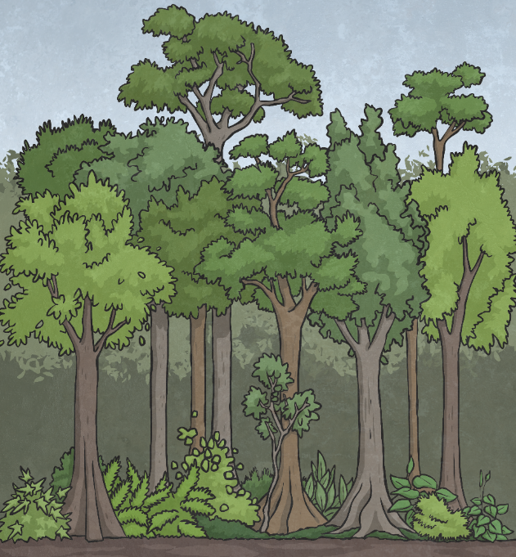
Layers of the Rainforest
A rainforest can be split up into layers.
Each layer is different because of the amount of light and water it gets.

Slide 5
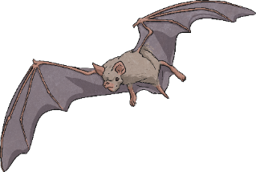
Layers of the Rainforest
Trees in this layer can be up to 60m tall.
Their trunks can be up to 5m in circumference.
They are usually broad-leaved, evergreen hardwood trees.
Emergent Layer
There is lots of sunlight up here, but it is also very cold and windy.
Many birds, monkeys, bats
and butterflies live here.

Slide 6
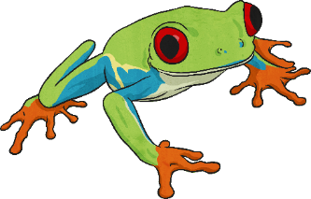
Layers of the Rainforest
Trees in this layer form a roof over the plants below.
Trees in this layer usually have smooth, oval, pointed leaves.
There is lots of sunlight but also plenty of rain.
Canopy Layer
Many animals live in this layer as there is plenty of food.
These include snakes, toucans
and tree frogs.

Slide 7
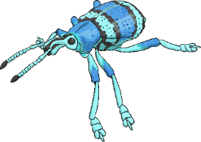
Layers of the Rainforest
Trees in this layer rarely grow taller than 4m.
It is very warm and very humid here.
Many insects live in this layer.
Understory Layer
Very little sunlight reaches this area, so the plants have to grow larger leaves to reach the sunlight that there is.

Slide 8
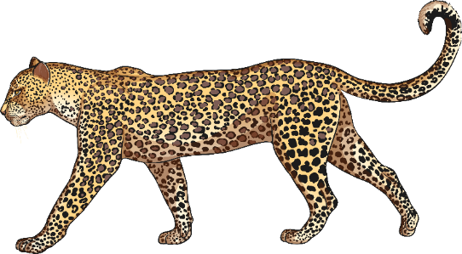
Layers of the Rainforest
It is very dark here – almost no sunlight reaches this area.
Very few plants grow in this area.
Leaves and other debris decompose very quickly.
Forest Floor
Animals such as gorillas, anteaters, leopards and tigers live here.

Slide 9
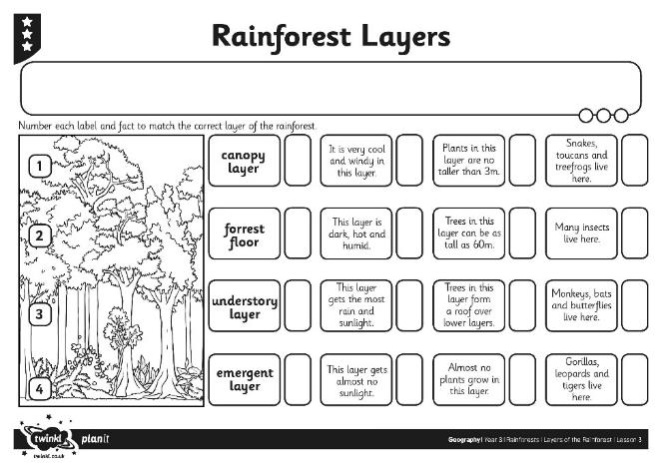
Layers of the Rainforest
Match the captions and the facts to the correct areas of the rainforest.

