Slide 1
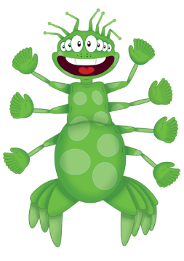
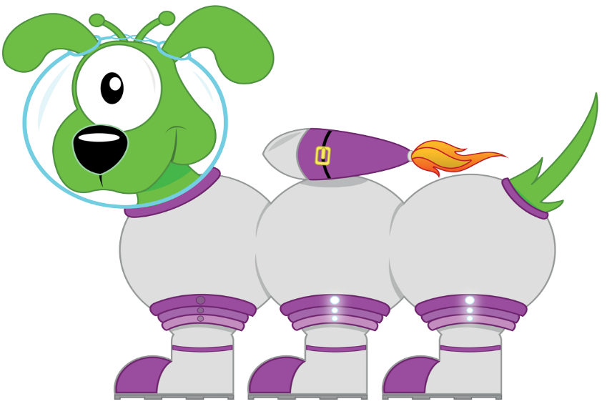
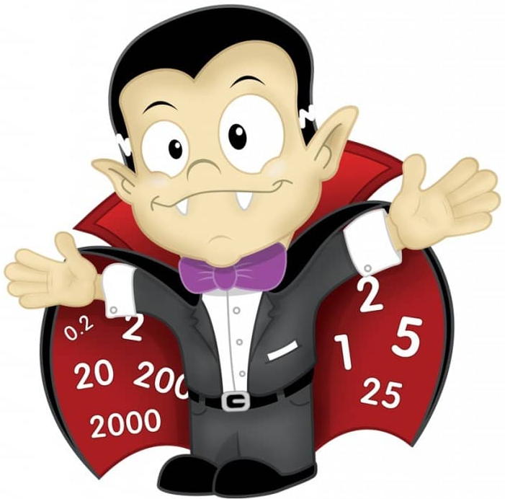
C
L
I
C
Year 2 Spring 1 Week 4 - 6

Slide 2
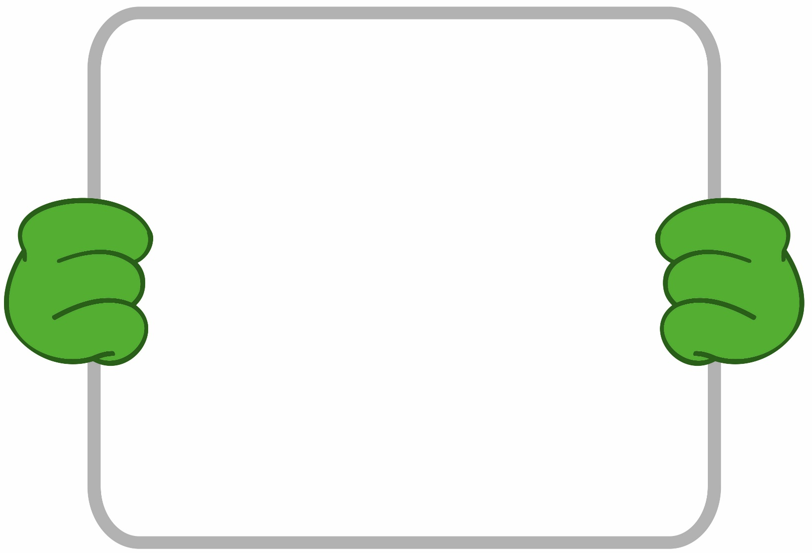
C
Monday
Squiggleworth - I can partition a 3 digit,
then a 4 digit number.
Remember to:
Say the thousands digit.
Say the hundreds digit.
Say and.
Say the 4d number.
5724
Th H T U

Slide 3
L
Monday
Learn Its
I can say multiples 1-5
1 five is…..
2 fives are…..
3 fives are…..
4 fives are…..
5 fives are…..
Step 7
1 X 5 = 5
2 X 5 = 10
3 X 5 = 15
4 X 5 = 20
5 X 5 = 25

Slide 4
I
Monday
Adding with PIM – I can add 100s
If I know that 4 cats & 3 cats is 7 cats
Remember to:
Use your addition Learn Its
Swap ‘the thing’ to a hundred
+
Then I know that 3 tens & 4 tens is 7 tens
+
10
10
10
10
10
10
10
Then I know that 3 hundred & 4 hundred is 7 hundred
+
100
100
100
100
100
100
100

Slide 5
C
Monday
Addition – I add 10 to any 2 digit number
Remember to:
Draw the diennes / Base 10 as tens and ones.
OR use your column method.
Tens | Ones
4 3
+ 1 0
________
________
________

Slide 6
C
Tuesday
Count Fourways - I can count in 50s, 500s, 5000s, ½s.
0
100
150
200
250
300
350
400
450
500
50

Slide 7
L
Tuesday
Learn Its
I can say multiples 1-5
1 five is…..
2 fives are…..
3 fives are…..
4 fives are…..
5 fives are…..
Step 7
1 X 5 = 5
2 X 5 = 10
3 X 5 = 15
4 X 5 = 20
5 X 5 = 25

Slide 8
I
Tuesday
I can double 2 digit numbers.
Remember to:
Partition the 2 digit number into tens and ones.
Double the tens.
Double the ones.
Add the digits back together.
4 3
40 3
80 6
86

Slide 9
C
Tuesday
Addition – I add a 1 digit number to a 2 digit tens number
Remember to:
Draw the diennes / Base 10 as tens and ones.
OR use your column method.
Tens | Ones
4 0
+ 7
________
________
________

Slide 10
C
Wednesday
Squiggleworth - I can partition a 3 digit,
then a 4 digit number.
Remember to:
Say the thousands digit.
Say the hundreds digit.
Say and.
Say the 4d number.
5724
Th H T U

Slide 11
L
Wednesday
Learn Its
I can say multiples 1-5
1 five is…..
2 fives are…..
3 fives are…..
4 fives are…..
5 fives are…..
Step 7
1 X 5 = 5
2 X 5 = 10
3 X 5 = 15
4 X 5 = 20
5 X 5 = 25

Slide 12
I
Wednesday
Halving
Remember :
Half of 3 = 1 ½ Half of 30 = 15 Half of 300 = 150
Half of 5 = 2 ½ Half of 50 = 25 Half of 500 = 250
Half of 7 = 3 ½ Half of 70 = 35 Half of 700 = 350
Half of 9 = 4 ½ Half of 90 = 45 Half of 900 = 450
What do you notice?

Slide 13
C
Wednesday
Addition – I add a 1 digit number to any 2 digit number
Remember to:
Draw the diennes / Base 10 as tens and ones.
OR use your column method.
Tens | Ones
4 5
+ 7
________
________
________

Slide 14
C
Thursday
Count Fourways - I can count in 50s, 500s, 5000s, ½s.
0
100
150
200
250
300
350
400
450
500
50

Slide 15
L
Thursday
Learn Its
I can say multiples 1-5
1 five is…..
2 fives are…..
3 fives are…..
4 fives are…..
5 fives are…..
Step 7
1 X 5 = 5
2 X 5 = 10
3 X 5 = 15
4 X 5 = 20
5 X 5 = 25

Slide 16
I
Thursday
Multiply by 10 and Divide by 10
Remember :
Move the digits to the left (and include a zero) when multiplying by 10.
Move the digits to the right (and remove the zero) when dividing by 10.
43 X 10 = 430
430 10 = 43

Slide 17
C
Thursday
Addition – I add a 2 digit number to 2 digit number
Remember to:
Draw the diennes / Base 10 as tens and ones.
OR use your column method.
Tens | Ones
4 5
+ 3 7
________
________
________

