Slide 2
Aim
To find out about the way new plants arrived in our country.
Success Criteria
I can identify plants in our local area.
I can describe how people brought new plants to our country.
I can design my own new plant and explain how it lives and grows.

Slide 3
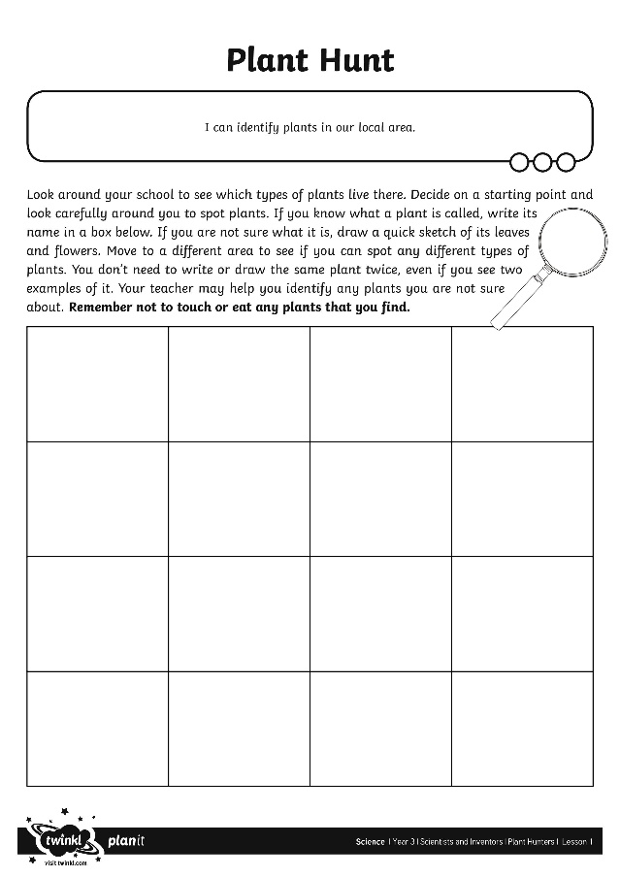
Plant Hunt
Plants are all around us. You will see plants in people's gardens, in parks, on roadsides and by footpaths.
?
What types of plants can you find around your local area/garden?
Take part in a plant hunt to find out!
Draw into your ‘Everything’book all the different plants you spot on your hunt. Try and identify them as well.

Slide 4
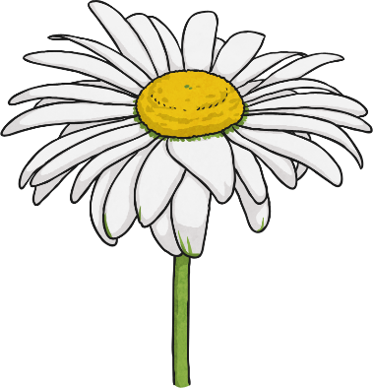
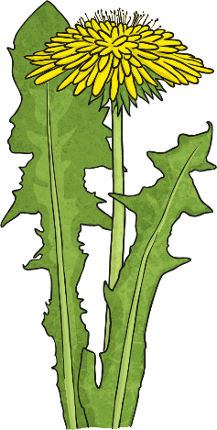
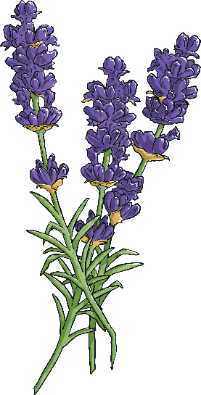
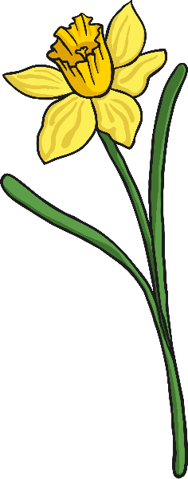
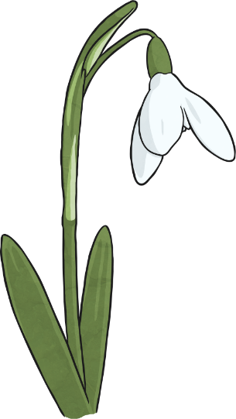
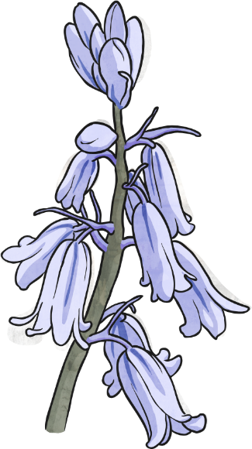
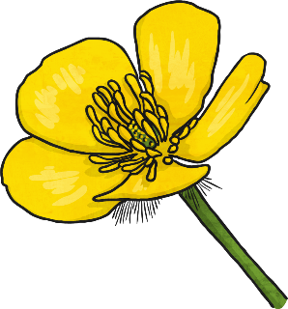
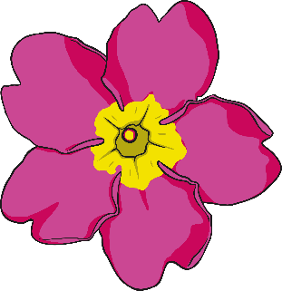
Plant Hunt
?
Did you spot different types of plant?
Depending on the time of year, you may have seen some of these plants:

Slide 5
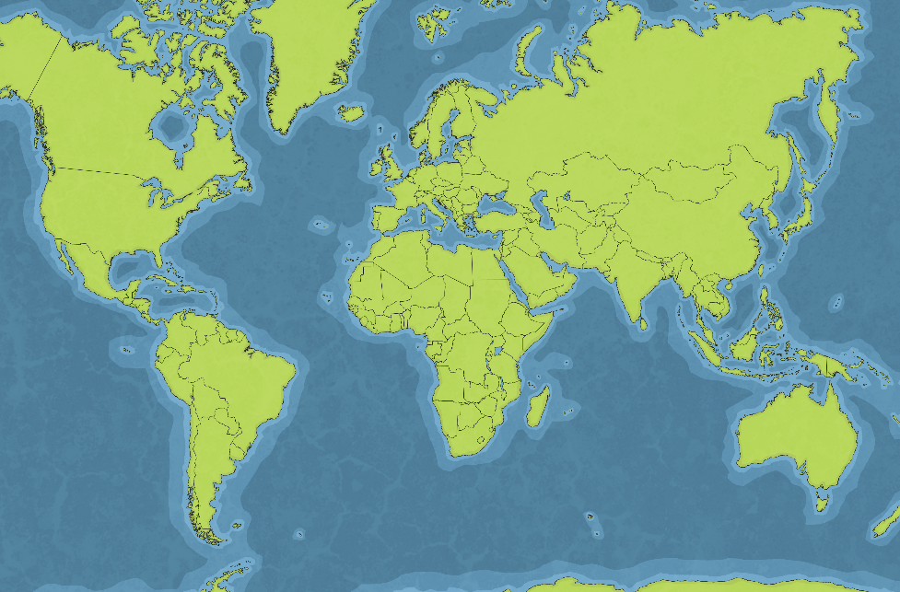
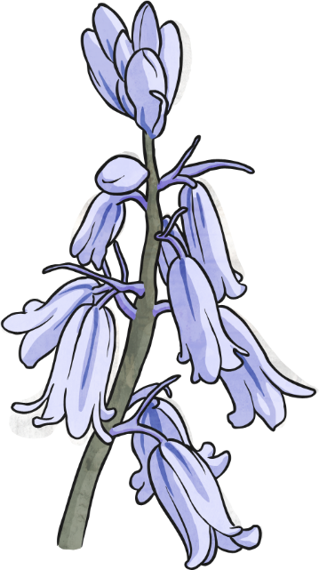
Native and Non-Native
?
Where have all these different plants come from?
Some plants are native to Britain. This means that they have grown here for many years and have not been brought here from any other countries.
Other plants are non-native. This means they have been brought here from different countries.

Slide 6
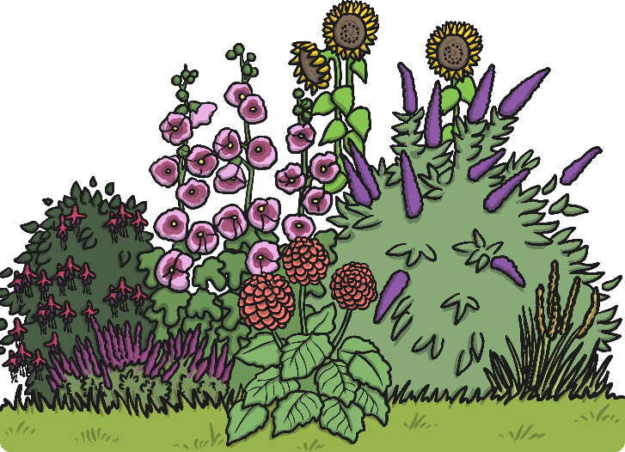
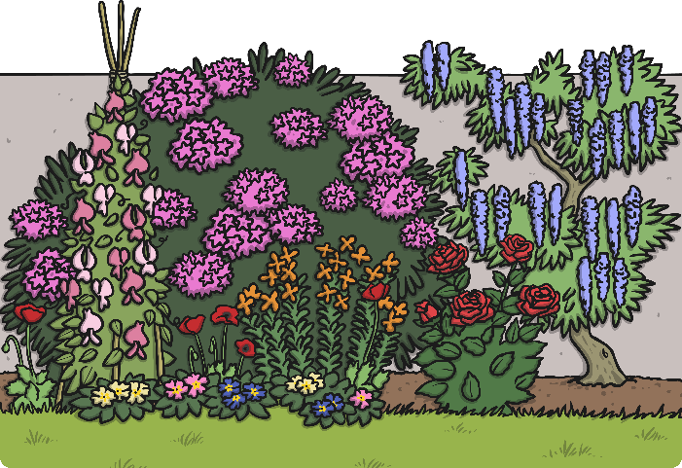
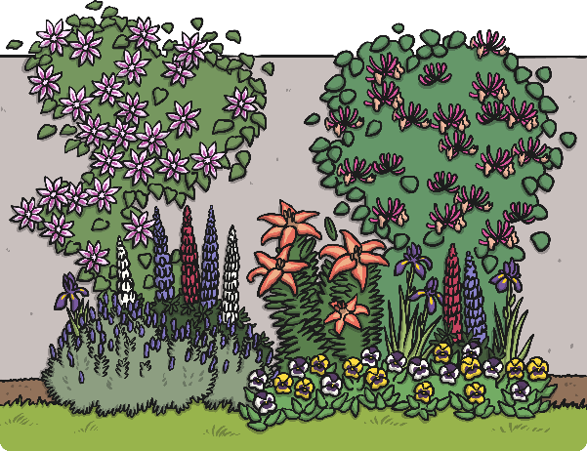
Native and Non-Native
Look at this garden and see where the different species of plants have originally come from.
Rhododendron
Asia and America
Wisteria
China, Korea, Japan, and North America
Honeysuckle native to the United Kingdom
Hollyhocks Asia
Sweet Peas Italy and Greece
Primrose native to the United Kingdom
Lavender Southern Europe and Africa
Lily
Asia and North America
Lupin North America
Buddleja America and Asia

Slide 7
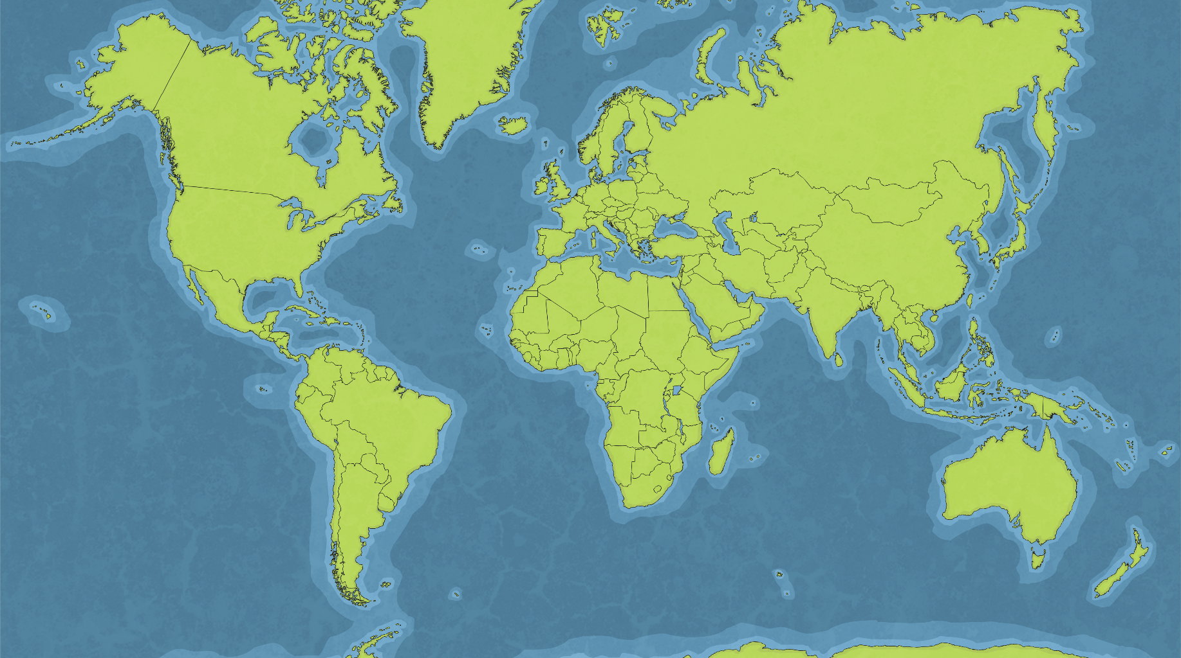
Native and Non-Native
?
Can you spot the countries that the different plants came from?
Honeysuckle native to the United Kingdom
Rhododendron
Asia and America
Wisteria
China, Korea, Japan, and North America
Lily
Asia and North America
Primrose native to the United Kingdom
Buddleja America and Asia
Lavender Southern Europe and Africa
Lupin North America
Hollyhocks Asia
Sweet Peas Italy and Greece

Slide 8
The Plant Hunters
?
How did the different species of plants get to the UK from these other countries?
Throughout history, men and women have travelled the world to find and bring back plants from far and distant places.
They faced many different challenges to find, transport and care for these plants in order to introduce them successfully to the UK.
Let's find out about some of these famous plant hunters!

Slide 9
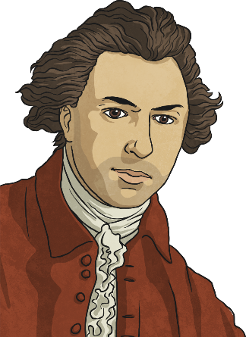
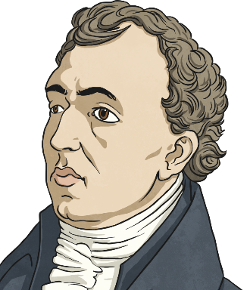
The Plant Hunters
Sir Joseph Banks 1743-1820
Joseph Banks was an English scientist who studied plants. He became famous when he took part in Captain Cook's first voyage to Brazil, Tahiti, New Zealand and Australia. He was President of the Royal Society for 41 years, and advised King
George III on how to set up the Royal Gardens at Kew. He introduced the eucalyptus, acacia and the banksia, which was named after him. Altogether, around 80 species of plants are named after him in some way.
David Douglas 1799-1834
David Douglas was a Scottish botanist who worked at the Glasgow Botanical Gardens and the Royal Horticultural Society in London. He took part in three trips from England to North America. He introduced the Douglas fir in 1827, as well as several other pines, fir trees, the lupin and the flowering currant. Douglas died on an expedition to Hawaii while climbing a mountain called Mauna Kea.

Slide 10
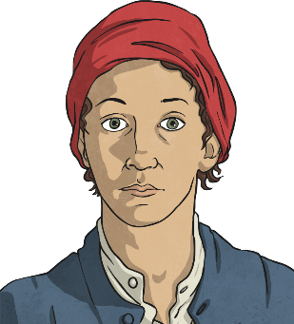
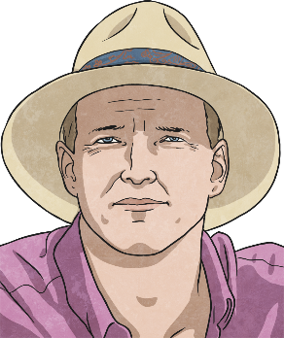
The Plant Hunters
Jeanne Baret 1740 - 1807
Jeanne Baret was a French woman who accompanied her partner, the botanist Philbert Commerson, on an expedition to South America, Tahiti and Mauritius. She was the first woman to sail around the world. Women were not allowed on board ships at
that time so she had to disguise herself as a man to join the expedition. She and Commerson introduced the bougainvillea to Europe, as well as around 70 other plants. Only one, the solanum baretiae, was named after her.
Tom Hart Dyke 1976 - Present
Tom Hart Dyke is an English horticulturalist and plant hunter. He is the designer of the World Garden at Lullingstone Castle. The World Garden contains around 8000 species of plants, many collected by Hart Dyke himself. Tom Hart Dyke was kidnapped on an expedition to collect a rare orchid in South America. He was held captive for nine months with his friend, Paul Winder. When he was released, he returned home and created his World Garden. He still hunts rare plants today.

Slide 11
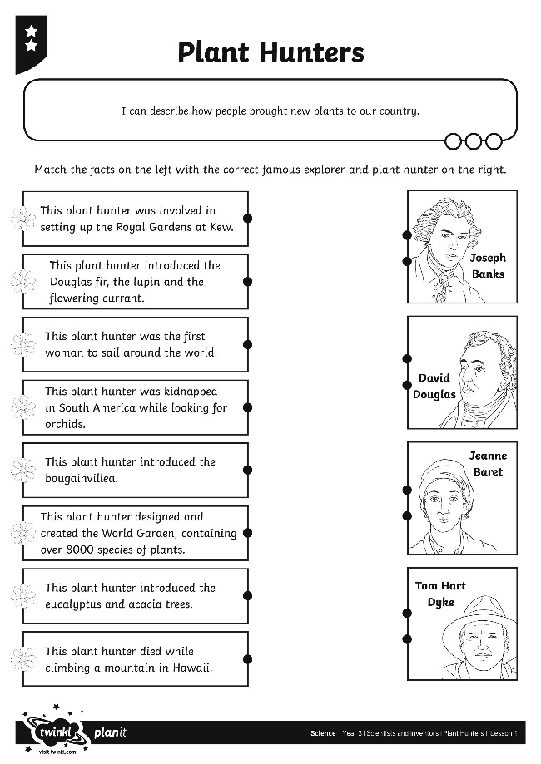
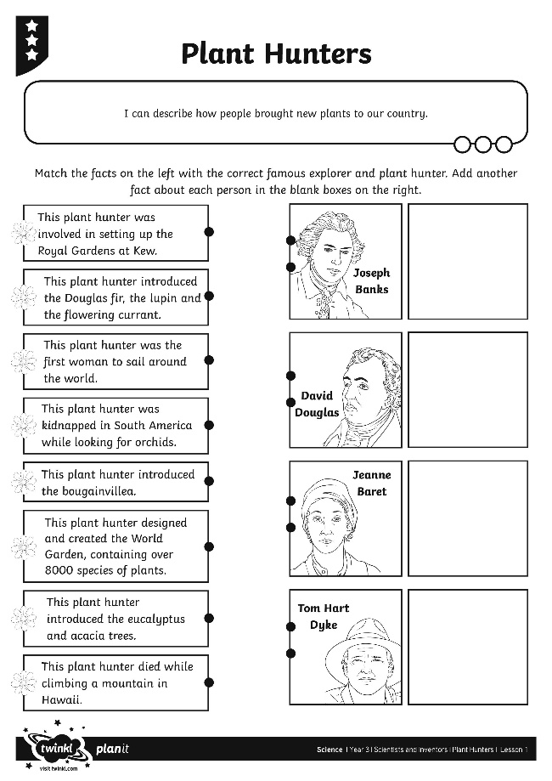
Plant Hunters Activity
Can you match the facts on your Plant Hunters Activity Sheet to the famous explorer?

Slide 12
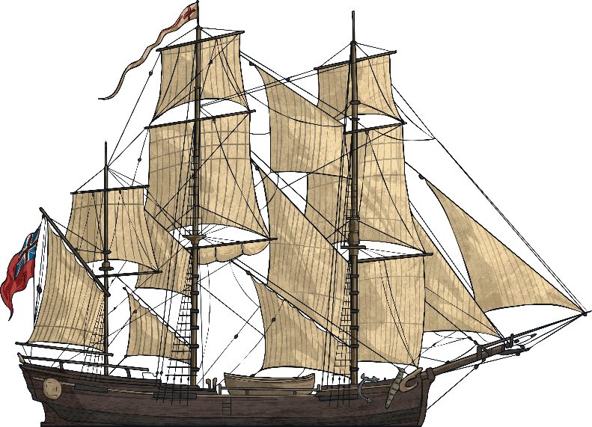
Travelling Home
One of the biggest challenges for the plant hunters was how to look after the plants and seeds they collected on their way home. The early explorers faced long sea voyages of many months and they had to make sure that the plants stayed alive on board their ship.
?
What would they need to provide the plants with to make sure that they grew healthily on board the ship?

Slide 13
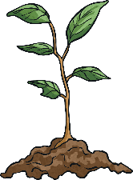
Travelling Home
Plants need several things to grow well and live healthily:
light
water
heat
air
room to grow
?
Would any of these requirements be hard to provide on board a ship?

Slide 14
What Did Joseph Banks Do?
Joseph Banks made sure that the ship he sailed on had special equipment to look after the plants and seeds he found.
He would have needed fresh water for the plants, a light and airy space for the plants to grow and enough heat to keep them healthy.
All these requirements cost a lot of money to provide. Joseph Banks spent £10,000 of his own money equipping the ship for his voyage!

Slide 15
A New Discovery
Imagine that you are a plant hunter!
You have made a new discovery, finding a new plant that nobody has ever seen before.
?
What will you call it?
?
What does it look like?
?
How does it take in water and light?
?
How will you care for it?
Use your New Discovery Activity Sheet to draw a picture of your new plant and explain what it needs to grow healthily.

Slide 16
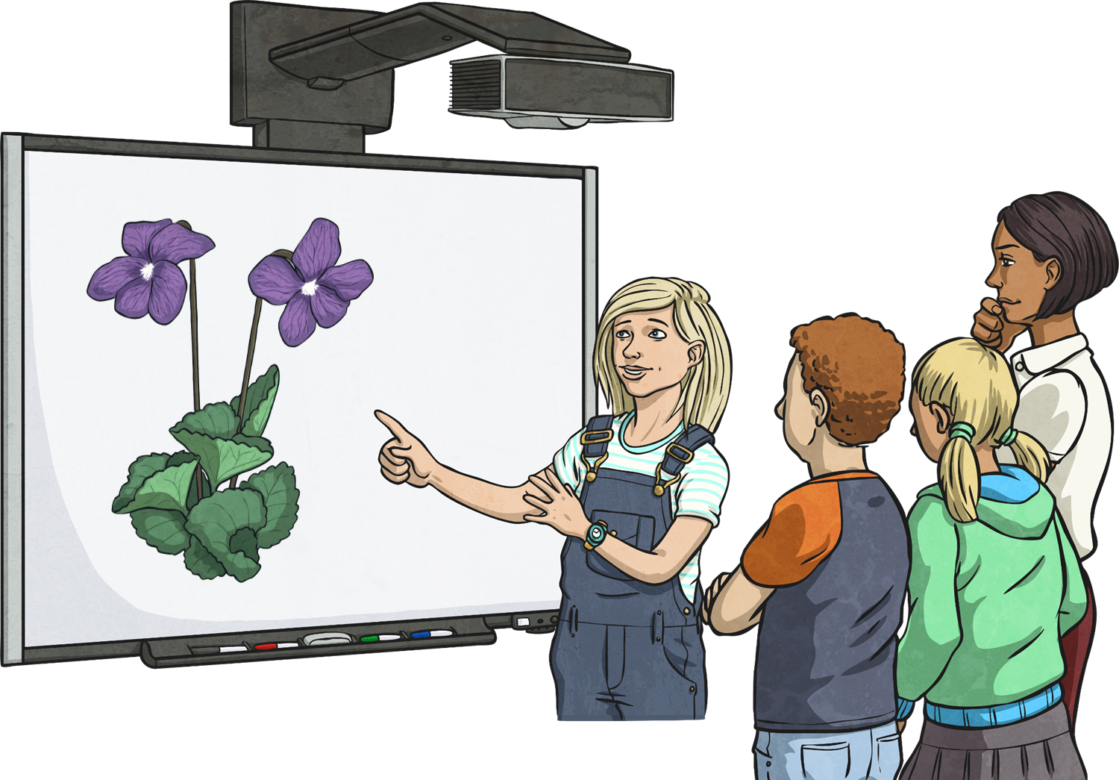
Present Your Discovery
Imagine that you have brought your new plant back to Britain. Lots of people are waiting excitedly to see your new discovery and hear about what it is like.
Present your discovery to your family, describing what your plant looks like and what it needs to grow.

Slide 17
Aim
To find out about the way new plants arrived in our country.
Success Criteria
I can identify plants in our local area.
I can describe how people brought new plants to our country.
I can design my own new plant and explain how it lives and grows.

