Slide 1
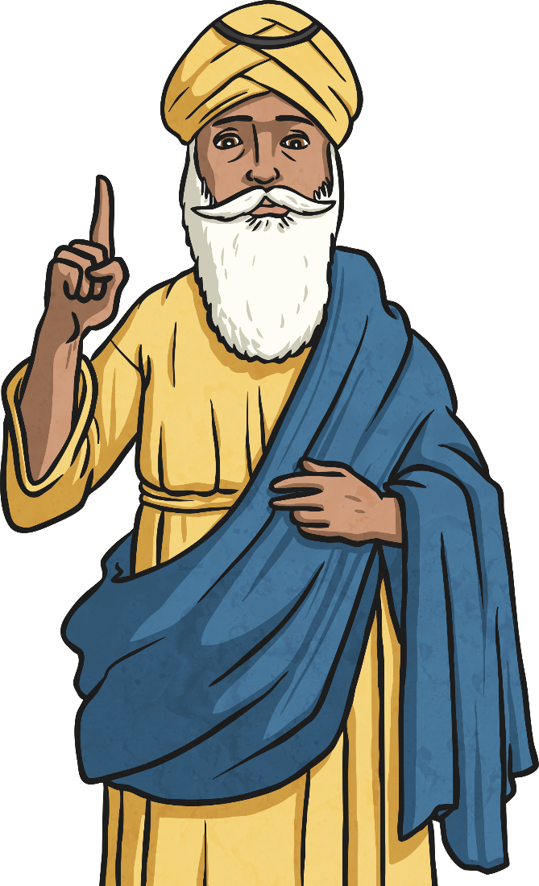
The Life of
Guru Nanak

Slide 2
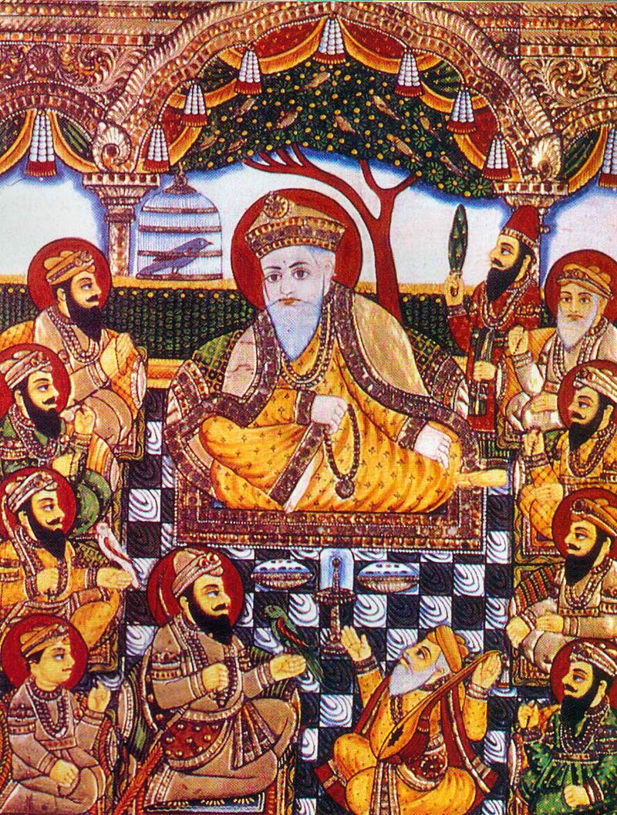
Guru Nanak
Guru Nanak was the first Sikh Guru, he came from a small town called Talwandi in India, about 40 miles from Lahore (now in Pakistan), 500 years ago. Sikh traditions teach that his birth and early years were marked with many events that showed he was special.

Slide 3
Growing Up
As Nanak grew and became a man he thought about God all of the time. He was thought of as a dreamer and was not interested in working. One day his father gave him 20 Rupees and told him to go to the city, buy something and then re-sell it to make a profit. When he arrived in the city he saw some monks who looked pale and ill. They told Nanak they had not eaten for 3 days. Nanak bought food for the monks and took it back to them.
When his Father found out he was very angry, but Nanak told him that feeding the hungry was a better way to spend the money. Nanak’s sister could see how angry her father was and asked if Nanak could live with her and her husband instead. Nanak’s father agreed.

Slide 4
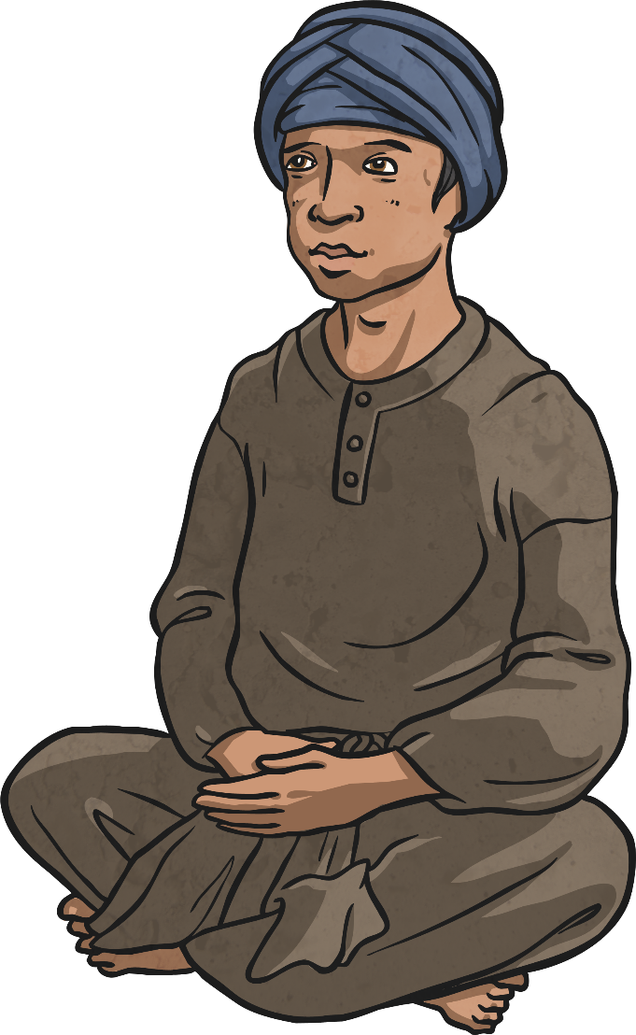
Nanak the Shopkeeper
Nanak’s first job was as a shopkeeper at Sultanpur. He would often explain his ideas about how to love and follow God to people who gathered in the village. Some began to call him a ‘Guru’, which means ‘teacher’.

Slide 5
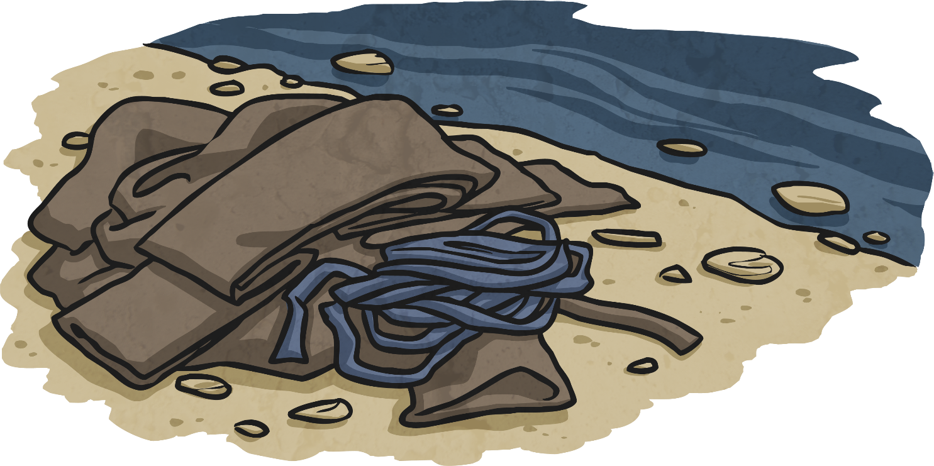
Nanak Disappears
One morning, when Nanak was 30 years old, he got up before dawn and went to the river to bathe and say his prayers; but he disappeared and all that was left were his clothes. The villagers searched everywhere for him, but could not find him and thought he had died.

Slide 6
God’s Message
Three days later, Nanak suddenly appeared and remained silent for a whole day. When he spoke, he said that he had been with God and had been told to tell the people how they could also become closer to God. He said that all people were equal in God’s eyes, “There is only God’s path and I shall follow God’s path.”
There is only God’s path and I shall follow God’s path.”

Slide 7
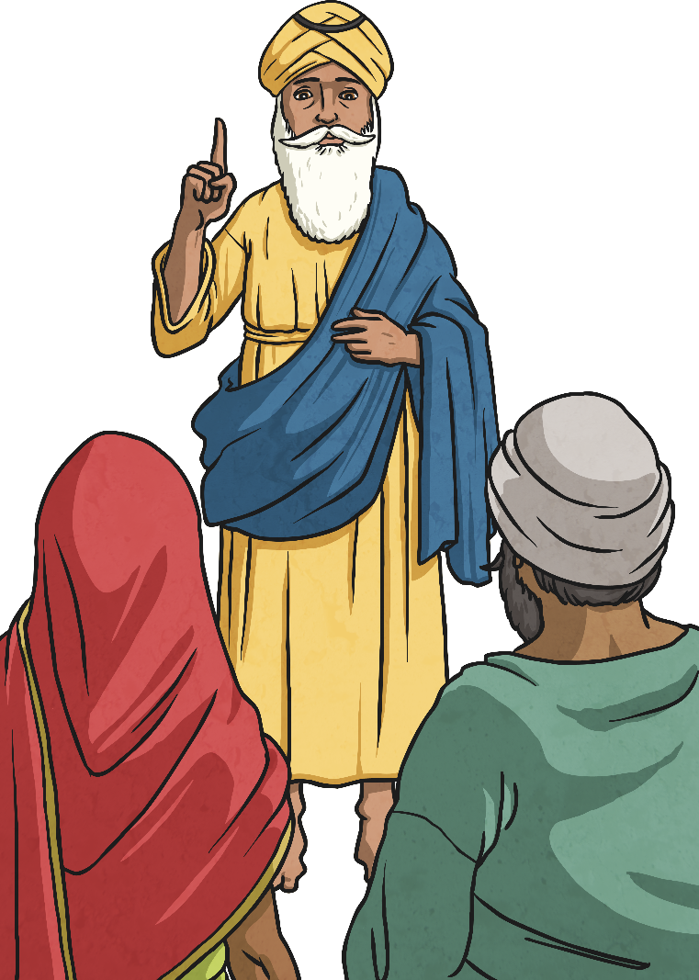
Nanak the Teacher
From that point onwards, Nanak’s life changed and he travelled around different parts of India, teaching God’s message. The people who listened to him were known as ‘Sikhs’, a word which means ‘learner’. Nanak became known as Guru Nanak, God’s teacher.

Slide 8
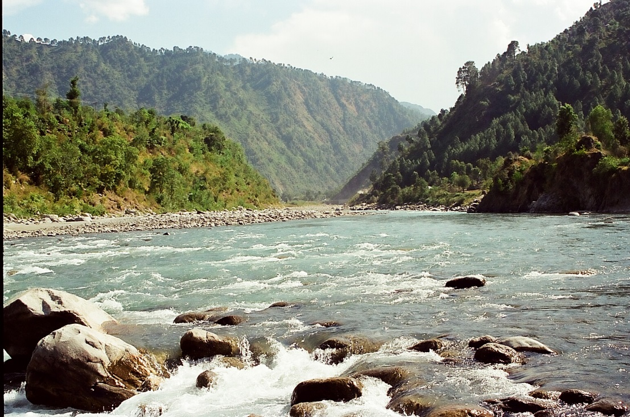
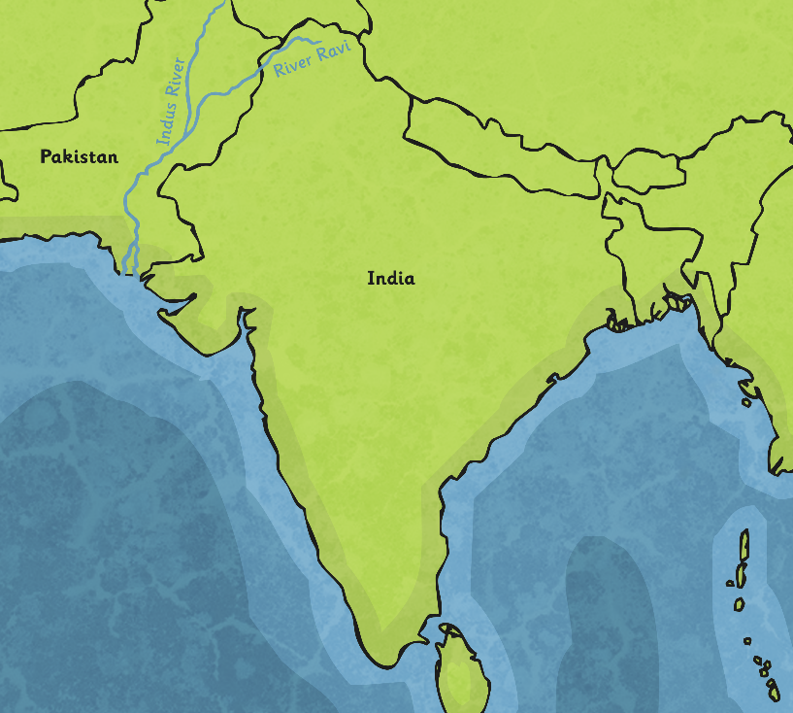
Guru Nanak
Guru Nanak spent twenty years making four long journeys and sharing his messages. He finally settled on the banks of the River Ravi (pictured below), where people would gather and pray together. In the evening, everyone would cook and eat together, no matter if they were rich or poor.
Photo courtesy of Vjdchauhan @ Wikimedia Commons

Slide 9
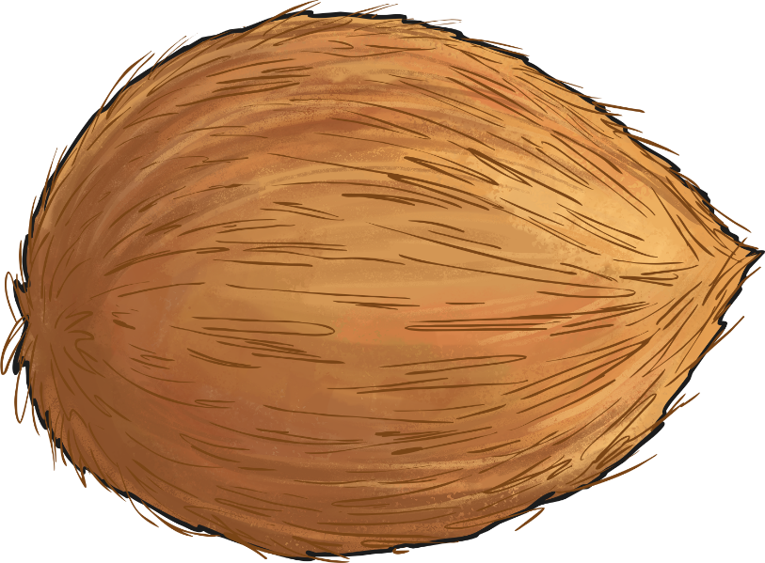
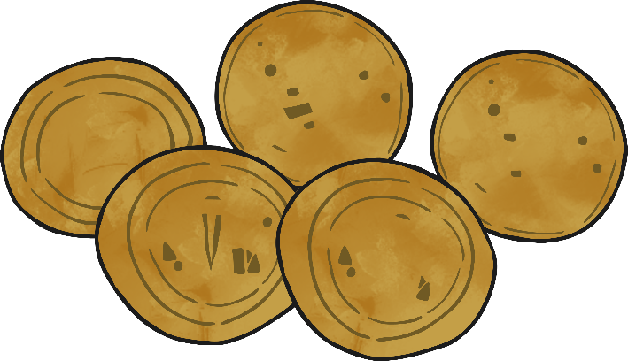
A New Guru
One day, near the end of his life, Guru Nanak called a disciple to him, whose name was Lahna. He placed five coins and a coconut in front of him, these were a symbol of respect. Guru Nanak said “From today, you are the Guru of the Sikhs and I name you Angad (meaning part of my body).” The people were amazed and all the followers were told to follow him now.

Slide 10
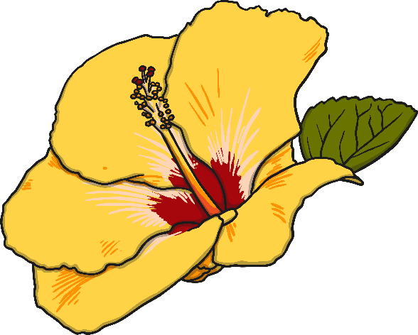
Guru Nanak’s Death
Days later, Guru Nanak died and his body was covered with a sheet. After his death, the Hindu and Muslim people argued about who should arrange the funeral service. The Hindus wanted him cremated, but the Muslims wanted him buried. A wise man appeared and told them to look under the sheet. They did as he said and discovered there was no body, just a few flowers. They realised that Nanak himself ,was telling them not to argue. The flowers and the sheet were split into two halves, so the Hindus cremated their half whilst the Muslims buried theirs.

Slide 11
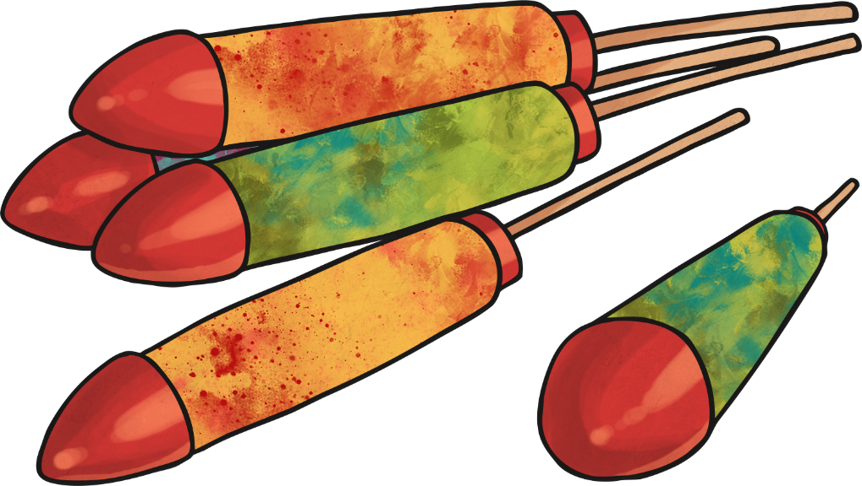
Celebrations
Today, each year, people remember and celebrate the life of Guru Nanak. There are processions through the street and firework displays. In the Sikh temples called Gurdwaras, the Sikh holy book (the ‘Guru Granth Sahib’), is read from beginning to end. Candles are lit in the Gurdwara and in homes, shops and offices. In the Punjab in India, where the Sikh religion began, children are given new clothes and have the day off school to join in the celebrations.

