Slide 2

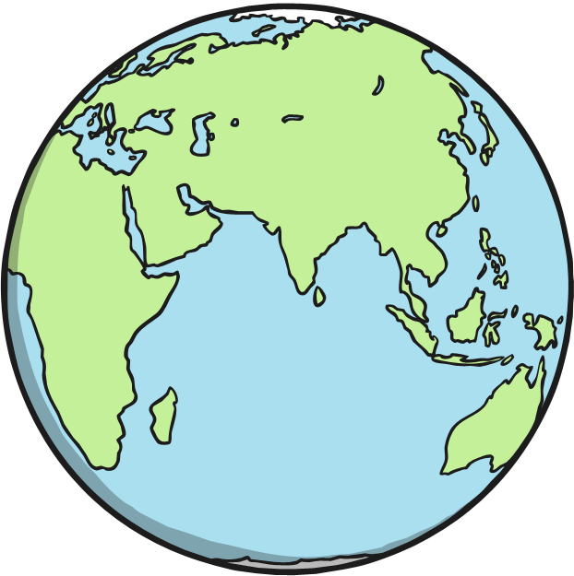
The South Pole
Planet Earth is a sphere, which means it is shaped like a round ball.
It has two ends – the North Pole and the South Pole.

Slide 3
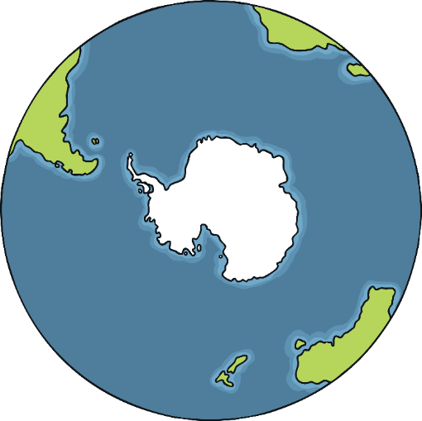
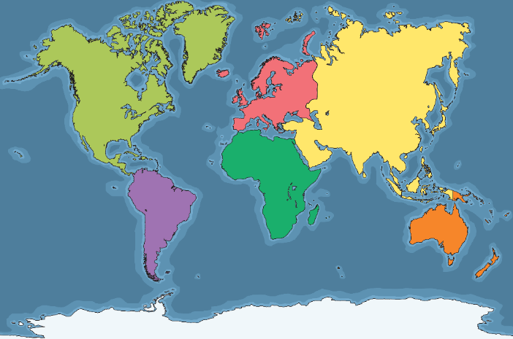
The South Pole
Do you know which continent the South Pole is in?
North America
Europe
Asia
South America
The South Pole is in Antarctica.
Africa
Antarctica
Australasia

Slide 4
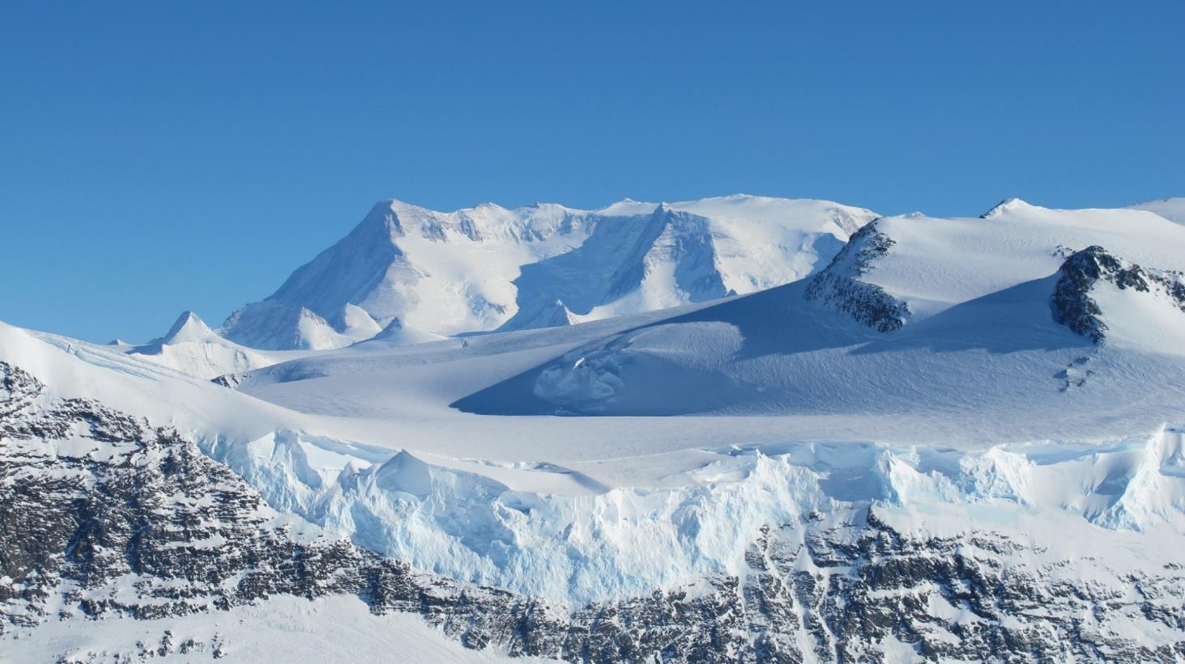
Antarctica
Antarctica is the coldest, driest and windiest continent on Earth.
Although it is covered in ice and snow, it is dry because it hardly ever rains.
It is very difficult for plants and animals to survive here.

Slide 5
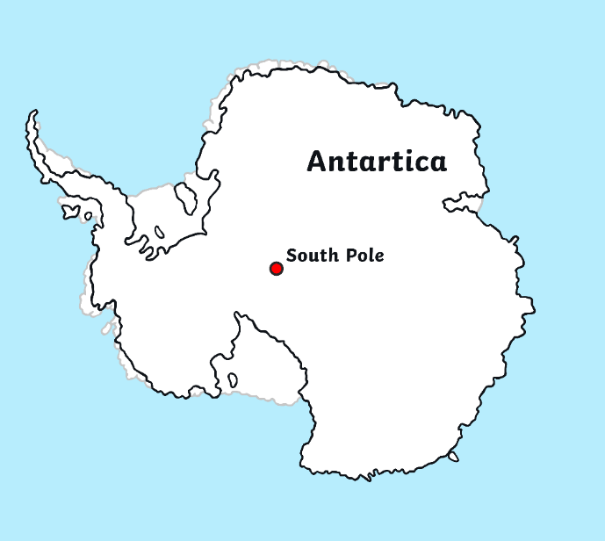
Antarctica
For thousands and thousands of years, no humans had ever been
to Antarctica.
They weren’t even sure it existed!
In the 18th and 19th centuries, many brave explorers tried to find it.
Eventually, humans found Antarctica!
Once it was discovered, the
next challenge was to reach
the South Pole.

Slide 6
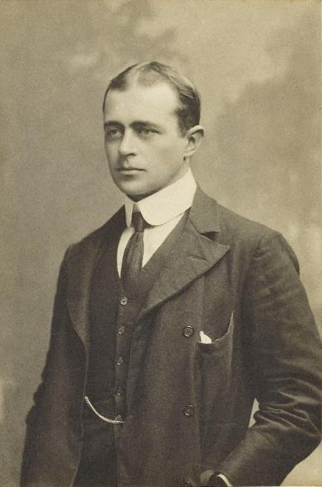
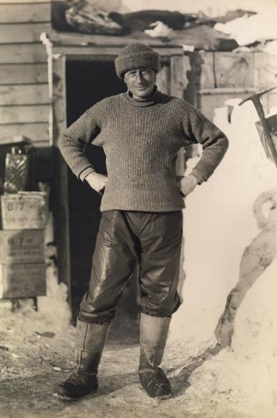
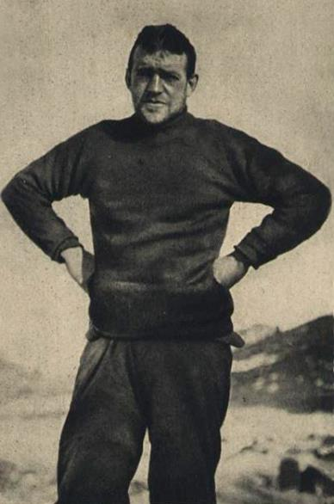
Reaching the South Pole
In 1902, Robert Scott, Edward Wilson and Ernest Shackleton set off to try to find the South Pole on the Discovery Expedition.
Scott
Wilson
Shackleton

Slide 7
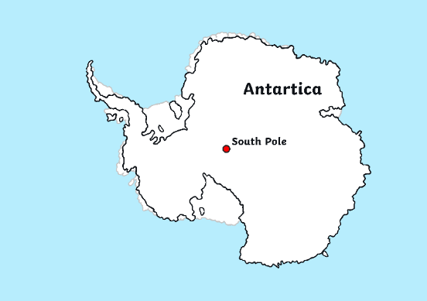
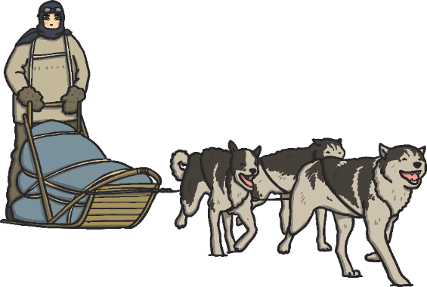
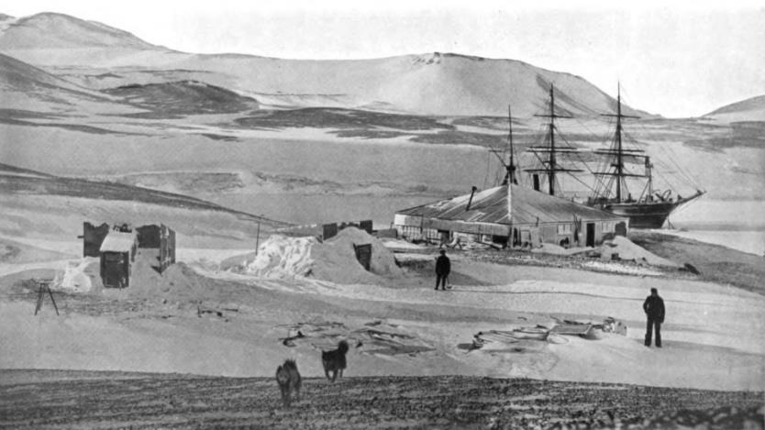
Discovery Expedition
The team travelled on a sledge pulled by dogs.
They reached further south than anyone had before!
Eventually, they were forced to turn back before reaching the South Pole.
By the time they returned to their ship, the explorers were all suffering from scurvy and frostbite.

Slide 8
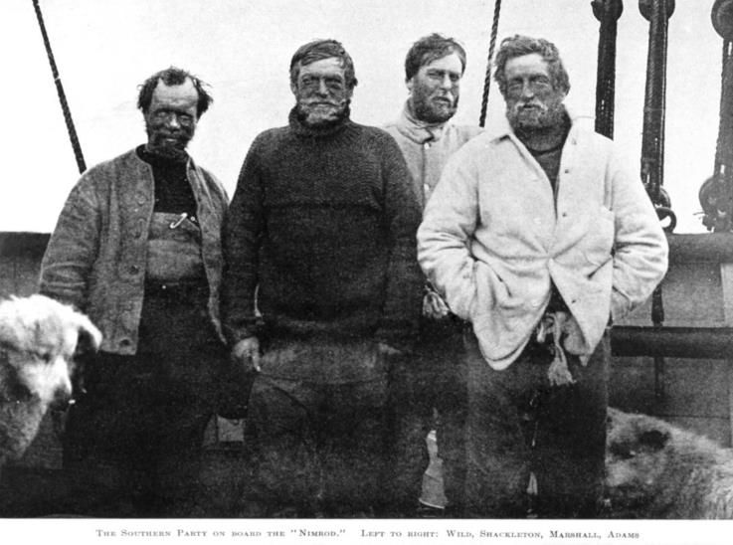

Nimrod Expedition
In 1908, Ernest Shackleton made another attempt to reach the South Pole on the Nimrod Expedition.
Alongside him were Frank Wild,
Eric Marshall and Jameson Adams.
Shackleton
Can you spot their sledge dogs?

Slide 9
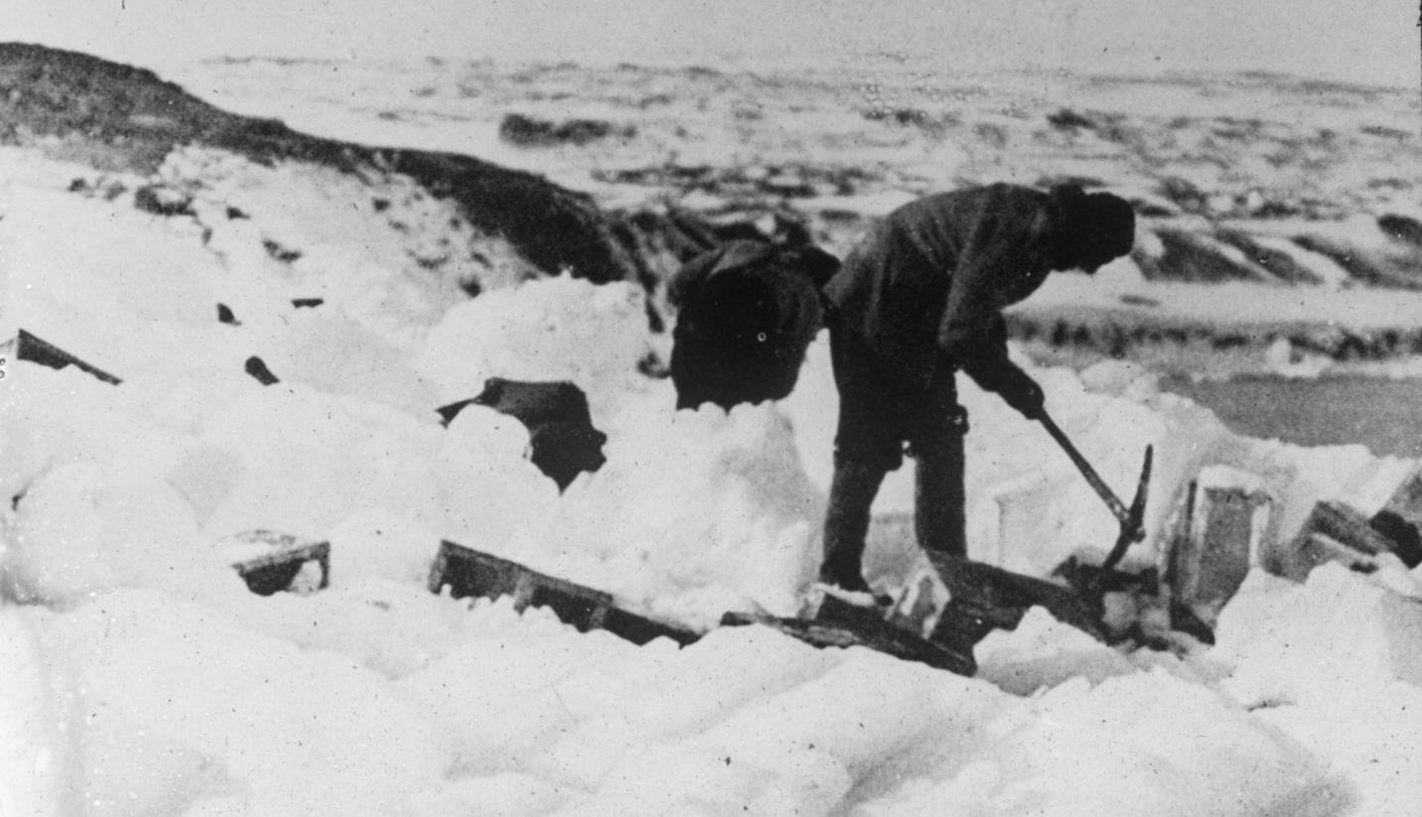
Nimrod Expedition
Travelling across Antarctica was extremely hard work.
They had to make their way across ice and through thick snow, using pickaxes to clear their path.

Slide 10
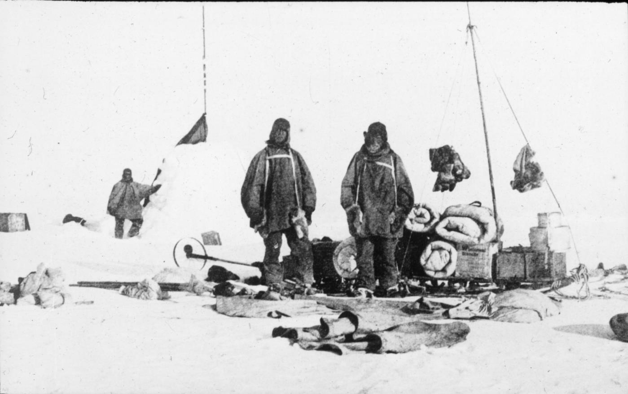
Nimrod Expedition
The team had to battle against temperatures as low as −90°C.
They had to carry all of their food, clothes, maps and other essentials.

Slide 11
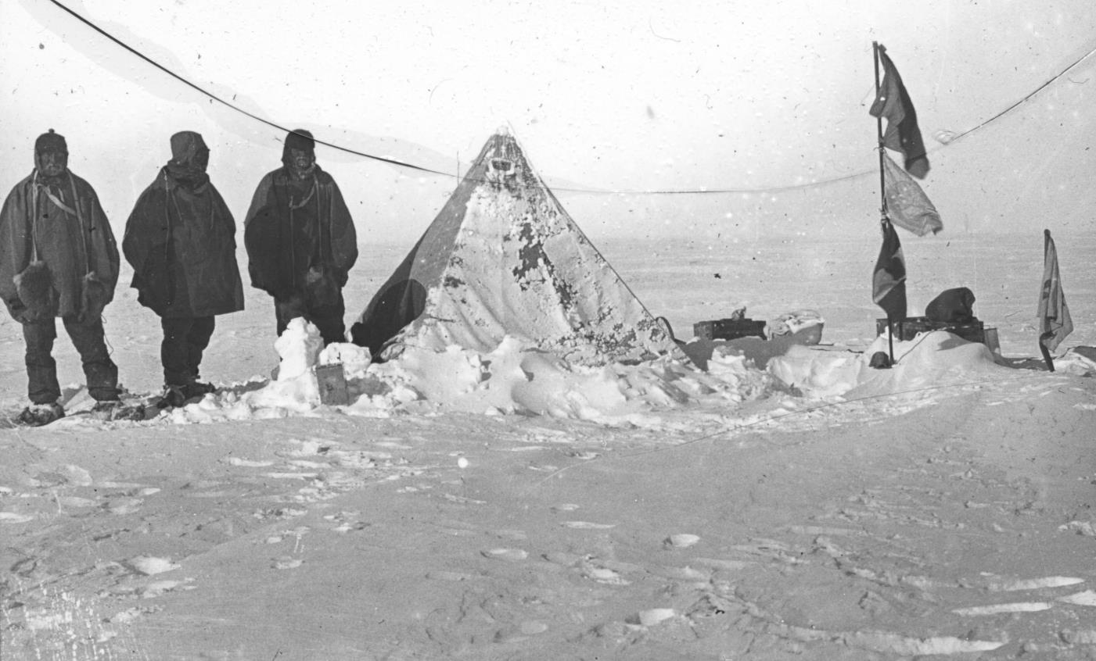
Nimrod Expedition
They had to set up camp on the ice when they needed to rest.
Can you imagine building your home every bedtime?

Slide 12
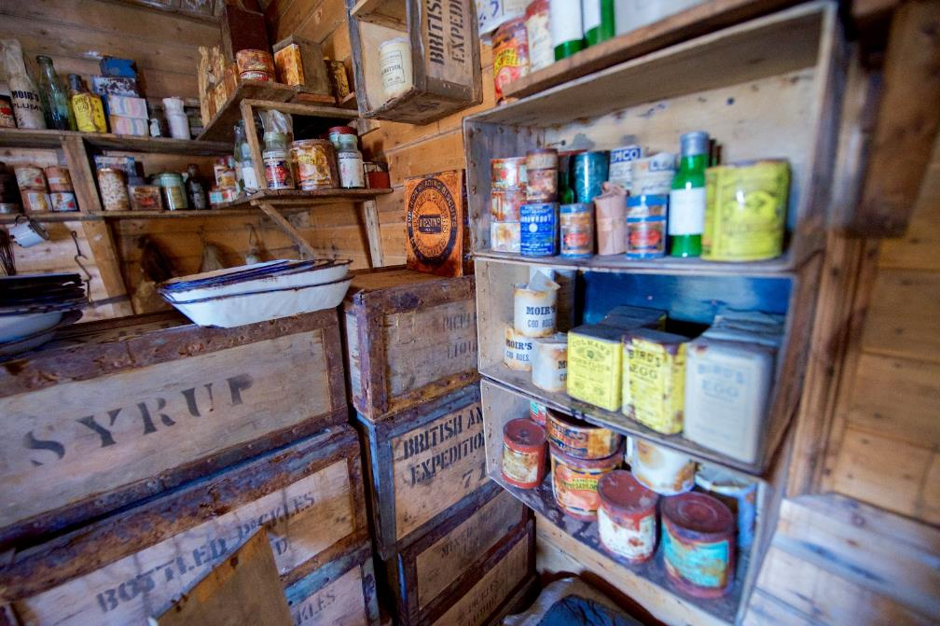
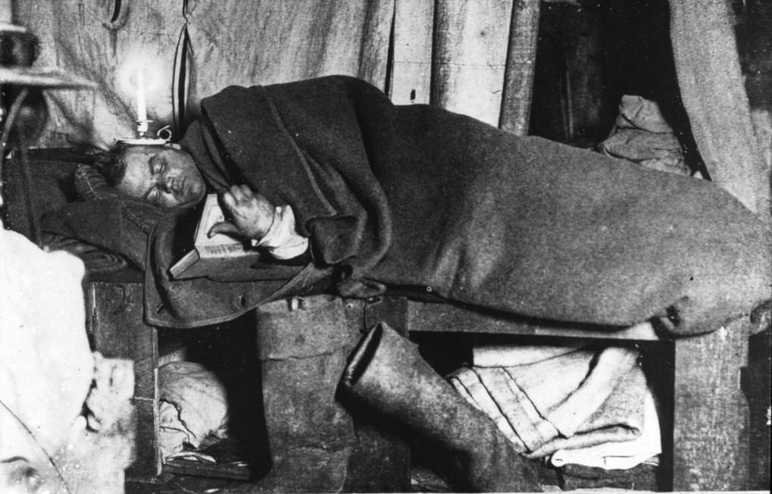
Nimrod Expedition
They had limited food.
There was no heating or electricity.
Can you see what Eric Marshall is using for light inside the tent?

Slide 13
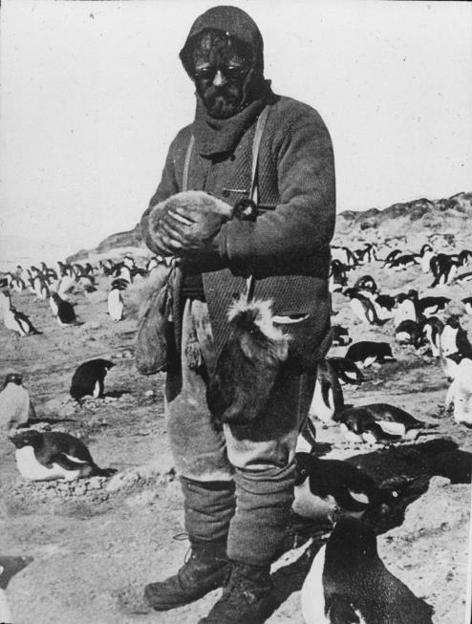
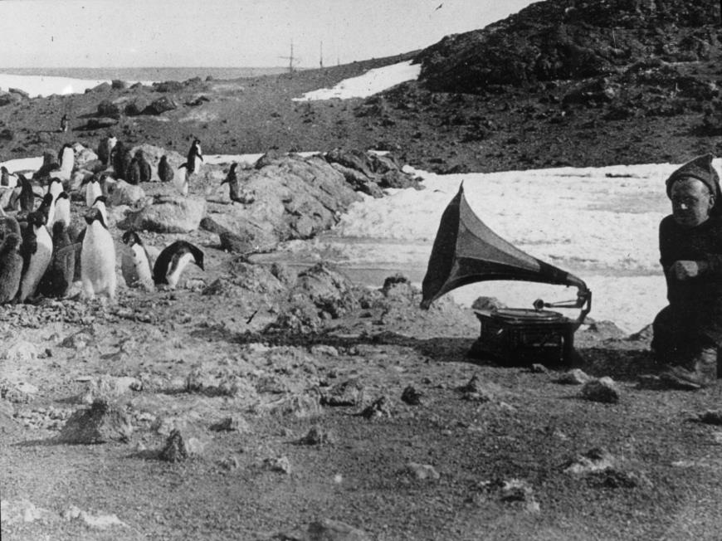
Nimrod Expedition
The team encountered many penguins.
What’s happening in these pictures?

Slide 14
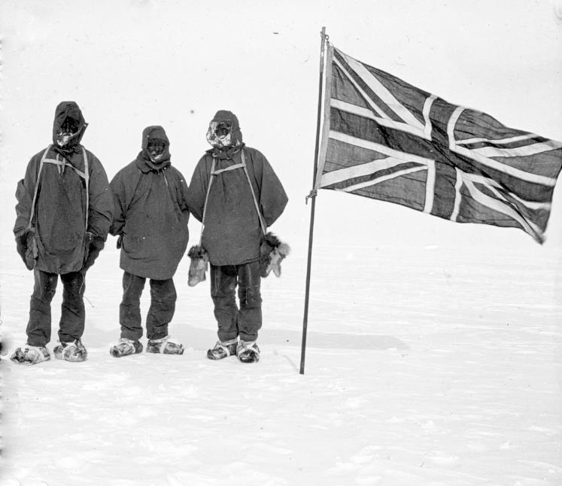
Nimrod Expedition
The Nimrod team managed to get further than Scott’s Discovery team.
However, they became very ill and didn’t have enough food to complete the mission.
They returned home before reaching the South Pole.
How do you think they felt about abandoning the mission?

Slide 15

Terra Nova Expedition
In 1910, Robert Scott set off on another expedition to reach the South Pole.
On the way to Antarctica, the ship encountered several problems.
Another explorer, Amundsen, had sent Scott a telegram. In it, he explained that he was also going to the South Pole!
The ship was struck by a storm. The crew had to use buckets to stop water from flooding in and sinking the ship.
The ship then ran into ice that it couldn’t sail through. They were delayed by
20 days.
Scott

Slide 16
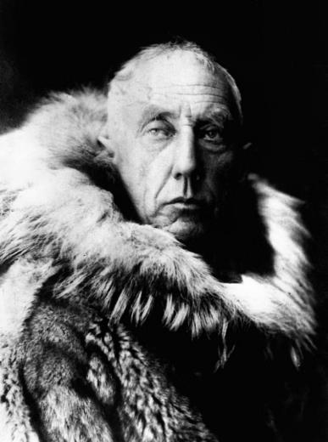
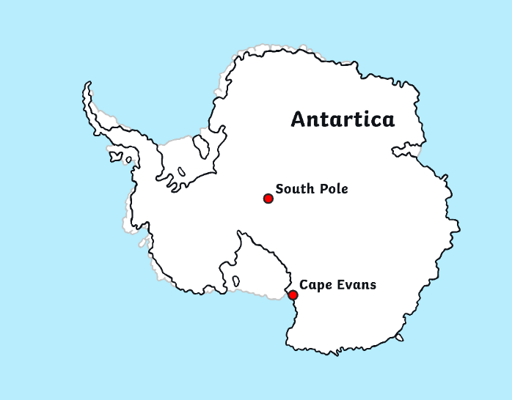
Terra Nova Expedition
In 1911, the Terra Nova team set up a hut on Antarctica in a place that they named Cape Evans.
Amundsen
It was while doing scientific research that the team found out that the rival explorer, Amundsen, was camped on Antarctica too!

Slide 17
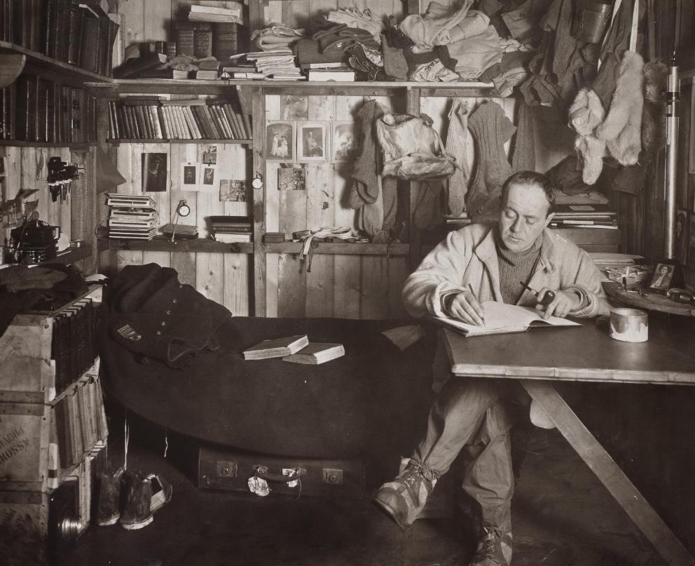
Terra Nova Expedition
There was now a clear race to reach the South Pole.
Scott wrote in his diary that he was going to carry on as usual, ignoring Amundsen and
his team.

Slide 18
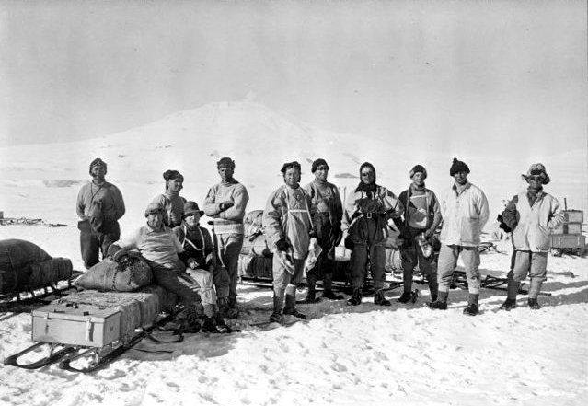
Terra Nova Expedition
In September, Scott set out to reach the South Pole.
He initially set out with a group of 12 men.
Along the way, some of the crew returned to base.
Eventually, it was a final team of five that completed the whole mission:
Scott, Wilson, Oates, Bowers and Evans

Slide 19
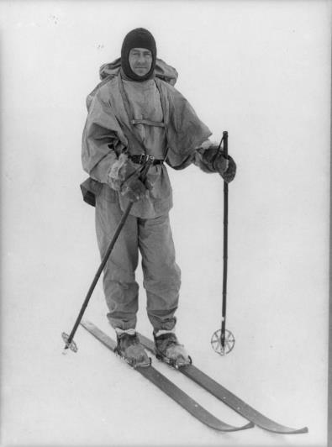
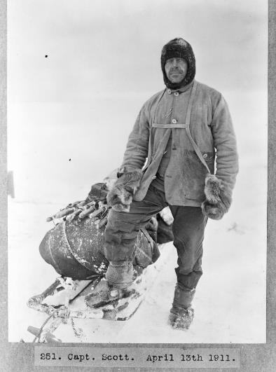
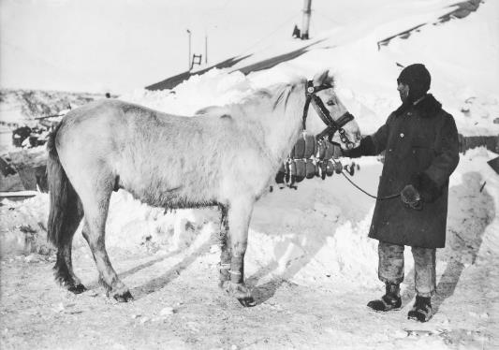
Terra Nova Expedition
The Terra Nova team travelled over the ice and snow on foot, on skis, on motor sledges and on sledges pulled by both dogs and horses.

Slide 20
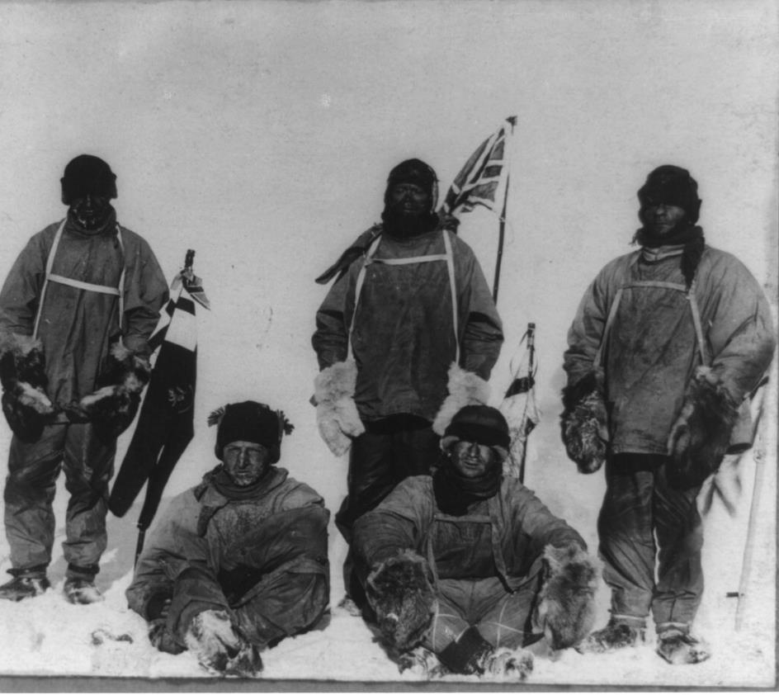
Terra Nova Expedition
In 1912, the team finally achieved
their incredible goal!
The team of five men reached the South Pole and planted their British flag.
There was just one problem…

Slide 21
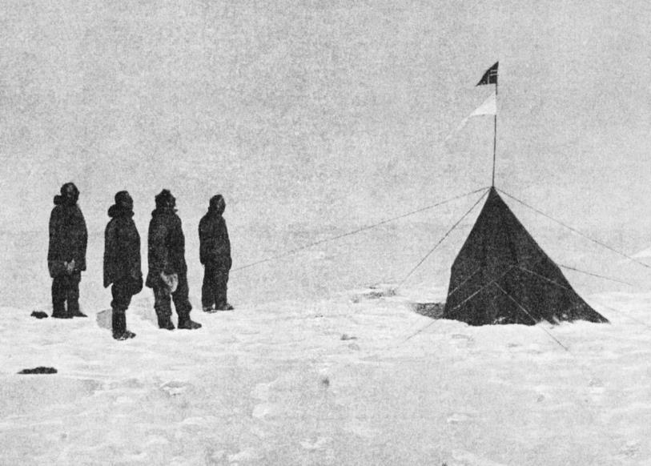

Amundsen Expedition
The Amundsen Expedition had already reached the South Pole!
Roald Amundsen, Helmer Hanseen, Sverre Hassel and Oscar Wisting were the first people to ever reach the South Pole.
They had arrived on 14th December, 1911, and planted the Norwegian flag.
They had discovered a new route to the South Pole that took them only 57 days.

Slide 22
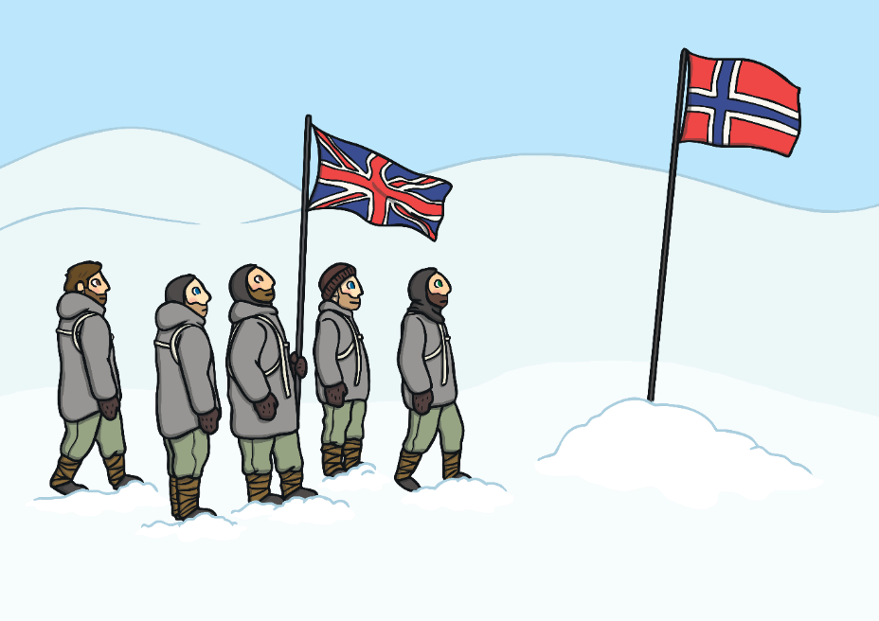
Scott’s Disappointment
It was over a month later, on 17 January, 1912, that Scott and his team reached the South Pole and discovered that the Norwegians had beaten them to it.
They were extremely disappointed.
After planting their flag, Scott’s team headed for home.

Slide 23
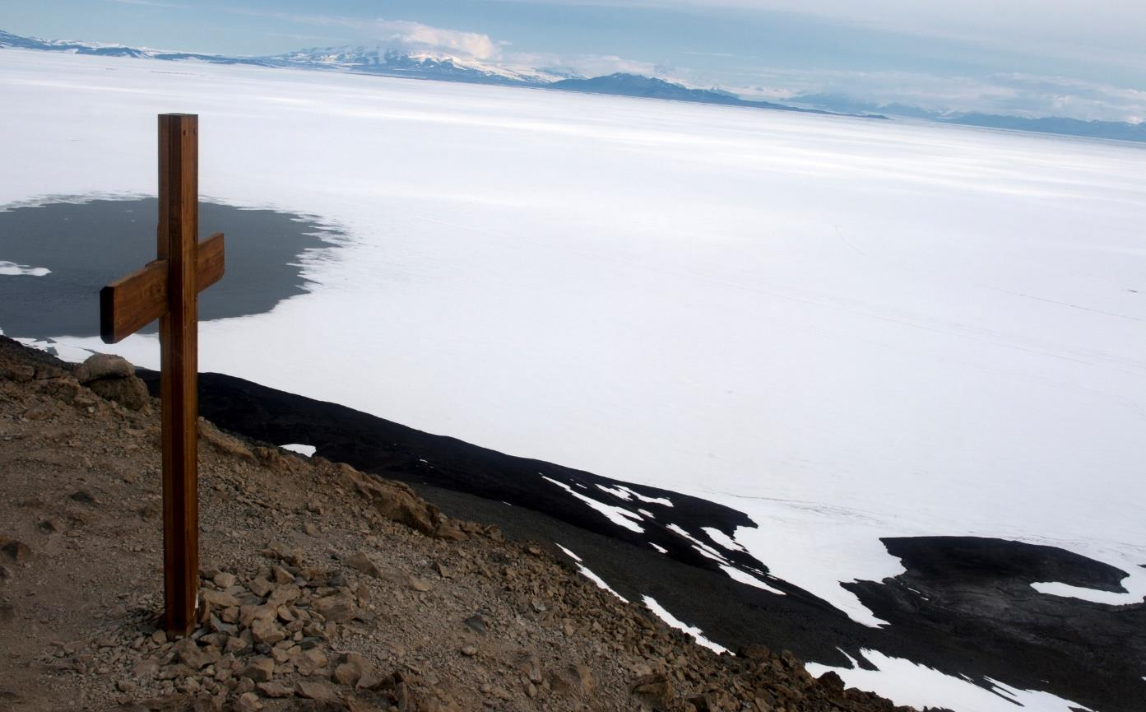
A Dangerous Mission
Scott’s Terra Nova expedition ended in tragedy. No one survived the return journey.
Later that year, a search party set out to find Scott and the Terra Nova team. They put up a cross that now acts as a memorial to these brave explorers.

Slide 24
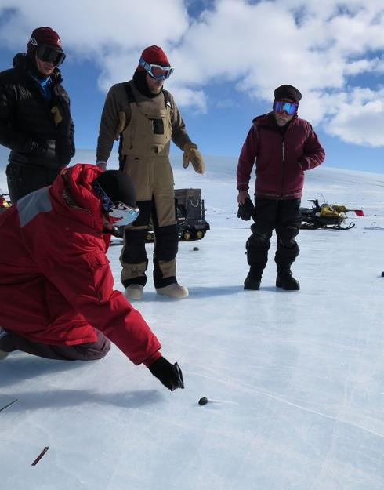
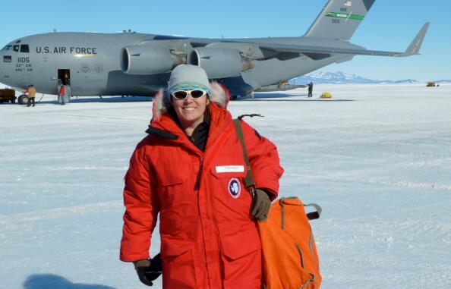
Exploring Today
Scott and Amundsen both reached the South Pole more than 100 years ago.
How do you think expeditions in Antarctica might be different today?
What do we have in the world today that might help modern explorers?

