Slide 1
I can write persuasive text
Superlatives, hyperbole, rhetorical questions… Use a range of punctuation.

Slide 2
Look at the Aviary Wonders Inc Spring Catalogue
The first part explains the need to replace the birds that have been lost and the need to replace them
The second section explains the catalogue and the company – they provide the solution
Your bird will be unique, made by skilled artists and craftspeople; it will be bespoke ( not made on a production line in a factory with many others) – find examples of the way they claim the birds a specially made

Slide 3
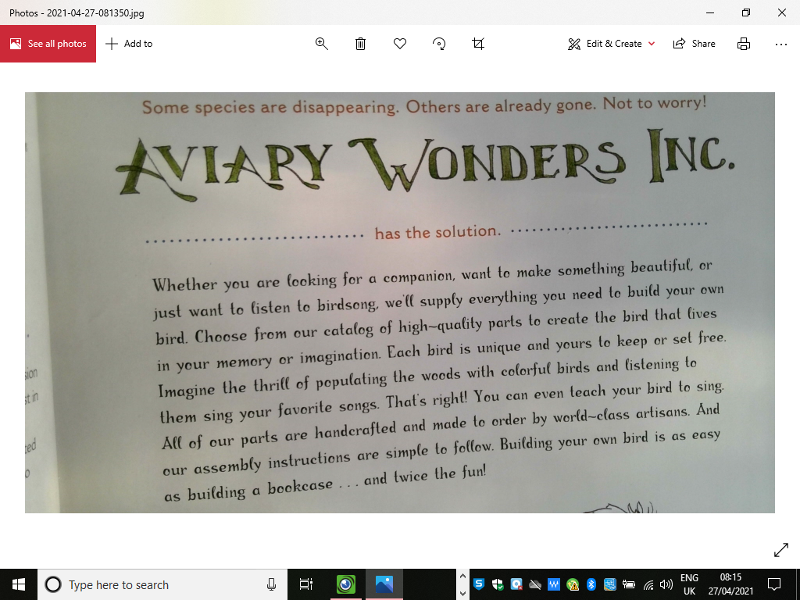

Slide 4
Things to notice: superlatives – only the best (not alright or better but always the best…)
Hyperbole (exaggerated) claims such as world-beating, a million times better than the competition,
Notice how the introduction makes you think that your bird will be unique: made by skilled artists and craftspeople; it will be bespoke (not made on a production line in a factory with many others).
Find examples of the way they claim the birds a specially made.

Slide 5
Write your own introduction to your company’s catalogue.
What is the name of your company? Does it do every bird or do they specialise? ( Raptors are us? Duck or Grouse! (joke!) Fly-by-night (we specialise in nocturnal birds)
You could use rhetorical questions:
Do you dream of hearing bird song when you wake up in the morning? Do you miss the dawn chorus? Well, we can help!
You need to persuade – you can use modal verbs – you might buy from our new range, you should look no further…
You need to say what is special about your company’s birds ( the materials , the design, the artistry, the choice you off
You might be able to offer a discount or a bargain ( buy one robin, get a sparrow free!)
You might specialise in a particular type of rare or beautiful bird.

Slide 6
When you have planned your ideas (a few bullet points is all you need), write a paragraph to introduce your company for the first page of your Spring Catalogue.
Check you must have list to remind yourself of the range of punctuation you should include and think abut the way you can write your sentences to make your writing lively and persuasive.
Remember to use adverbs, adjectives, noun phrases… alliteration if you think it works
Read your work aloud so you can hear what it sounds like.
Remember to use joined and legible hand writing.
Purple pen:
Look for spelling patterns and tricky words. ( check the root of the word); upgrade any vocabulary; add/change punctuation

Slide 7
In pairs: role play a situation where a customer rings or visits your bird company. They want to buy a bird for a gift or as special treat and want to know if you stock the bird they require.
Customer – why do you want to purchase a bird? Which sort do you want? Do you have a budget or can you spend any amount? Do you want accessories (crest, wattle, special plumage)?
Sales person – what sort of birds do you sell? Do you offer help or support to the customer to help them build their bird? Do you deliver? DO you have any bargains or sales on today?
Make a conversation between the customer and the salesperson. The customer has to be persuaded to buy a bird and you can give them a copy of your catalogue so they can select the special features and extra accessories.
When you have tried it out, script your ideas using playscript lay out. (You can work on one copy between you)
Try it out when you have written it and see if it works.

