Slide 1
Awesome Women – Greta Thunberg
wb 1.3.2021

Slide 2
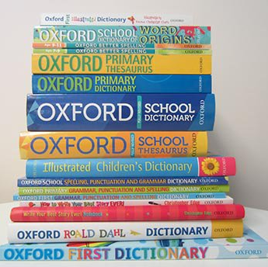
Monday - Vocabulary Corner
… because no-one is too small to make a difference.
The teenage climate activist has inspired many…
Since staging a protest…
… gained even more international attention for her passionate speeches…
… met the former American President…
Greta had her speeches published in her very own book.
… and has been the cover star of some of the world’s biggest magazines.

Slide 3
Tuesday - Watch Newsround’s ‘Who is Greta Thunberg?’
https://www.youtube.com/watch?v=WORnPLZE5CA
True or False – Greta has inspired many people to take a stand against climate change.
Where did Greta protest in 2018?
Find and copy an adjective used to describe the speeches made by Greta.
Which former US President did Greta meet in 2019?
Who has bullied Greta during 2019?
Which ocean did Greta sail across twice in 2019?
Why did Greta hitch a life on sailboats when she visited the UN Headquarters in New York?

Slide 4
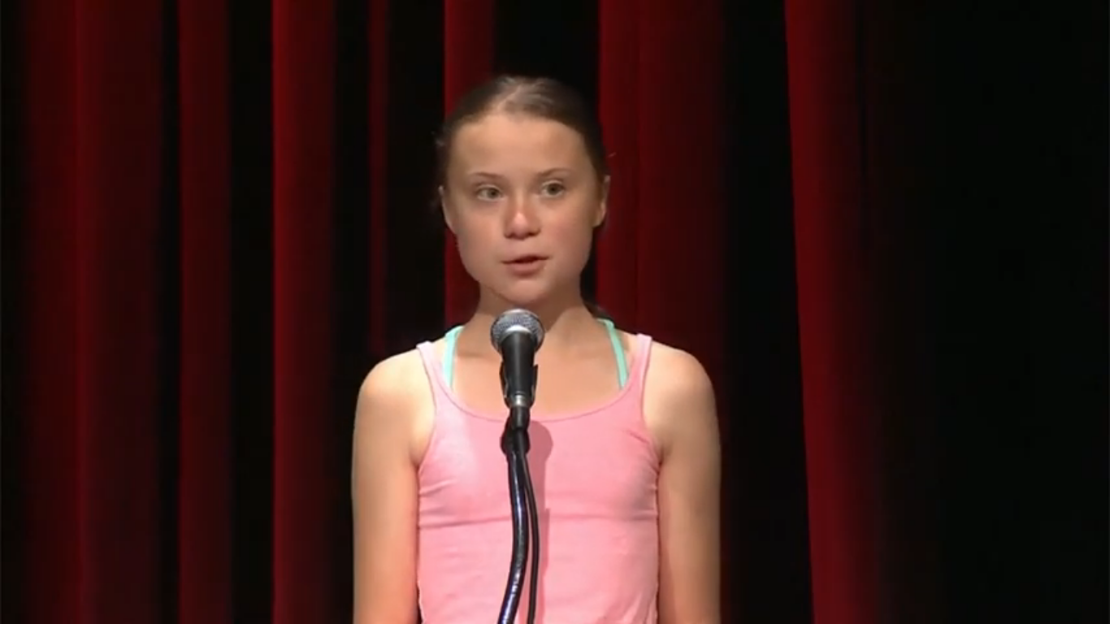
Wednesday - Time To Talk…
Greta says, “no-one is too small to make a difference.” What does she mean by this?
Have you ever felt nervous about raising something you feel strongly about? Be ready to discuss.

Slide 5
Thursday – Time to Talk
Why do you think important and influential people like Presidents, celebrities and the Pope are happy to meet with Greta?
What does this tell you about both her and them?

Slide 6
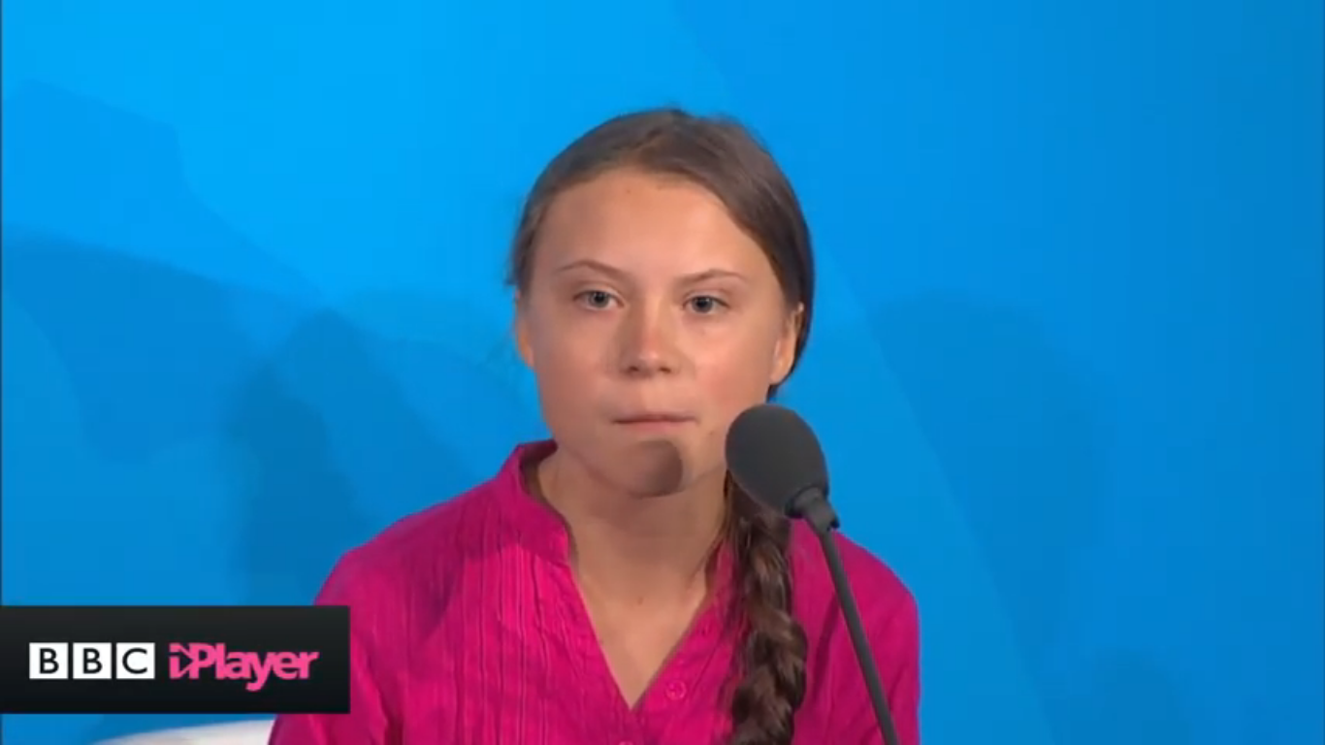
Thursday - Time To Talk
1) Some politicians, like Donald Trump, were unhappy when Greta told them, “Change is coming whether you like it or not.” Why do you think they didn’t like hearing this from Greta?

Slide 7
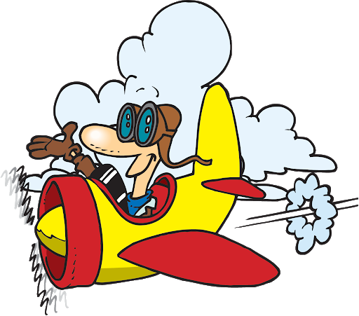
Friday - Flying Solo…
What do you think Greta would consider her proudest achievement of 2019? Explain your choice.
Why do you think some people decided to bully and be unkind to Greta? Can you understand their decision?
Has this clip and the work of Greta Thunberg inspired you in any way? Explain your answer fully.

